Slide 1
Getting better together
By Planning Our Improvement Tasks

Slide 2
Learning together
In this module we will learn how one Leadership Team:
Engages in the school planning process
Creates a plan based on a needs assessment
Prioritizes and selects indicators to work on
Decides how an objective will look when fully implemented
Develops tasks to accomplish the objective

Slide 3
The Leadership team
Principal
Process Manager
Teacher from each grade level
Special Education teacher
School Counselor
Parent
Notes:
Star Middle School is located in an urban area. It draws from the diverse neighborhoods surrounding the school. Its Leadership Team includes the school Principal and Process Manager or notetaker, a teacher representative from each grade level, a special education teacher, the school counselor, and a parent. This is the Principal’s second year at the school, and there are several members of the team who were on the Leadership Team last year.

Slide 4
Leadership Team Responsibilities
Meet twice per month
Work to Improve student achievement
Hold each other accountable
Develop a culture of candor
Notes:
The Leadership Team meets at least twice a month, and over the last year they have worked hard to develop a culture of candor among themselves and throughout the school. They hold each other accountable for attending meetings and for continuously seeking ways to improve their professional practice. The team is determined to put practices in place that will improve the achievement of all students in the school. Last year the team worked throughout the year on their school plan objectives. They brought several objectives to full implementation.

Slide 5
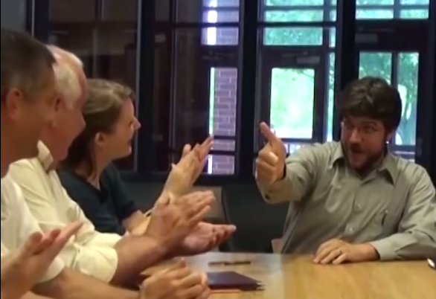
Goal: Add new objectives to plan
Conduct a needs assessment
Review data
Celebrate improvements
Notes:
This year the Leadership Team wants to add some new objectives to their school plan. Over the past month they conducted a needs assessment. They reviewed a variety of data and celebrated the improvements they made over the last year

Slide 6
Leadership team - Assess:
Discusses categories of indicators
Chooses indicators to work on
Reviews research briefs for chosen indicators
Determines current implementation of practice across the school
Notes:
The school uses an indicator approach for school planning. The team went back to their list of indicators from the Restructuring Handbook found on the CIL website.
They discussed several categories of Indicators and read the Wise Ways research briefs for Indicators they were considering, They then considered whether the practices described in Wise Ways were fully implemented across their school.
Let’s take a look at one Leadership Team working thru this process…. (NOTE-when recording pause for about 3-5 seconds before stopping recording on this slide)

Slide 7
Notes:
(Just video, no recording needed)

Slide 8
Limited Implementation
Is this indicator priority?
Do we have the resources
needed to implement?
Notes:
For the indicators they assessed as having limited implementation, the team also discussed whether each indicator was a priority for their school and if the school had the resources that would be necessary to implement the practice during the current school year.

Slide 9
Strategic Planning…
Notes:
Today the Leadership Team is meeting to decide which indicators to add to their school plan. They wanted to be strategic and have a plan for getting better together. So they reflected back on their school-wide data and on their reasons for choosing the particular indicators they assessed. Let’s listen in:
Video set at 25 seconds.

Slide 10
Quick Wins!
Notes:
The Team considered which indicators offered “Quick Wins.” Choosing a Quick-Win indicator would help the school staff see the progress they were making, since with a small amount of additional work they could take the objective to full-implementation.

Slide 11
All teachers individualize instructional plans in response to individual student performance on pre-tests and other methods of assessment to provide support for some students and enhanced learning opportunities for others.
Which indicators may require some foundational work?
Notes:
They also looked to see if there were any indicators that would require some foundational work. The team wanted to focus on differentiating instruction in all classrooms across the school, and considered adding the indicator, “All teachers individualize instructional plans in response to individual student performance on pre-tests and other methods of assessment to provide support for some students and enhanced learning opportunities for others.”
(Note: Sbenedict updated the indicator language from original since Sam had recently re-wrote it)

Slide 12
1. Differentiated Instruction
2. Differentiated Instruction
Notes:
However, there were some classrooms that were still working on managing student behavior. They knew that for teachers to successfully differentiate instruction in their classrooms, they needed to have strong classroom management systems in place. They decided to work on some of the managing student behavior indicators before taking on the one about differentiation.

Slide 13
Notes:
Based on their discussion, the Team chose six new indicators to work on. Since there were still four objectives that had not been fully implemented last year, the new indicators would be added to these as objectives making a total of ten objectives to begin on this year.
The Star Middle School Leadership Team was now ready to begin creating their plan.

Slide 14
For each new objective, the leadership team will:
Determine what the objective will look like when fully implemented
Use research to guide the discussion and plan
Discuss evidence and data to be collected
Notes:
For each new objective, the team began by describing what the objective would look like when it was being fully met. They used the Wise Ways research briefs as a guide and considered what they knew about implementation in their building to write this description. The team also discussed what evidence they would need to collect along the way so that they would know that it was implemented with fidelity across the school.

Slide 15
Activity 1: what will it look like
As a team, describe what the objective will look like when fully and effectively implemented in the school.
Read the sample level of development on the worksheet
Read the Wise Ways® research brief associated to the indicator
Make a list of bulleted ideas that would be included in the description
List types of evidence or data that might be needed to show full implementation or monitor progress
Click to restart after activity.
Notes:
Activity:
You will work in small groups and function as the Leadership Team to write a description of what the objective will look like when fully and effectively implemented across the school. You can download and use the worksheet and the Wise Ways research brief on the website.
At the top of the worksheet you will see the indicator and the team’s description of its present level of implementation at the school. Read it and the Wise Ways research brief. Then take a few minutes to
Make a list of bulleted ideas that would be included in your description. There is no need to craft a written description today.
List ideas for evidence you might collect to show the objective has been fully implemented.
Select someone from your group to report out some of your ideas.

Slide 16
Assigns a team member to be responsible for the Objective
Describes how the Objective will look in the school when it is fully implemented
Describes what they will need to gather to provide evidence when it is fully implemented
Create a series of tasks to reach the Objective
Set a Target Date for completion
Notes:
Now that the Leadership Team has written the descriptions of what the new objectives will look like when fully implemented and the evidence they will gather, they will assign each objective to one of the Leadership Team members. This person will oversee all the work for the objective and report progress at each bi-weekly Leadership Team meeting.
The team’s next decision was to assign a target date for completion of each objective. The date needed to be reasonable given that they wanted “all” teachers to be fully implementing the objective when they checked it off.
The team was now ready to create a series of tasks that would lead them to full implementation of the objective.

Slide 17
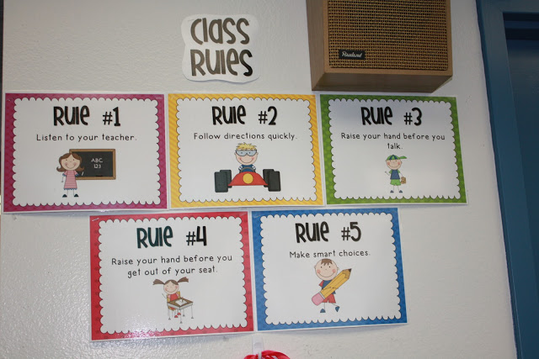
Working backwards from where you want to end up…
…make decisions about how to arrive at that outcome.
Notes:
At their next meetings, they would need to consider a few issues as they created the tasks, including:
Working backwards from where they want to end up. Considering the objective about displaying rules and procedures in the classroom, they knew that ALL teachers must display rules and procedures in their classrooms in order for this objective to be met. They also knew that rules and procedures should align across the entire school so that students do not become confused when they move from one class to another within the school. So beginning with this knowledge, they must make decisions about how they would arrive at the outcome.

Slide 18
Align tasks specifically and narrowly to the objective…
…displaying class rules and procedures.
All teachers individualize instructional plans in response to individual student performance on pre-tests and other methods of assessment to provide support for some students and enhanced learning opportunities for others.
Notes:
A second consideration was:
Aligning their tasks specifically and narrowly to this objective. The team realized that in the end they wanted to increase differentiation across the school. However, they were not ready to go there yet. The step they were taking now was focused on displaying class rules and procedures. They would design tasks that were specific to that particular objective.

Slide 19
Keep tasks discrete…
Task
Task
Task
…celebrate your accomplishments.
Notes:
Another consideration was related to how much to include in each task:
By keeping tasks discrete, they could check them off as each one was accomplished in order to build momentum. Each time the team could check off a task, they would celebrate their accomplishments. Small successes over time build toward big gains in the end.

Slide 20
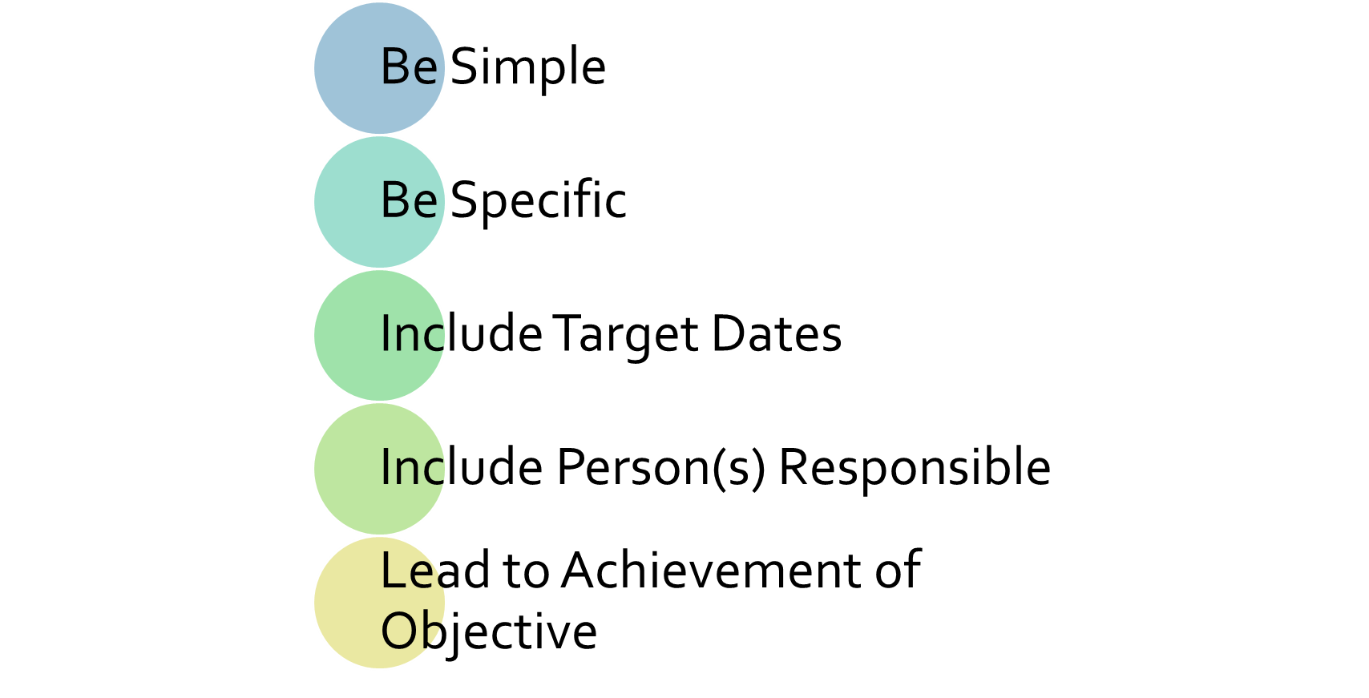
And remember this…Tasks should:
Notes:
When they wrote a task, the team would--
Specify who would do the work for each task, and what specifically they would do
They reminded themselves that:
Tasks should be—
Simple
Specific and practical
Include target dates and person responsible
Tasks should—
Build the understanding and capacity of people to demonstrate full implementation, and
Include steps to gather the data needed to know that the objective is met.
…and of course, the tasks created should always lead to the achievement of the objective!

Slide 21
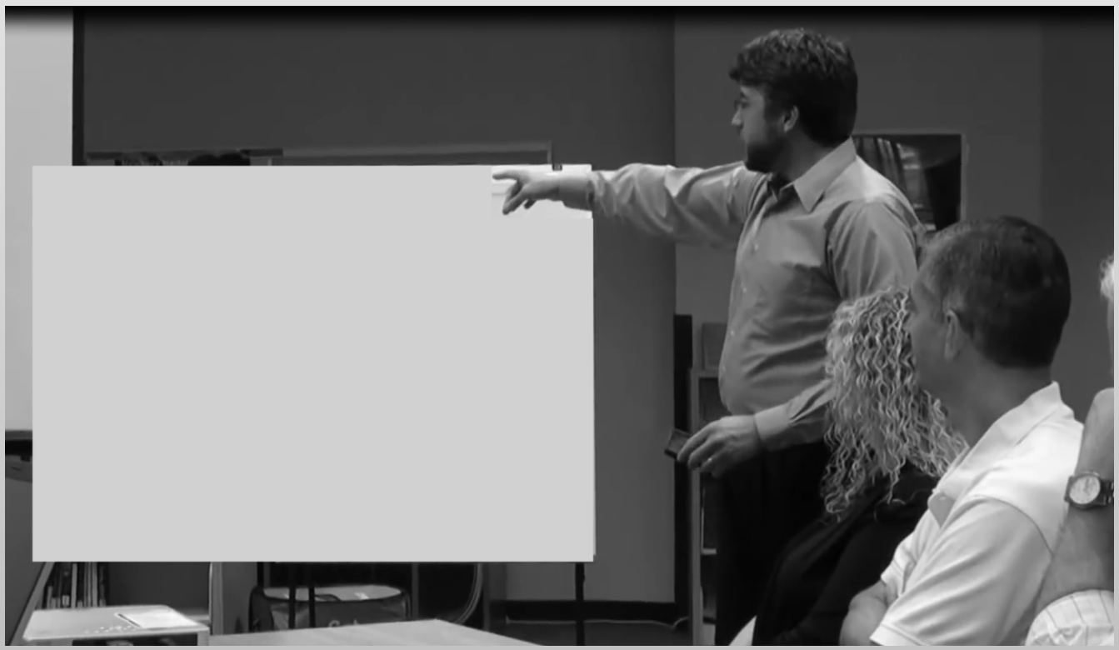
Leadership Teams should:
Have a sense of urgency
Communicate often
Work continuously
Set implementation goals
Notes:
The Star Middle School Leadership Team knew that it was important to get to work as quickly as possible. Improving student achievement requires a sense of urgency.
Once the Team developed tasks for an objective, they communicated them to all members of the school community and began working on them.
The Team knew that school planning is a continuous process. The Leadership Team would add plans for their new Objectives to those they were still working on from last year.
They tried to keep approximately 10 Objectives active at a time. Over the course of the school year they hoped to bring at least 15 Objectives to “Full Implementation.”

Slide 22
Activity 2: Creating Plans
Steps to create plans and tasks:
Adding new objectives to the school plan
Creating tasks for the school plan
Working on objectives and tasks over time
Team up, review together, and explain in your own words
Click to restart after activity.
Notes:
Activity:
In this module we have shared the story of how one effective Leadership Team Creates their School Plan.
Read over the bulleted list of the steps they went through. Then work with one or two others in your group to restate and explain each bullet in your own words.

Slide 23
What we learned together
In this module we learned
How to engage in the school planning process
How to create a plan based on a needs assessment
How to prioritizes and selects indicators to work on
How to decide how an objective will look when fully implemented
How to develop tasks to accomplish the objective
Notes:
Please take a moment and fill out the What We Learned Together form available on the website.
In the next module, Monitoring, the Leadership Team manages the completion of tasks for each objective and assesses the level of implementation along the way. Once the objective has been fully met, the team considers how it will be sustained over time.

