Slide 1

The Process
Getting Better Together
Notes:
So, you’ve established a vision and revisited your passion. We’ve looked at the school from 30,000 feet with Deciding, Learning, and Connecting.
What does this look like in real life? What is the view on ground level?

Slide 2
Learning Together
In this module, we will:
Discuss our process of improvement
Discuss how to make this process more efficient
Discuss a web-based system to keep us on track

Slide 3
Where we began
Do you remember your first day on the job? (as a teacher or as an administrator)
What were your feelings?
Did you feel prepared?
How did that first day go? The first week?
Notes:
We’ve discussed what got you into education in the first place-who inspired you and what you hope your legacy will be. Looking back and looking forward is always a good way to reflect. But now, I’d like for you to think back to your first day on the job.

Slide 4
Table Discussion
Discuss with a partner or with your table your first day experiences.
List some common themes coming from your stories
Report out to the group the common themes.
Click to restart after activity

Slide 5

Valerie’s Story
Notes:
Valerie is a recent graduate from college with her degree in elementary education. She loved student teaching and is excited about stepping into her own classroom for the first time.
She spent last week getting her room prepared and going over her lesson plans. On a warm day in late August, she waits by her door for all her new third grade students to come pouring in.
She’s been imagining this day for months.

Slide 6


Notes:
The students all file in and take their seats. Valerie starts in on her first lesson—mathematics. As she begins her instruction, a few of the boys near the back of the room are talking. Valerie isn’t sure how to handle them. She doesn’t want to get off on the wrong foot with her students. She tells the boys repeatedly to be quiet and pay attention, but it seems to just draw more attention to them and away from her lesson. She scolds the boys, but she is now flustered and has lost her concentration on the lesson she prepared.

Slide 7


Notes:
The rest of the day does not go much better. Valerie quickly realizes that she has rushed through the material she has prepared and there is too much time left in the school day. Some of the class didn’t seem to understand what she was teaching them. Others just seemed bored. The reading activity completely bombed. She had three students at her desk at once to ask for help and the rest of the class took that opportunity to get up and run around the room.

Slide 8



Notes:
She shut her door to make sure no else could see how the class is behaving. She feels underprepared and frustrated with the class’s behavior. At the end of the day, she is relieved to see the last of the students go. She decides tonight, she will just have to prepare twice as much material to cover, but she has no idea how to keep her class in line. And if they didn’t get what she taught today, how will they ever understand what she has to teach tomorrow?

Slide 9
Assessing
Lesson plans
CLASSROOM MANAGeMENT
Assess
Research
Planning
Notes:
Valerie knows that she needs to read up on what she learned about effective practices in classroom management. She needs to learn how to make sure all her students are getting the information at their level of understanding. But, how will she find time to do all that research? And once she’s found the research, she has to compare what she does now to what the effective practices are telling her she should do. She has to assess her own practices against the standard.

Slide 10
Monitor
Implement
Plan
Notes:
But not only that—just knowing what she is doing wrong doesn’t make her better. She has to figure out a way to improve. She has to plan how to get better. And then, she has to check if what she decided to try is making a difference. It will take close monitoring to see if what she tries is really effective with her class. All of that—and she still has to be ready for class tomorrow!

Slide 11
Discuss
Discuss with a partner about this process
How often do you assess your own professional practice compared to what research says is effective?
Do you make a plan for improvement? Monitor your progress?
Where else does this “cycle” appear (assess, plan, monitor)
Click to restart after activity
Notes:
Either at your table or with a partner, discuss this cycle of assessing, planning, and monitoring your own professional practice. How do you do that on a daily basis?
Where else does this “cycle” appear?
Facilitator note: Make sure the point of the process being the same as what they do with students and student performance is mentioned.

Slide 12
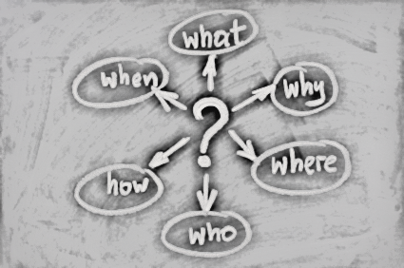
Teams
Notes:
As educators, we are always looking for ways to improve our practice so we can improve the way our students’ learn. We see their faces every day. We know their stories. We are connected to their lives. We are the people closest to them and therefore we have the greatest impact on how and what they learn. But, the process can be daunting. Read research to keep current. Understand the research and figure out how to make it practical. Assess your own professional practice to see if you are doing what the research suggests. Figuring out how to reach the students better—especially those who struggle. All the parts and pieces of your constantly moving day. Assessing, planning, monitoring everything you do within a school day, a month, a year.
But, what if there were a better way?

Slide 13

How Do we change Valerie’s experience?
“We used to close our doors”
Notes:
How would Valerie’s day have been different if, as a new teacher, she had been plugged into
an instructional team made up of the veteran teachers in her building that could have shared
lesson plans, activities, and classroom management tips with her? How often do classroom doors get
closed in the hopes that no one sees what goes on or does not go on?
Parret and Budge (2012) write, “We used to close our doors and rarely did we collaborate. We really didn’t know what the other teachers were doing. Like somebody once said, we were independent operators united only
by a common parking lot” (p.143).

Slide 14

Work as a Team
“Within a school, we need to collaborate to build a team working together to solve the dilemmas in learning, to collectively share and critique the nature and quality of evidence that shows our impact on student learning, and to cooperate in planning and critiquing lessons, learning intentions, and success criteria on a regular basis” (p. 172).
“Within a school, we need to collaborate”
Notes:
Hattie, in his book Visible Learning for Teachers (2012), says, “Within a school, we need to collaborate to build a team working together to solve the dilemmas in learning, to collectively share and critique the nature and quality of evidence that shows our impact on student learning, and to cooperate in planning and critiquing lessons, learning intentions, and success criteria on a regular basis” (p. 172).

Slide 15
Discuss
Take a minute to discuss with the person next to you or at your table all the teams that are in your school.
On which teams do you participate?
Click to restart after activity
Notes:
Share out names of teams - popcorn

Slide 16
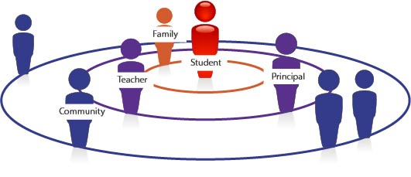
What Does Research Tell Us?
Notes:
Redding (2006) believes that “Some decisions are best made by the teachers responsible for particular groups of
students—grade level teams or subject area teams, which we will call ‘instructional teams.’
Instructional teams are manageable groupings of teachers by grade level or subject area who
meet to develop instructional strategies aligned to the standards-based curriculum and to
monitor the progress of the students in the grade levels or subject area for which the team is
responsible.” (p. 46)

Slide 17

Notes:
Teams of teachers, either grade-level, grade-level clusters, or subject—
which ever fits your school—meet together to plan instruction, review assessments, discuss their
students, and together create ways to improve instruction for all their students. Tasks shared by
many become much more manageable. Let’s see how this looks in action. (embed video here)

Slide 18
What Does Research Tell Us?
Plan
Common Understanding
Team
Challenges and Progress
Evaluate Impact
Notes:
“Planning can be done in many ways, the most powerful
is when teachers work together to develop plans, develop common understandings of what is
worth teaching, collaborate on understanding their beliefs of challenge and progress, and work
together to evaluate the impact of their planning on student outcomes" (Hattie, 2012, p. 41)

Slide 19
What Does Research Tell Us?
Culture
Familiarity
Higher Levels of Student Learning
Instructional Practice
Focus on Instruction
Collective Experience
Notes:
This sentiment is echoed by Supovitz in his 2002 study which stated that “district policy makers
sought to take advantage of teachers’ collective experience and familiarity with their students and
focus teachers on the task of instructional improvement. Team-based schooling, they reasoned,
would improve the culture of schooling, enhance the instructional practice of groups of teachers,
and bring about higher levels of student learning” (p. 1591).

Slide 20
Teams: Instructional Teams Create
Shared Expectations
High Standards
Learning Experiences
Collaborative Culture
Notes:
Lummis (2001) gives some benefits of working in teams. The benefits include
Teachers working together are better able to create shared expectations and high standards for all students.
Teachers working together engage in discourse that leads to creating learning experiences that are richer and of higher quality than those created by teachers working in isolation.
Teachers working in teams are more effective in creating the collaborative culture that allows a school to continuously reflect on and improve its practices. (p. 6)

Slide 21
Discuss
Discuss with a partner or at your table one challenge that you have had recently that you think another educator in your building may be able to think through and strategize with you.
Share out one from each table.
Notes:
Think back to Valerie and her dilemma. Can you relate to that feeling of being overwhelmed with what you had to do immediately and thinking that there must be better ways to do it?
Discuss at your table one challenge you have that you think others in you school may be able to think through and strategize with you on.

Slide 22
Superman Syndrome
“No leader, no matter how effective, can change an organization and maintain it in that changed state on her or his own.”
Notes:
So, that’s great for the teachers in the building. They have a support system that can work together to create better lesson plans, activities, and learning environments for the students for which they are responsible.
But, what about the principal? What support is there for the leader? Is the principal expected to shoulder the responsibility of keeping the school on track, managing the staff in the building, creating the schedules for meeting times and adequate classroom time, working with the staff on their instructional practices, AND maintaining communication with the families and community alone?
In the current climate of school turnaround/transformation, it is tempting to think of the “turnaround principal” or “turnaround leader” that can come into a school and transform it from the ground up. While these individuals do exist, the number of them is few and typically, they remain at a school only as long as it takes to begin to see student achievement begin to rise. Then, the principal is moved to another school in dire need. So, what happens to the school that is left behind? Ben Levin writes in his book, How to Change 5000 Schools, “No leader, no matter how effective, can change an organization and maintain it in that changed state on her or his own. Organizations are about shared leadership and teamwork” (p. 181).

Slide 23
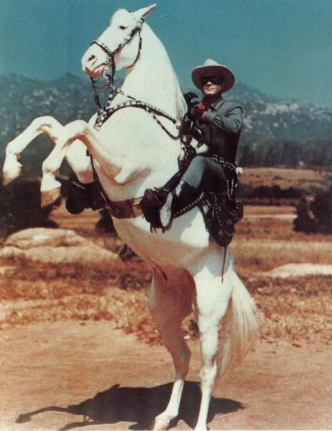
The Lone Ranger
“One of the common misconceptions about leadership at the school level is that is should reside with a single individual—namely the principal.”
Notes:
Research on effective and successful schools state that leadership should NOT rest only in the hands of one person, but should be distributed throughout a dedicated staff working in a team whose responsibilities include overseeing all the processes and moving parts of a school. “One of the common misconceptions about leadership at the school level is that is should reside with a single individual—namely the principal….Although it is certainly true that strong leadership from the principal can be a powerful force toward school reform, the notion that an individual can affect change by sheer will and personality is simply not supported by the research” (Marzano, 2003, p. 174).
That team may already exist in your school. It can be called a variety of names, but for our purpose here, we will call it the Leadership Team.

Slide 24
Leadership Team
Notes:
Some decisions concern the general operation of the school and its continuous improvement. Schools typically place those decisions with a Leadership Team. In order to facilitate communication and coordination among the grade levels and the departments of the school, a typical composition of the Leadership Team is the principal and team leaders from the Instructional Teams as well as other staff members. The Leadership team needs time to meet, and it needs the right team members to drive innovations forward.

Slide 25


Leadership Teams
Notes:
“In a collaborative culture, members of the school community work together effectively and are guided by a common purpose. All members of the community—teachers, administrators, students and their families—share a common vision of what the school should be like. Together they set goals that lead them toward this vision. In doing so, they create a culture of discourse in which the most important educational matters facing the school are opening and honestly discussed” (Turning Point, 2000, p. 3). We call this “deep practice.”

Slide 26

Teamwork implies engagement
“Improvement efforts need the good will and engagement of the people whose work is the subject of change.”
Notes:
In the book, Learning to Improve: How America’s Schools Can Get Better at Getting Better, the author’s write, “Improvement efforts need the good will and engagement of the people whose work is the subject of change.” (Bryk, Gomez, Grunow, LeMahieu, 2015, p. 119)
Whatever the degree of intended change, achieving it depends upon the engagement of people, communication of purpose, and articulation of short-term wins.
In other words, everyone needs to be singing from the same songbook.

Slide 27
Research on effective practices
Details matter
Sweat the small stuff
Assess, Plan Monitor
Celebrate daily victories
Work in teams
Notes:
We’ve talked about knowing what the effective practices are that can make adult actions better. We know that we need to keep current on the research. We’ve talked about our students’ and our own process of learning: Assess, Plan, Monitor. We’ve talked how it all happens more efficiently, more effectively, and ultimately more successfully in teams. A Leadership Team to keep the school on track, Instructional Teams to keep classrooms on track, a School Community Council to keep your community involved, supportive, and excited. It helps to have a common language—everyone on the same page and understanding. And we know how important it is to celebrate when we are successful.
In Thaler and Koval’s book, The Power of Small, they write, “Small, seemingly insignificant acts are powerful agents of change and growth—if we pay attention to them. Unfortunately, we live in a world where we are contstantly told to concentrate on the big things, to not sweat the small stuff. Because of that, we often feel that incremental change doesn’t count for much—it doesn’t pay off. We celebrate milestones and ignore the daily victories that herald persistent substantial change over time.” (p. 3)

Slide 28
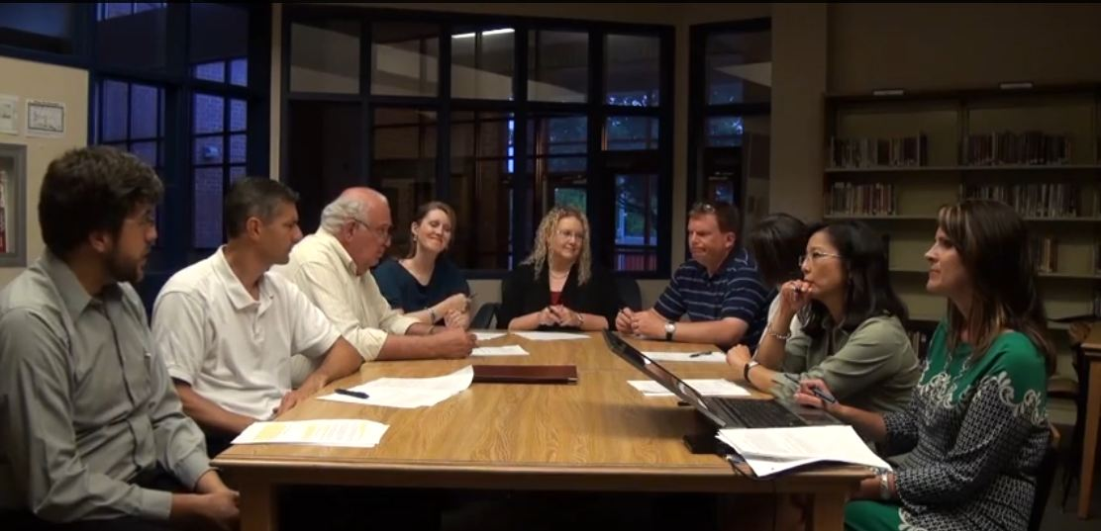
Keeping the Leadership Team on Track
Notes:
All of these teams are involved in deep engagement of their own professional practices and how those practices affect the students most closely associated with them. Teams allow you to highlight each person’s experience and expertise and to share that with others. It also allows you to bolster and support those teachers, like Valerie, who may struggle with certain skills or lessons.
Now, what if there was a web-based process that could keep everyone on track?

Slide 29
Indistar
Notes:
“Educators—practitioners, policy makers, and researchers alike—are rarely at a loss for ideas about how to make things better. But they often lack the specific, practical knowledge necessary to get these ideas to actually work.” (Bryk, Gomez, Grunow, & LeMahieu, 2015, p. 118-119)
Indistar was created to do just that. Give educators the practical knowledge necessary and present that knowledge in a format which gives everyone something to work on in a logical and strategic order while leaving the details of how that works in YOUR school with YOUR staff up to you. Indistar is premised on the beliefs that the people closest to the students can direct the continuous improvement of their schools and that those people bring to the table a wealth of experience and ingenuity.

Slide 30
Structure of Process
Establish a Team structure with specific duties and time for instructional practice
Focusing the principal’s role on building leadership capacity, achieving learning goals, and improving instruction
Teachers are organized into grade-level, grade-level cluster, or subject-area Instructional Teams.
Notes:
The work of school improvement is best accomplished collaboratively, involved in “deep practice”, with a Leadership Team, Instructional Teams, and a School Community Council to involve and inform families of the work of the school.
Indistar gives the Teams a structured process, guided by indicators of effective practice. The effective practices are listed in Indistar in a logical order. You have to have teams and strong principal leadership. That comes first. You have to have instructional teams. You have to create time for these teams to meet. And then you work on what these teams do, what they are responsible for in the school process. All of it affects the classroom and every detail matters in the education of every child.

Slide 31

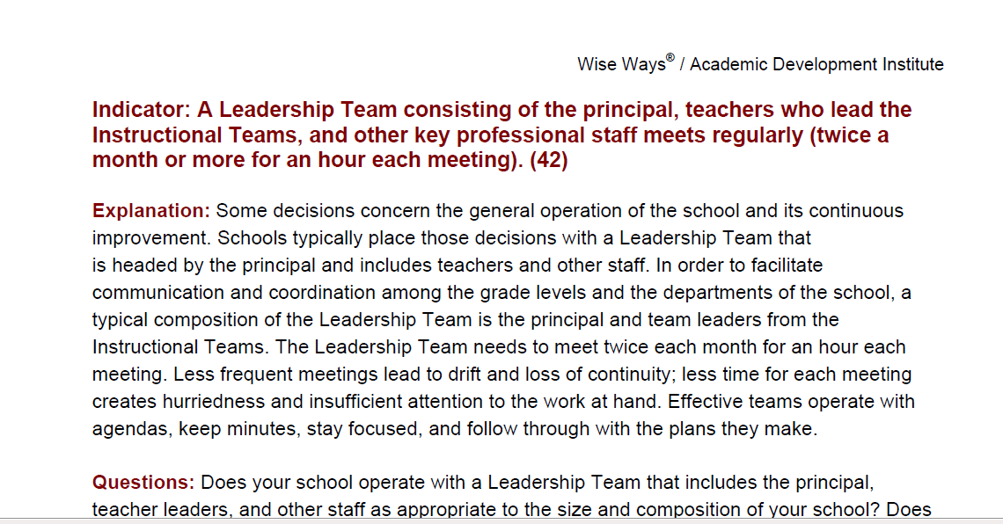
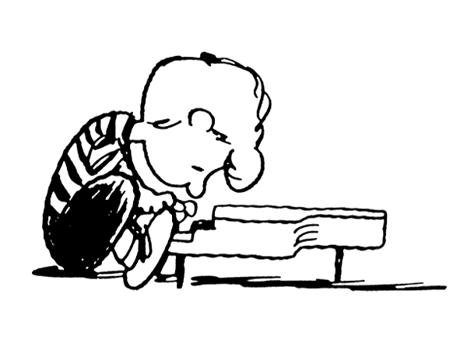
Mastery
Notes:
Indistar has a Wise Way, or a short research brief, attached to every indicator so the team does not have to go searching for the research that supports the indicator. The Leadership Team can read the short brief before their meeting and come prepared to assess how they think the schools meets what the research says or if they still have some work to do. And that’s okay. The whole point of looking at your own professional practices is to find places where you can do better. We can all do better—even at something we’ve been doing for years. A concert pianist still practices every day for hours on end. A master carpenter still hones his craft. We can always improve our own practices—even if we’re pretty good at them.

Slide 32

Start the journey…
Assess
Notes:
Indistar provides a place for the Leadership Team to record their assessment of their professional practices. The team decides on each indicator of effective practice if they are already successfully implementing it in their school, are somewhat doing that in their school, or don’t have that practice in place at all. There is no punishment that comes down from above for being honest. It simply tells the team where they are beginning on their improvement journey. If the team is already successfully implementing one indicator, then they record their evidence—how do they know it is being implemented? How will they keep implementing? Once the evidence is in, the team can focus on indicators that are not being successfully implemented.
Does this seem familiar? Assessing. It’s part of the cycle.

Slide 33

Plan
Tasks
“we substantially underestimate the importance of . . .considering and altering people’s attitudes and behavior to overcome their natural resistance to change.”
Notes:
If the Leadership Team has decided it isn’t fully implementing an indicator, they get to decided if it is a priority right now, or if it is something that can wait. If it is a priority, then the team is going to PLAN how it will get better.
The next step in the cycle. Plan. How do we get from where we are to where we want to be? What does an effective practice look like in my school? In my classroom? With my students? Small, incremental steps keep the team on track and moving toward improvement. Tasks assigned to Leadership Team members, instructional staff, and others as appropriate makes sure everyone is involved and onboard. Engaged. Taking ownership of the changes happening in the school. Cokins (2009) writes that “we substantially underestimate the importance of . . .considering and altering people’s attitudes and behavior to overcome their natural resistance to change” (p. xxix). A change in attitude—mindset—is necessary for everyone to discover the joy of collaborative engagement in purposeful pursuit of professional mastery.
And that is what we want: professional mastery. Becoming the best at our profession that we can possibly be.

Slide 34
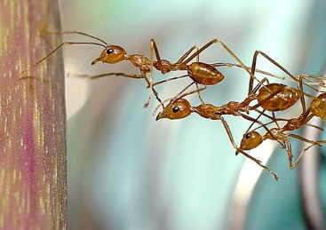
Implement
Monitor
Notes:
So, now we have a great plan in place. Indistar gives the Leadership Team a place to put all the details of the plan. Tasks to get us to where we want to go. People assigned to the tasks. The real work begins. Implementing the tasks. Making sure that what you planned to do actually works. The team comes back together to check on progress. Make changes to the plan if it isn’t working. You monitor the work constantly and calibrate changes when needed. Tweak here. Shift there. Honing your skills until…

Slide 35
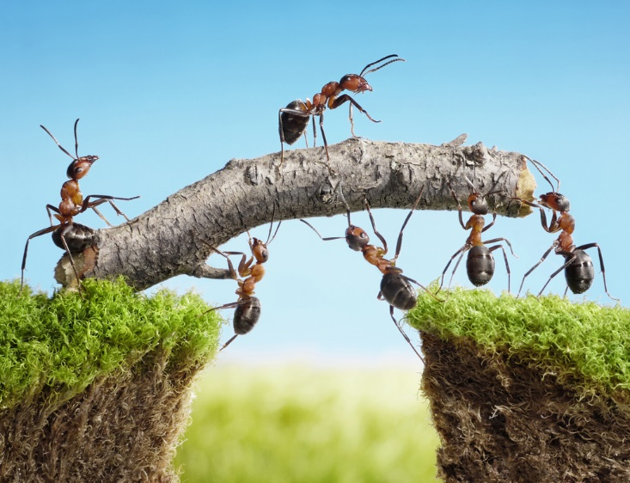
Full Implementation
Notes:
You reach full implementation. Record your experience in Indistar. Write about the evidence you have that it is working. Plan how you will sustain all that hard work. And then…

Slide 36

CELEBRATE!
“We celebrate milestones and ignore the daily victories that herald persistent substantial change over time.”
Notes:
Celebrate! Remember the quote? “we live in a world where we are constantly told to concentrate on the big things, to not sweat the small stuff. Because of that, we often feel that incremental change doesn’t count for much—it doesn’t pay off. We celebrate milestones and ignore the daily victories that herald persistent substantial change over time.” (Thaler and Koval, 2009, p.3) Celebrating success keeps momentum and motivates everyone to reach higher.

Slide 37
What We Learned Together
Assess, plan, monitor
Teams
  Indistar
Notes:
In this module, we’ve looked at the practices that effect student learning: our own professional practices. We’ve talked about how it is more efficient to work in teams—sharing expertise, bolstering those who need support, spreading the work among everyone to get buy-in and investment in the work. We’ve talked about the web-based process that makes this work streamlined and gives a roadmap to a school to know what is important to focus on but gives the school autonomy to figure out how that looks to them in their school and situation.
Please take a moment and fill out the What We’ve Learned. Also, decide what a next step might be for you as you go back to your own school to embed what you’ve learned into your daily practices.
In the next module: Teams, we’ll take a deeper dive into what teams look like and what they do specifically by looking at some of the indicators of effective practice that center on teams.

