Slide 1
WIIN Star File Cabinet Feature Office of Superintendent of Public Instruction – Leslie Rose
Feature

Slide 2
WIIN Star File Cabinet Feature
Purpose: Provide a repository for evidence of implementation of SIG required elements as well as school improvement achievements

Slide 3
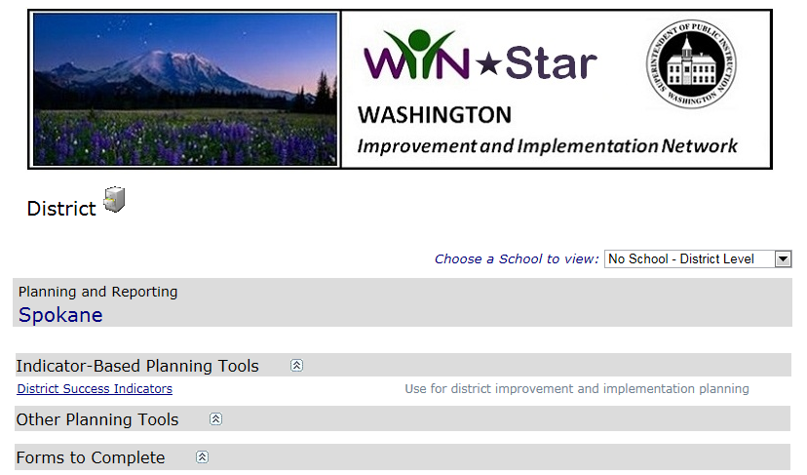
Document Upload: School or District Dashboard View

Slide 4
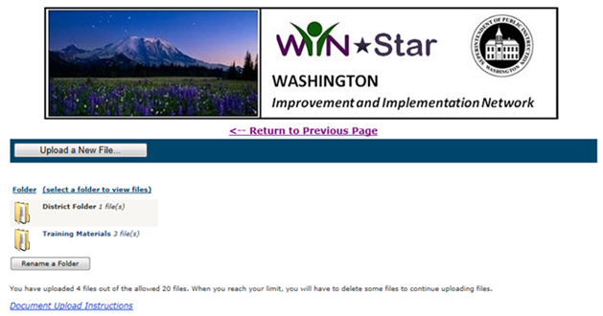
Document Upload: School or District Dashboard View

Slide 5
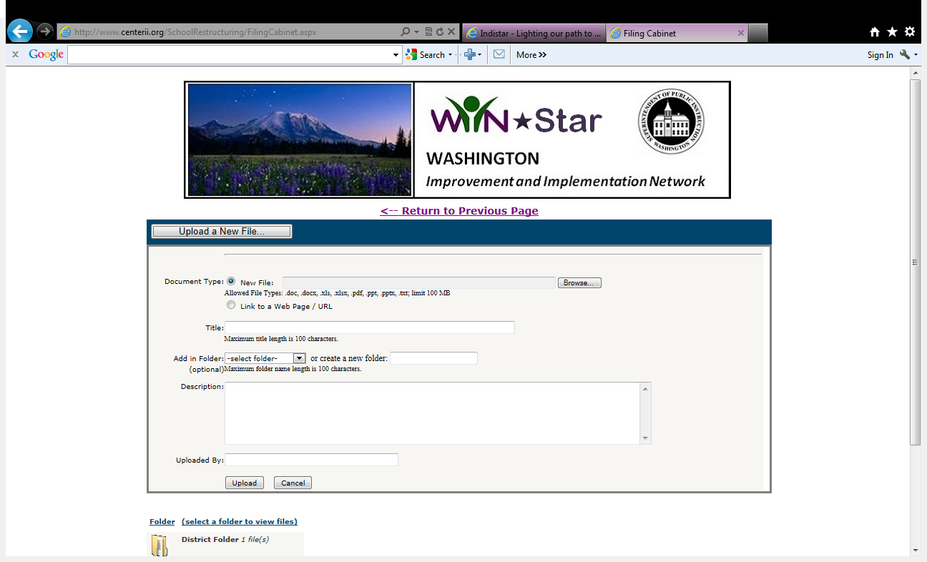
Document Upload: School or District Dashboard View

Slide 6
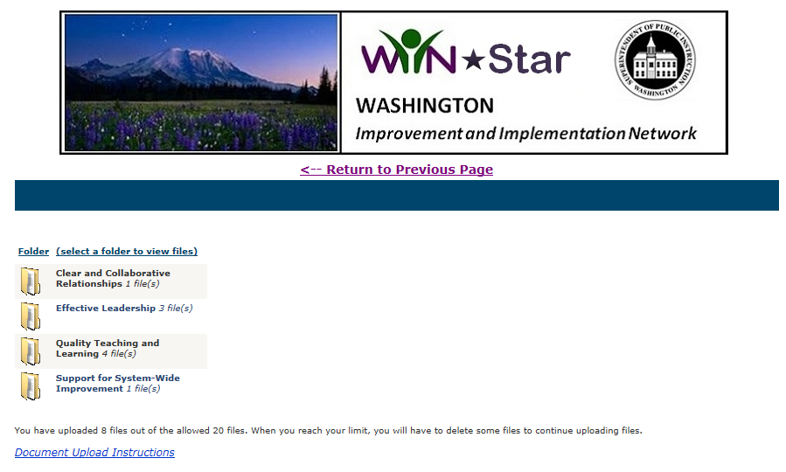
Document Upload: School or District Dashboard View

Slide 7
Document Upload: School or District Dashboard View

Slide 8
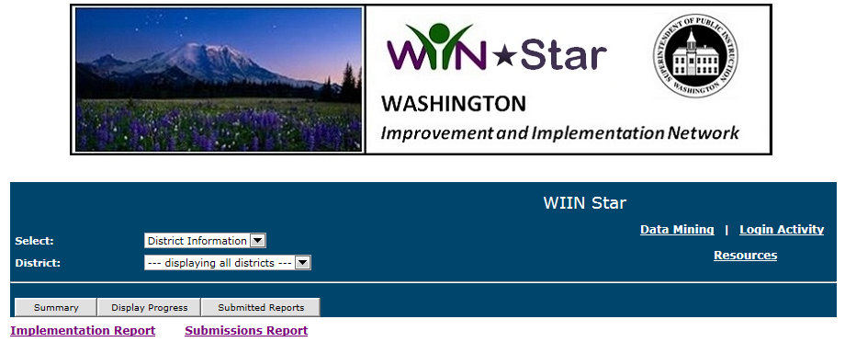
State Administration Page

Slide 9
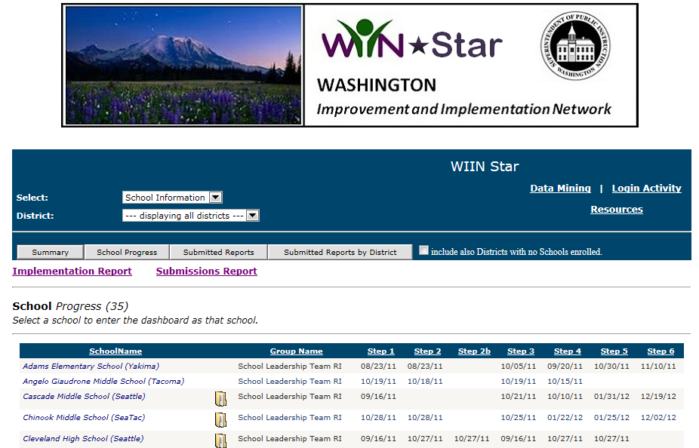
State Administration Page

Slide 10
Required Element | District/School Improvement Success Indicator | Evidence to post to File Cabinet
Teachers and Leaders
Replace Principal |  | Job posting, interview questions, description of hiring process; OR if the principal was not replaced, the process used to determine current principal possesses competencies necessary for turnaround (Cohort II only)
Implement such strategies as financial incentives and career ladders for recruiting, placing, and retaining effective teachers. | DISI-IIA3: The district’s monitoring practices provide frequent feedback aligned with district expectations for instructional practice and student achievement. Ineffective and mediocre practitioners are held accountable. DISI-IIA4: Recruiting and hiring practices ensure the selection and retention of staff accountable to high levels of student performance. | Recruiting, selection and hiring plans developed based on newly adopted competencies, policy changes regarding transfers, placement, retention or reduction in force, MOU

Slide 11
Questions

