Slide 1
State Administration Page, Data Mining and State Reports
How an SEA can gather helpful information
Stephanie Benedict – CII, Client Relations Coordinator
Bob Goodrich – CII, Lead Programmer
Lisa Kinnaman – CII, Director of Improvement Support to States

Slide 2
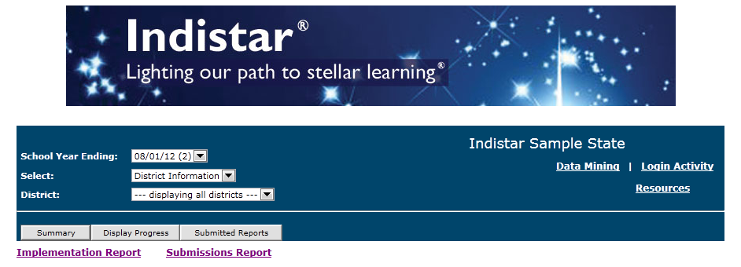
From the State Administration main page, you will be able to get easy access to: 1. A summary of submissions made by schools or districts
1
State Administration Page - General Information
Notes:
Steph

Slide 3
2. Display Steps 1-6 progress dates
2 & 3
State Administration Page - General Information
Notes:
Steph

Slide 4
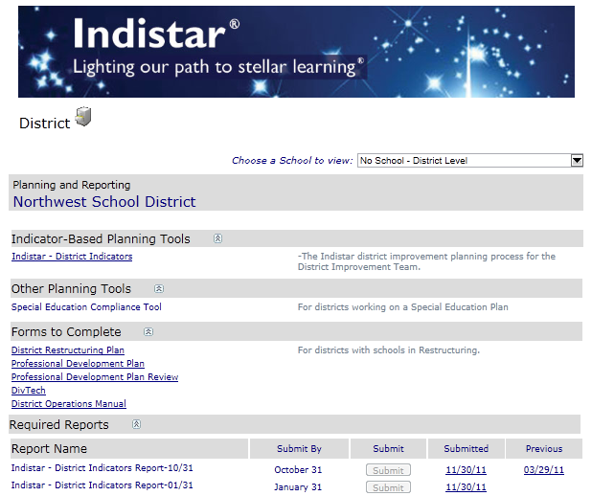
3. Drill down to a school or district dashboard
2 & 3
State Administration Page - General Information
Notes:
Steph

Slide 5
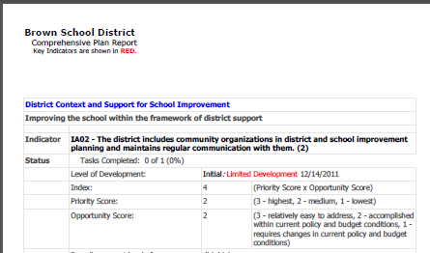
4. View actual submitted pdf’s from schools and districts
4
State Administration Page - General Information
Notes:
Steph

Slide 6
Currently, there are four state level reports: 1. Implementation Report 2. Submissions Report 3. State Aggregate Report 4. State Drill Down Report
State Administration Page - Reports
Notes:
Steph

Slide 7
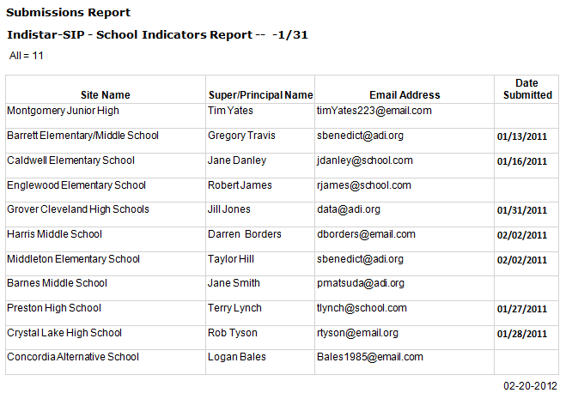
An SEA can easily see who has or has not submitted a specific school or district report. The Submissions Report includes submission dates, principal names and even email addresses.
Submissions Report
Notes:
Steph

Slide 8
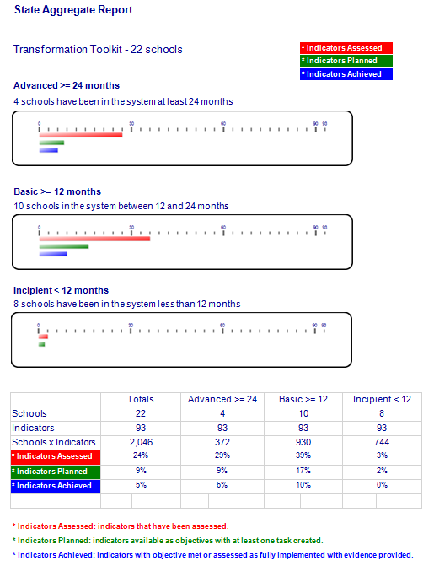
The State Aggregate Report shows a graphic of the status of districts or school groups. Status is based on the number of months since a team was formed. A calculation for each status subset shows the percent of indicators that have been assessed, planned, and achieved.
State Aggregate Report
Notes:
Steph

Slide 9
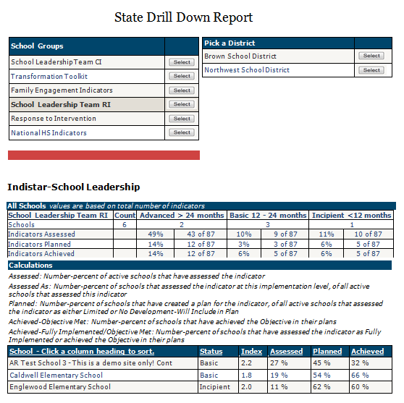
The State Drill Down Report shows the aggregated progress of all schools within each school group. The report can then display aggregated progress by district and individual school. Information includes indicators assessed, planned, and achieved; status (Basic, Incipient, Advanced) and the school’s individual Index Score.
State Drill Down Report
Notes:
Steph

Slide 10
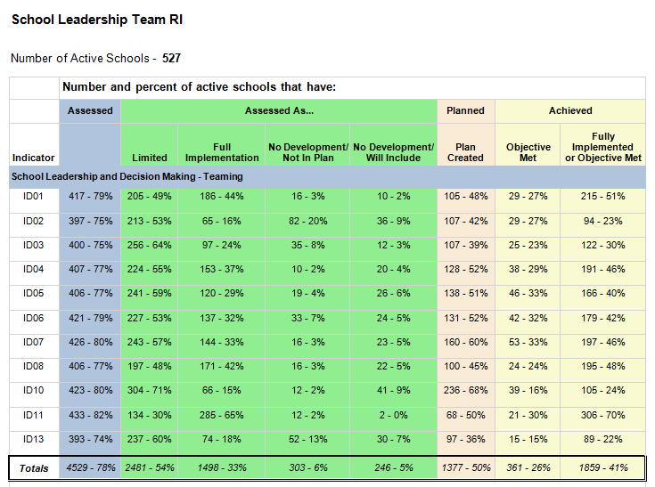
The Implementation Report shows the number and percent of districts or schools working on each indicator...assessments, plans and implementation. SEAs can see where focus is at and where more focus might need to be.
Implementation Report
Notes:
Steph and then Lisa....

Slide 11
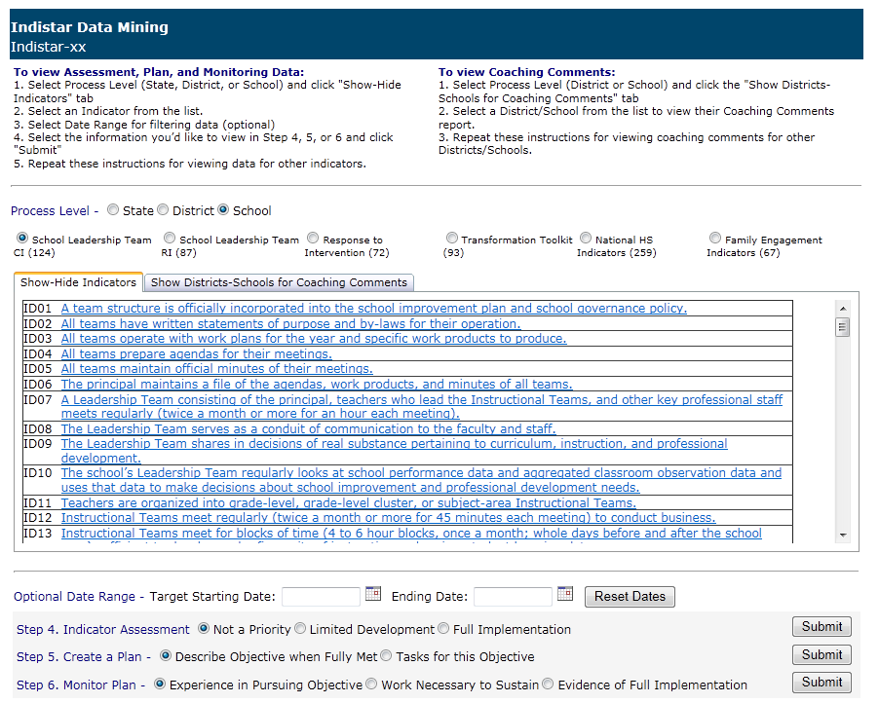
Data Mining - Indicators
Notes:
Lisa....

Slide 12
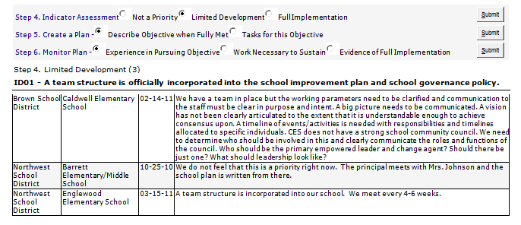
Data Mining shows evidence that is given, reasons why an indicator was marked as ‘not a priority/not in plan’, plans and tasks that have been created, and sustainability efforts. Specific areas of focus gathered from the Implementation Report can be mined here.
Data Mining - Indicators
Notes:
Lisa....

Slide 13
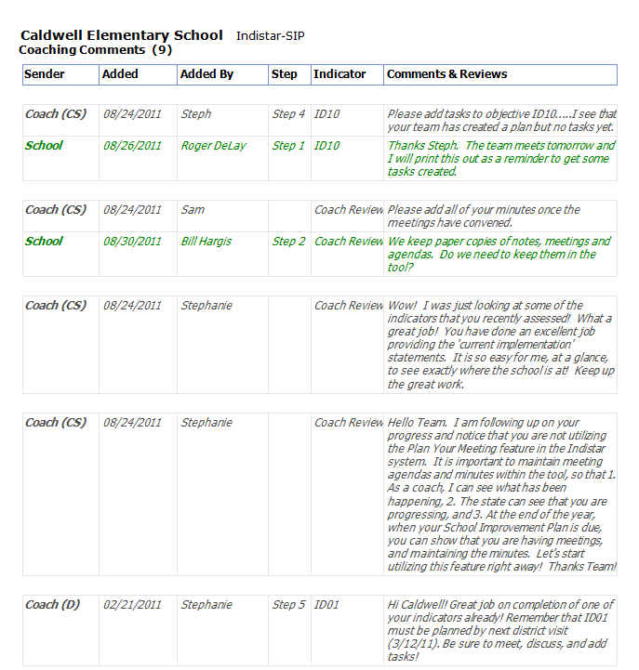
By clicking on a school or district, you will be able to view the complete history all coaching comments and responses.
Data Mining – Coaching Comments
Notes:
Lisa....

Slide 14
Additional Comments and Questions
State Administration Page – Additional Information
Notes:
Lisa....

