Slide 1
Indistar School and District Reports
How to get the information that you need
Stephanie Benedict – CII, Client Relations Coordinator
Bob Goodrich – CII, Lead Programmer
Lisa Kinnaman – CII, Director of Improvement Support to States

Slide 2
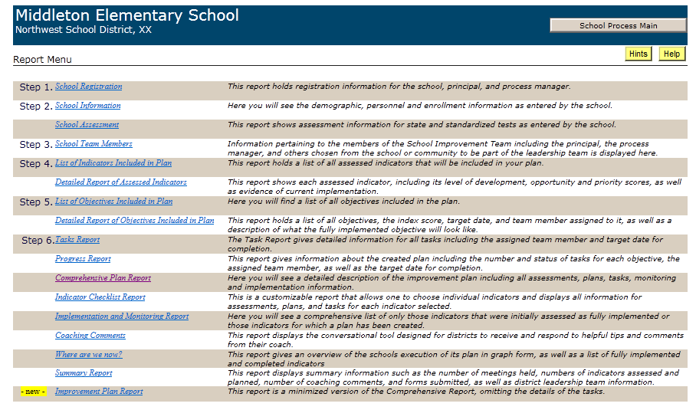
Report Page – School/District Level

Slide 3
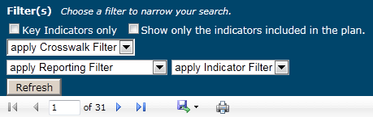

17+ different reports
Printable
Exportable to several file formats
Can be filtered by names, date ranges, filter options

Slide 4
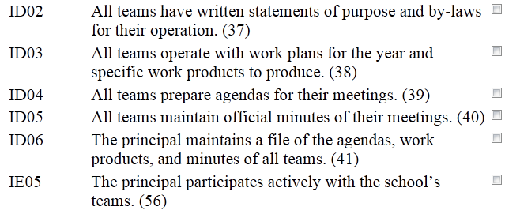
INDICATOR CHECKLIST REPORT
Only chosen indicators will be shown in this report. Report will include assessments, plans, tasks and implementation information.

Slide 5
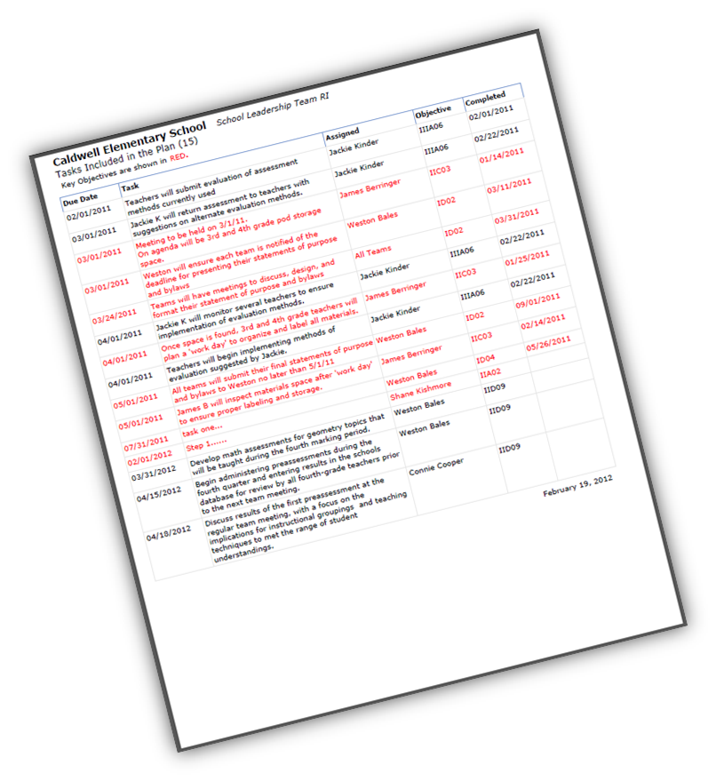
TASKS REPORT
-Objective code
-Task description
-Target date for task completion
-Person assigned to carry out task
-Completion date if applicable
*Report can be filtered by persons’ names
*Reports can be filtered by target due date ranges

Slide 6
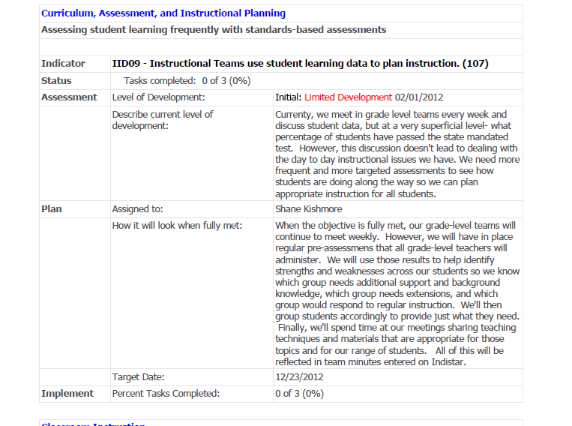
COMPREHENSIVE PLAN REPORT
CURRENT STATUS
INITIAL ASSESSMENT

Slide 7

Suggestions and Special Requests
Hi! Can I get 3 indicators, an order of Wise Ways and a Comprehensive Report without the tasks, please?

Slide 8

So...what does happen to all of those ideas, requests and suggestions?

Slide 9






Idea/Suggestion
Test, test, retest
Gather details
Who will ‘create’ it?
Team discussion and decision...
later?
How do we do it?
Notes:
Bob....

Slide 10
Notes:
Brad Billings

Slide 11
Improvement Plan Report
Several districts began asking us for a more streamlined report to share with parents.
This report shows the plan with only the objectives (tasks are not included).
CII created the report efficiently and in a way that met the needs of our state.
Notes:
Brad Billings

Slide 12
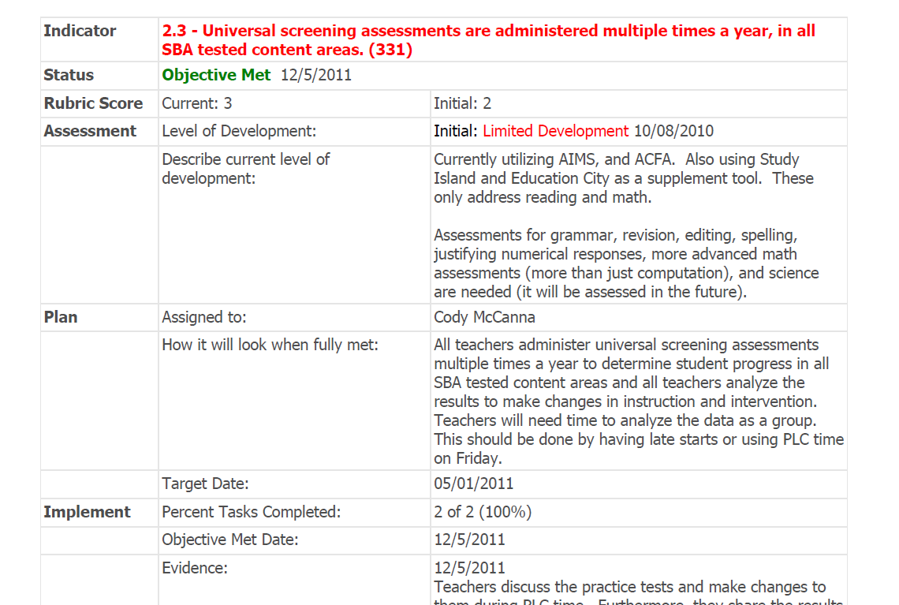
Notes:
Brad Billings

Slide 13
Questions

Slide 14
State Administration Page, Data Mining and State Reports
How an SEA can gather helpful information
Stephanie Benedict – CII, Client Relations Coordinator
Bob Goodrich – CII, Lead Programmer
Lisa Kinnaman – CII, Director of Improvement Support to States

Slide 15
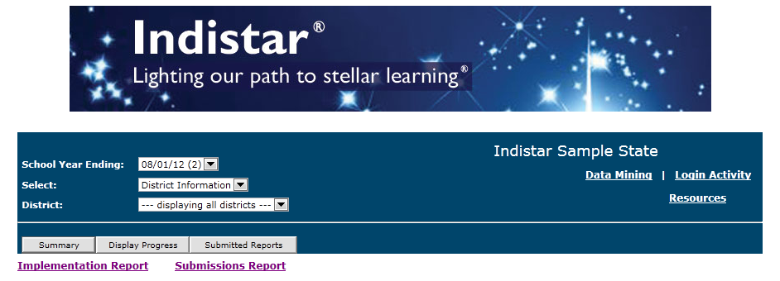
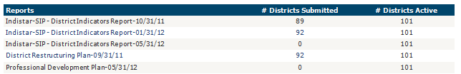
From the State Administration main page, you will be able to get easy access to:
1. A summary of submissions made by schools or districts
1
State Administration Page - General Information
Notes:
Steph

Slide 16

2. Display Steps 1-6 progress dates
2 & 3
State Administration Page - General Information
Notes:
Steph

Slide 17
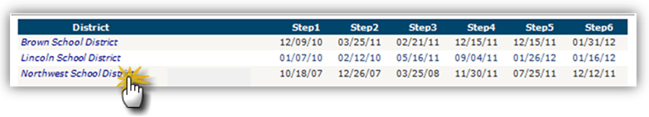
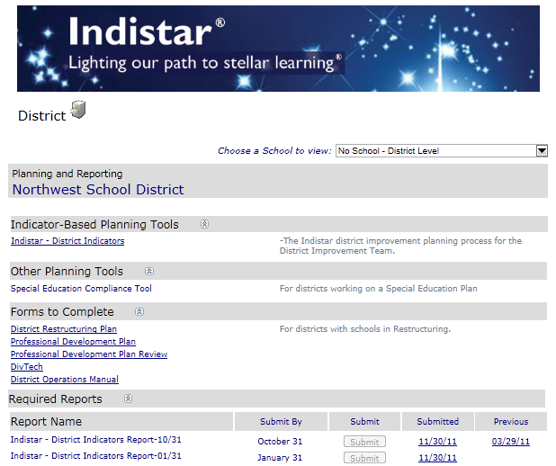
3. Drill down to a school or district dashboard
2 & 3
State Administration Page - General Information
Notes:
Steph

Slide 18
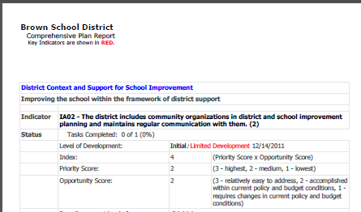
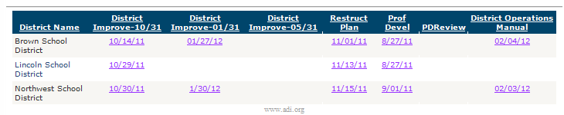
4. View actual submitted pdf’s from schools and districts
4
State Administration Page - General Information
Notes:
Steph

Slide 19
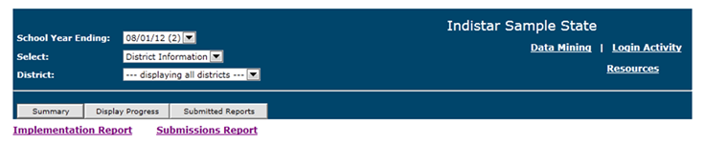
Currently, there are four state level reports:
1. Implementation Report
2. Submissions Report
3. State Aggregate Report
4. State Drill Down Report
State Administration Page - Reports
Notes:
Steph

Slide 20
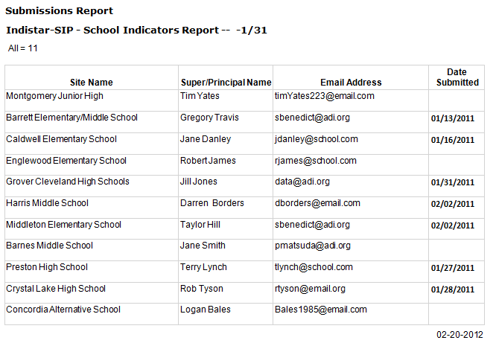
An SEA can easily see who has or has not submitted a specific school or district report. The Submissions Report includes submission dates, principal names and even email addresses.
Submissions Report
Notes:
Steph

Slide 21
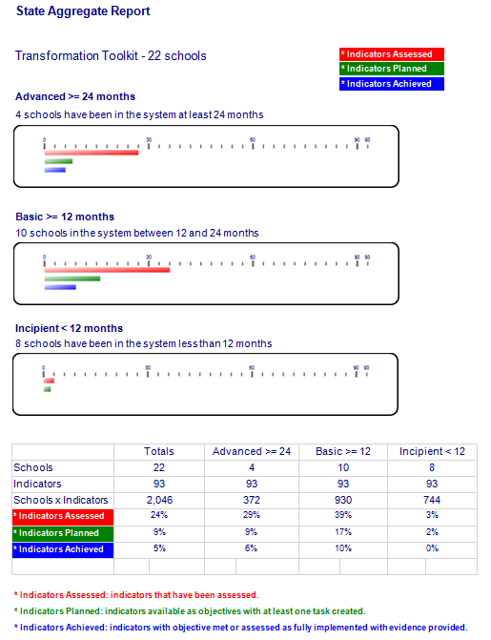
The State Aggregate Report shows a graphic of the status of districts or school groups. Status is based on the number of months since a team was formed.
A calculation for each status subset shows the percent of indicators that have been assessed, planned, and achieved.
State Aggregate Report
Notes:
Steph

Slide 22
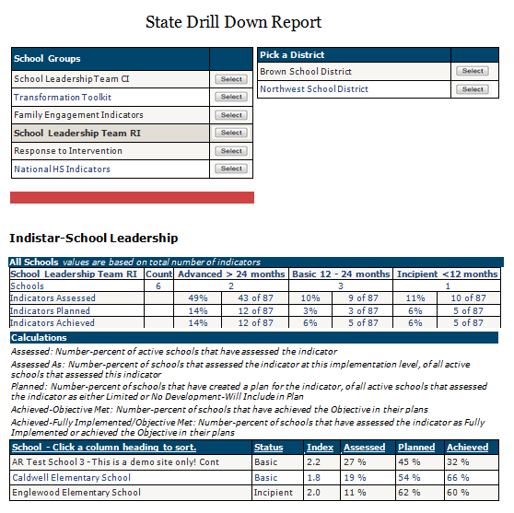
The State Drill Down Report shows the aggregated progress of all schools within each school group.
The report can then display aggregated progress by district and individual school.
Information includes indicators assessed, planned, and achieved; status (Basic, Incipient, Advanced) and the school’s individual Index Score.
State Drill Down Report
Notes:
Steph

Slide 23
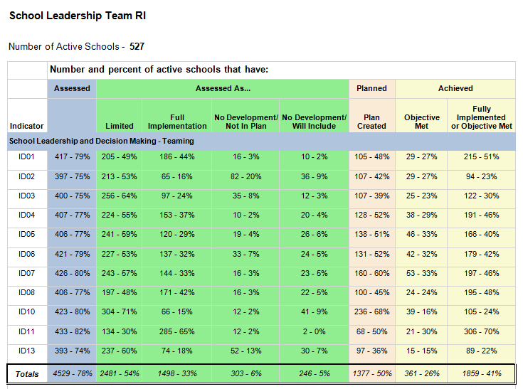
The Implementation Report shows the number and percent of districts or schools working on each indicator...assessments, plans and implementation. SEAs can see where focus is at and where more focus might need to be.
Implementation Report
Notes:
Steph and then Lisa....

Slide 24
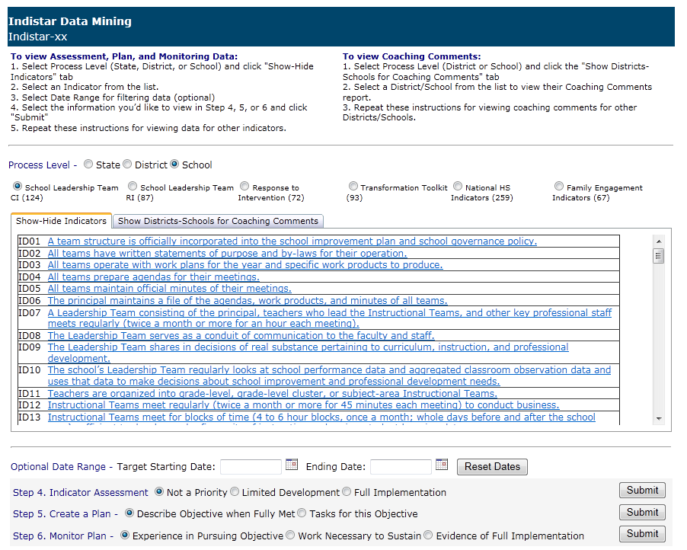
Data Mining - Indicators
Notes:
Lisa....

Slide 25
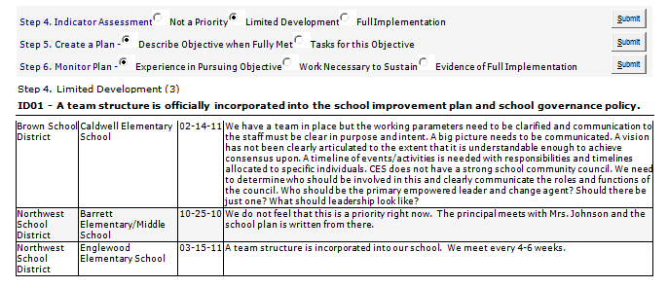
Data Mining shows evidence that is given, reasons why an indicator was marked as ‘not a priority/not in plan’, plans and tasks that have been created, and sustainability efforts.
Specific areas of focus gathered from the Implementation Report can be mined here.
Data Mining - Indicators
Notes:
Lisa....

Slide 26
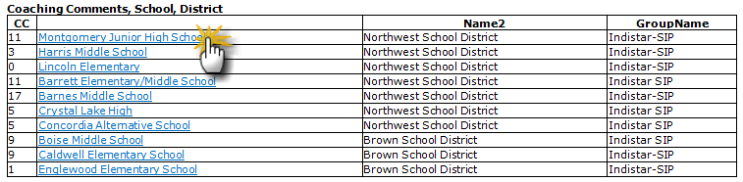
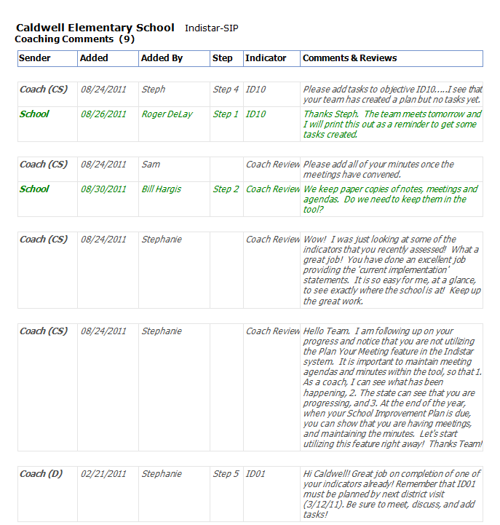
By clicking on a school or district, you will be able to view the complete history all coaching comments and responses.
Data Mining – Coaching Comments
Notes:
Lisa....

Slide 27
Additional Comments and Questions
State Administration Page – Additional Information
Notes:
Lisa....

