Slide 1
Reviewable Documents
Marilyn Orgaard - North Dakota Department of Education
Lois Myran – Consultant, Center on Innovation and Improvement

Slide 2
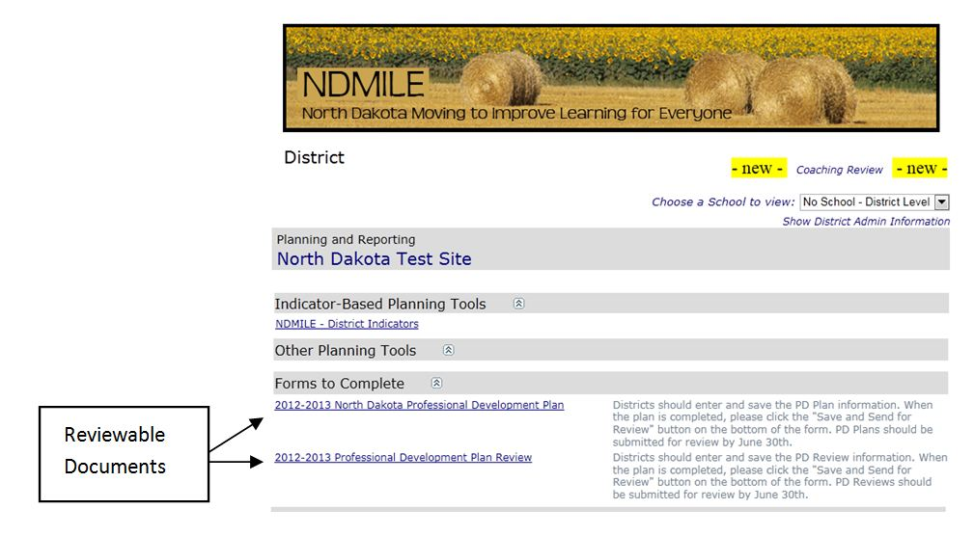
Dashboard

Slide 3
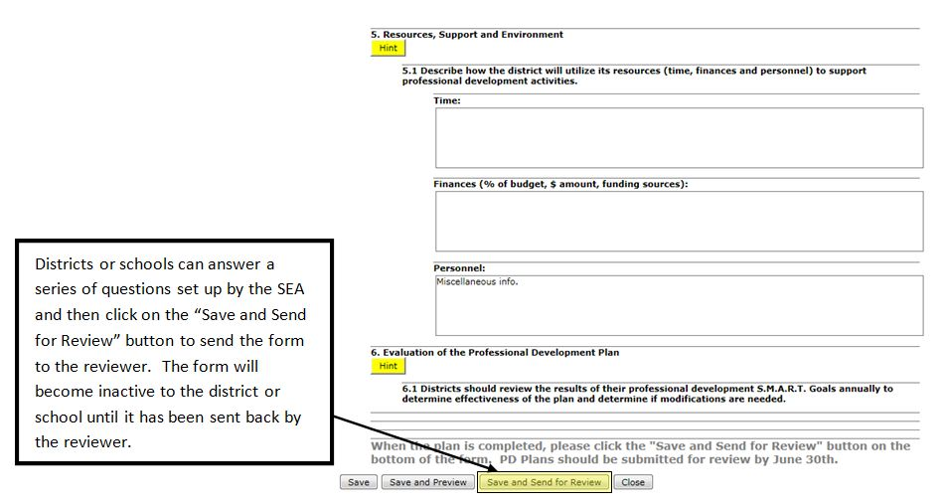
Forms to Complete

Slide 4
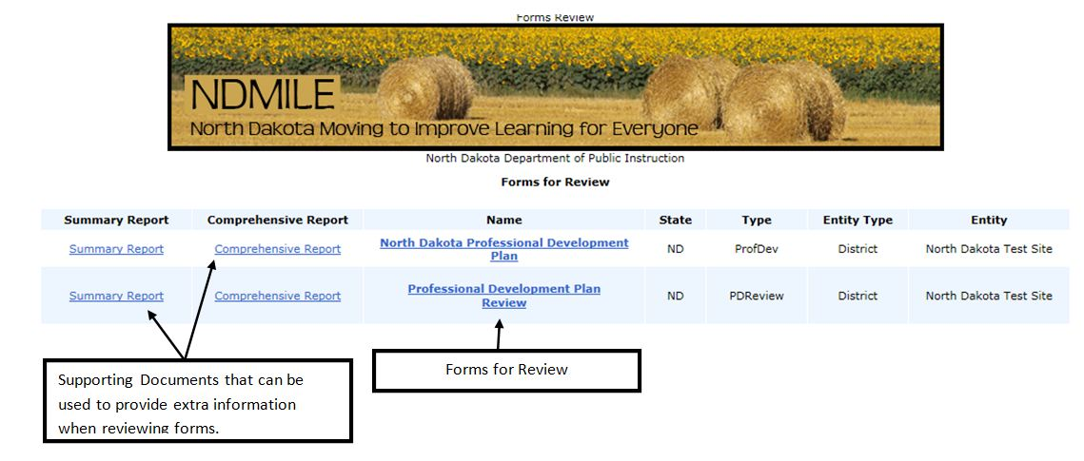
Reviewer’s page

Slide 5
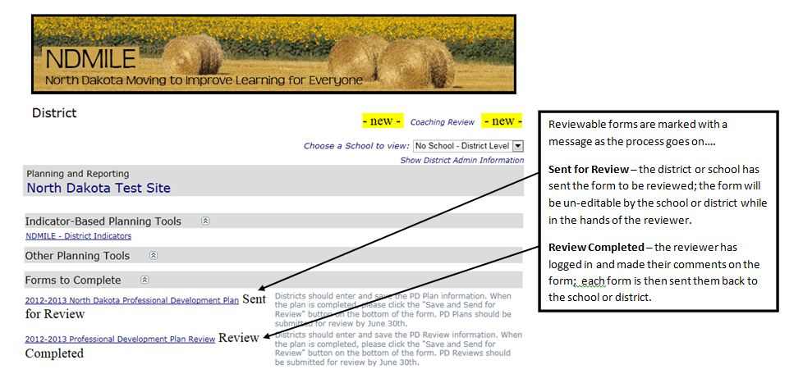
Dashboard

