Slide 1
School Improvement Grants: SIGnaling Positive Changes in Mississippi
Indistar Summit
February 28-29, 2012
Biloxi, Mississippi
Mississippi Department of Education

Slide 2
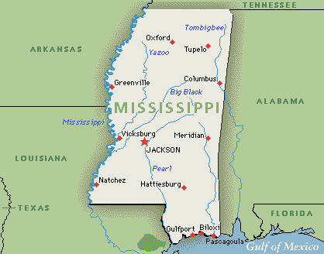
Mississippi
14
Transformation
3 Elementary
2 Middle
8 - High Schools
1 -Attendance Center
4
Turnaround
2 - Elementary
1 - Middle
1 -High School
18 Schools

Slide 3

SIG Monitoring in Mississippi
Technical Assistance Visits and Monthly Reports by OSR Staff
SIG Mississippi Star Reporting by Districts
Pilot in November 2011-June 2012
Annual Monitoring Visit (Programmatic)
Interviews, Observations, Supporting Documentation
Quarterly Reports
ARRA Financial Reports and Implementation Specialists’ Summaries
Annual Monitoring Visit (Fiscal)

Slide 4
An Integrated Approach to
SIG Monitoring Requires Balance
  Regulatory Function / Compliance
  +
  Emphasis on Effectiveness of Implementation
  +
  Targeted Technical Assistance
  =
  SIGnificant School Improvement

Slide 5
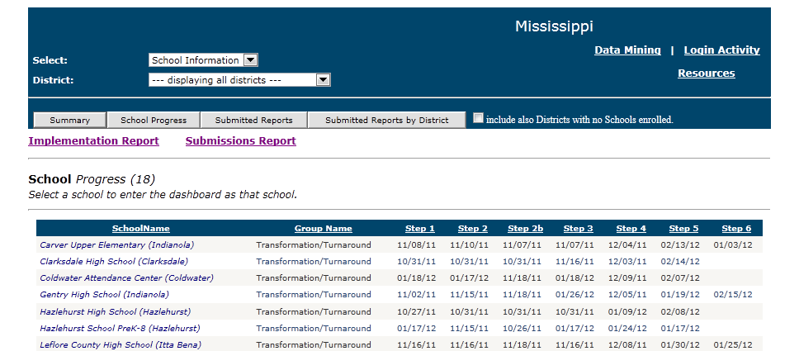

Slide 6
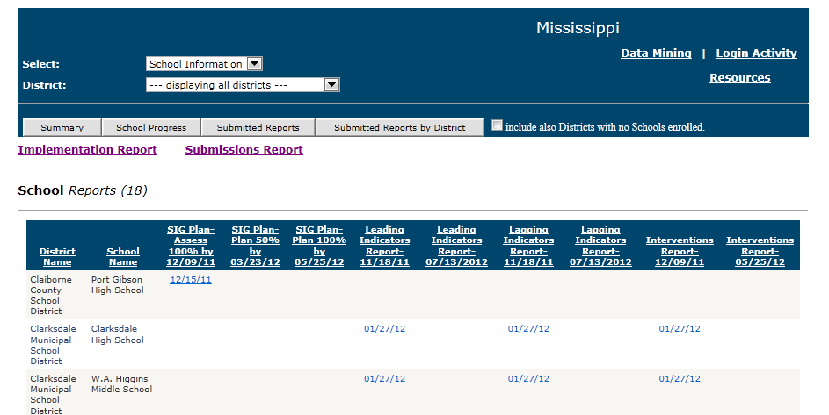

Slide 7
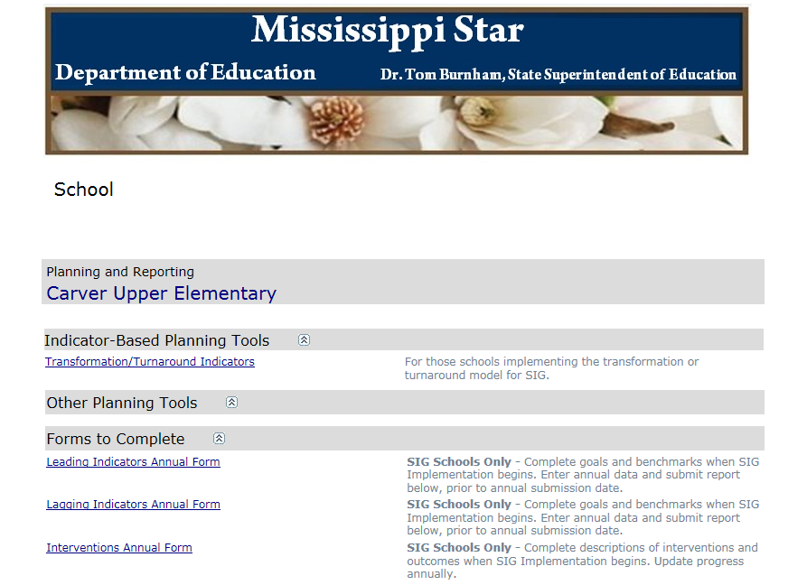
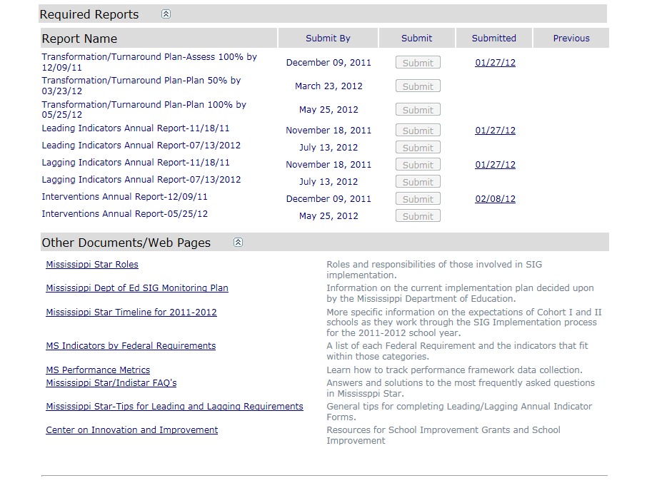

Slide 8
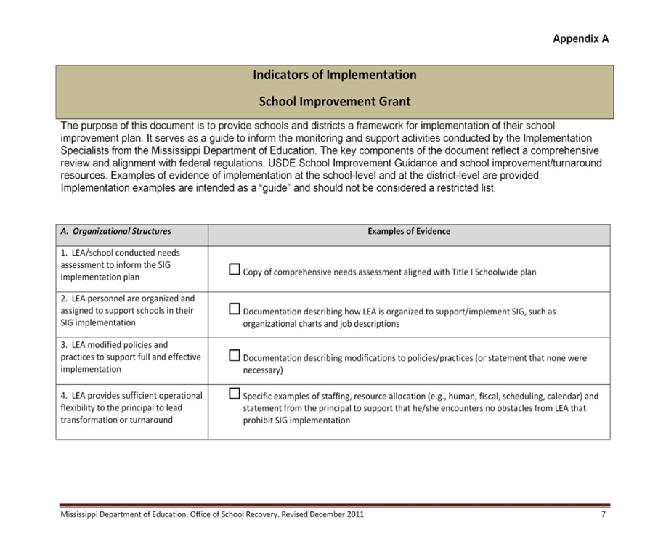
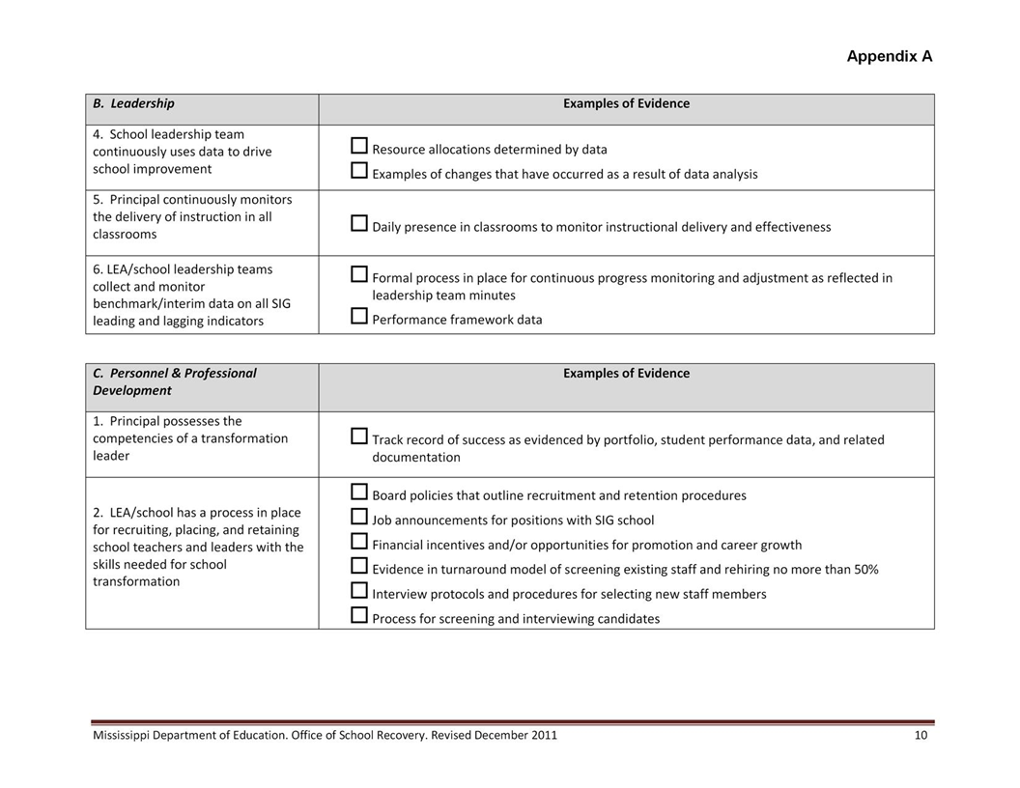
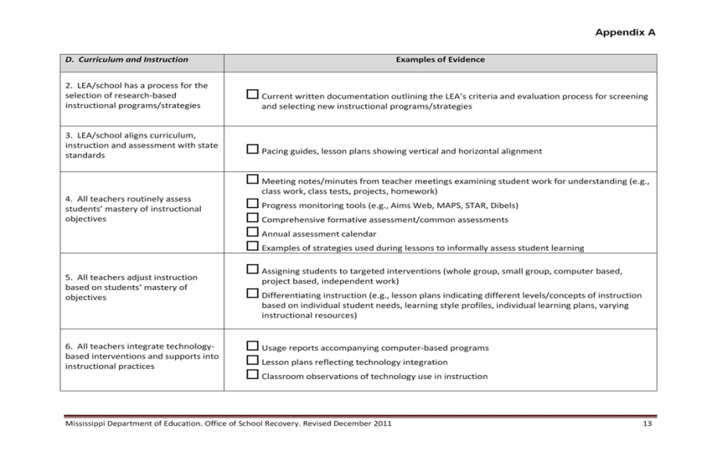
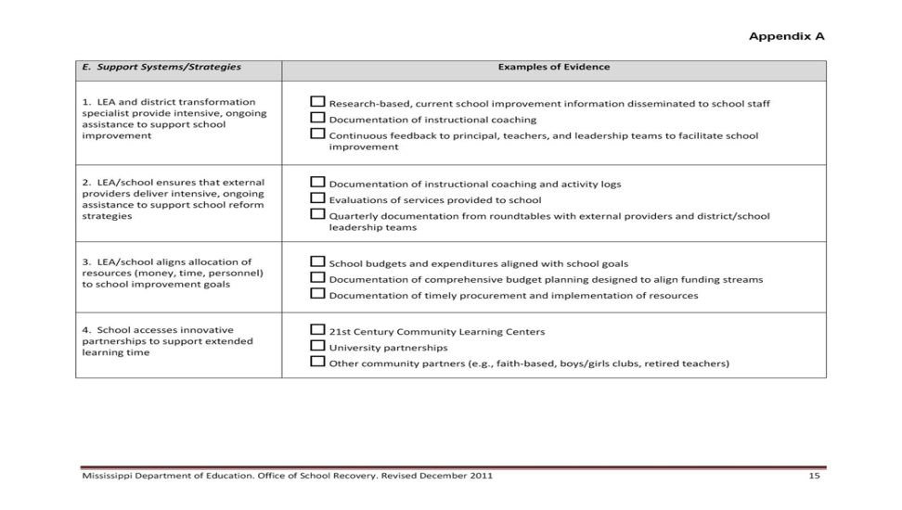
Indicators of Implementation

Slide 9
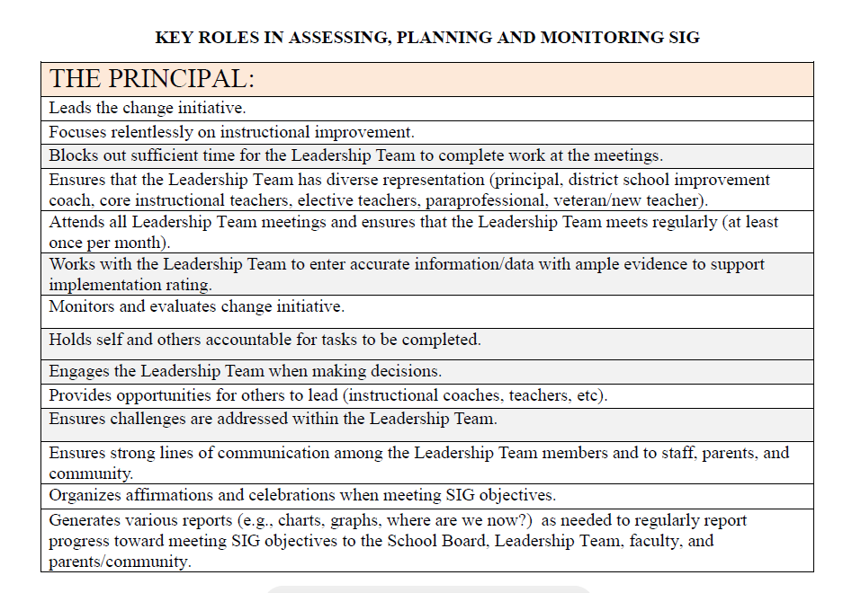
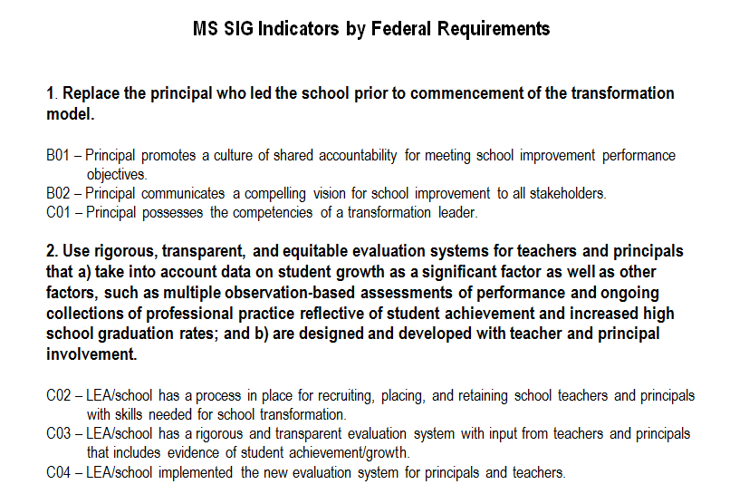
Mississippi Star Roles
Mississippi Indicators Aligned to Federal Regulations

Slide 10
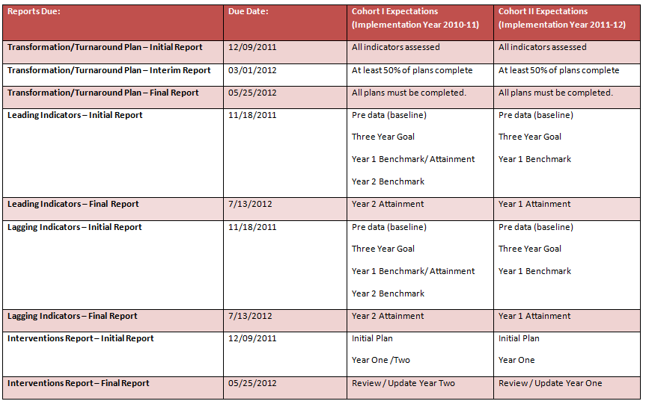

Slide 11
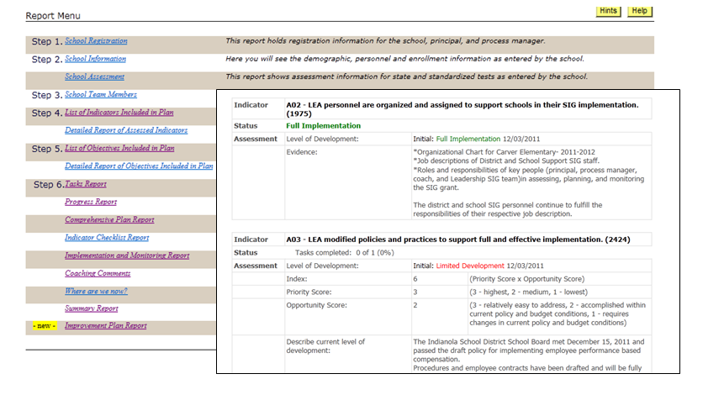

Slide 12
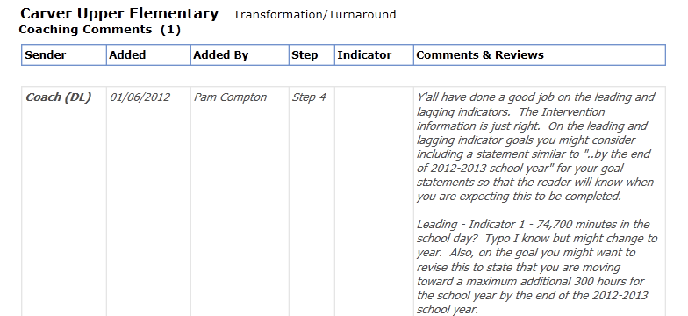
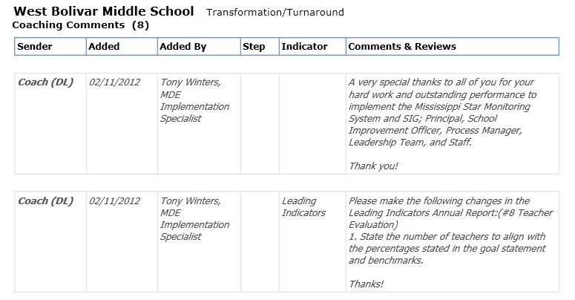
What Are Our Coaches Saying?

Slide 13
Training and Technical Support
Initial Training (Sept-Oct)
Overview for SEA Coaches
Follow-Up Training (November –January)
In-Person for School-Level Teams
Indistar Summit
(February)
SEA Coaches
Training for District Leadership Teams
In-Person SEA Coaches
Webinar for SEA Coaches
In-Person for District Leadership Teams
More Follow-Up
(March – May)
District Teams
SEA Coaches
Cross-District Training

Slide 14
What Are Our Schools Saying?
“Our Transformation Team is having some of the best conversations we have ever had. We have never engaged in such focused, honest discussions. We are talking about things we needed to address.”
“Mississippi Star aligns our school improvement plan and other plans in our school around data, supported with research - one comprehensive school plan.”
“We can put this information into actual practice immediately.”
“I see how Mississippi Star provides a link with indicators and evidence – we will be ready for SIG monitoring.”
“This process promotes collaboration and focused conversations.”
“With the help of Mississippi Star, I understand how SIG drives schools forward.”

Slide 15
Mississippi Star: Seeing Teams Achieve Results!
Mississippi Star: Guiding Light for SIGnificant Growth!
Mississippi Star: School Teams Advancing Rapidly!
Mississippi Star: Next Level, New Us, No Limits!
Mississippi Star Lighting the Path to Success!
One School, One Team, One Dream – Together We Succeed!

Slide 16
In Mississippi, we see the potential for leading Systemic Change. By increasing the capacity of LEAs and schools we can sustain school improvement efforts beyond SIG funding. With Mississippi Star we can…
  Change conversations in schools
  Empower leadership teams and administrators
  Foster mutual accountability and ownership
  Focus school improvement efforts
  Link school improvement to research based actions
  (Wise Ways and Indicators in Action)
  Provide a “one-stop-shop” for improving schools

Slide 17

Contact Information:
Dr. Kim Benton, Office of School Recovery
Mississippi Department of Education
601-359-1003
kbenton@mde.k12.ms.us

