Slide 1
Crosswalk and Filters Feature
Steve Underwood - Director, Statewide System of Support
Division of Student Achievement & School Improvement
Idaho State Department of Education
Rosie Santana – Southwest Idaho Regional School Improvement Coordinator

Slide 2
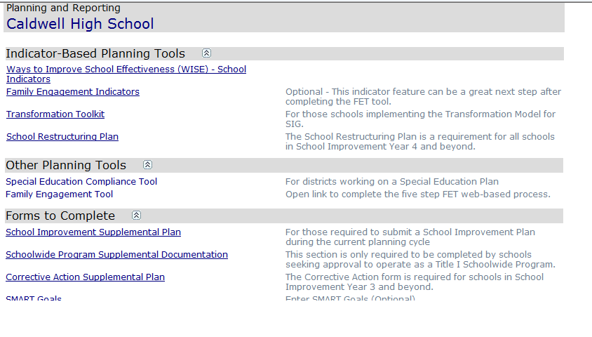
Dashboard

Slide 3
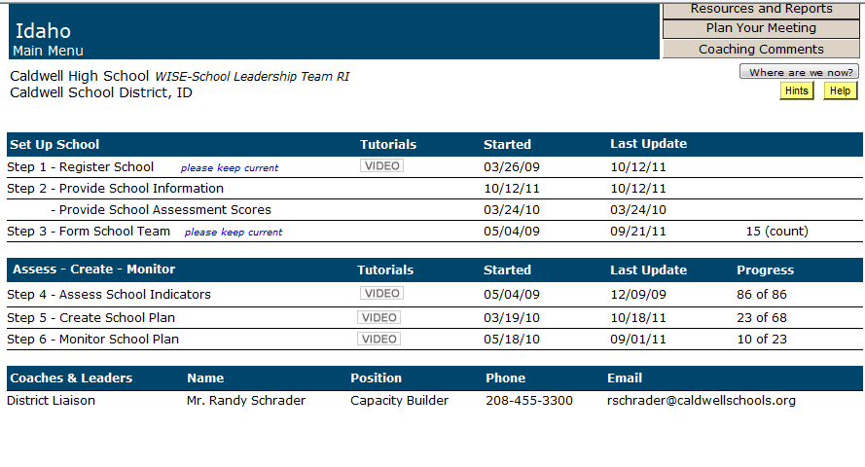

Slide 4
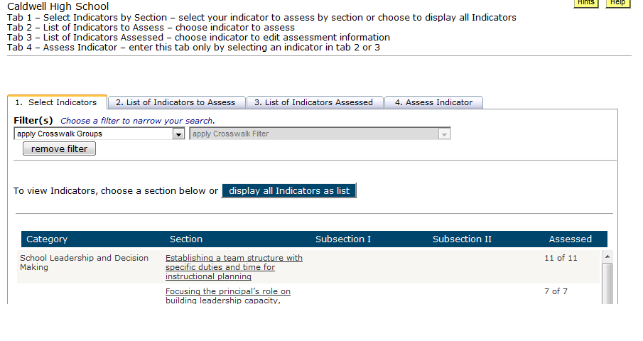

Slide 5
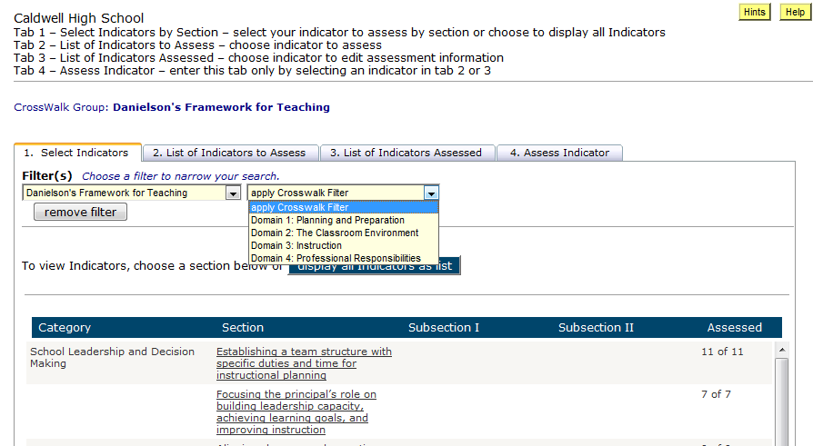

Slide 6
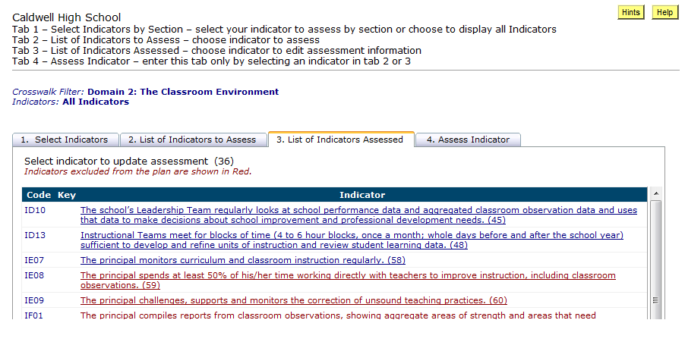

Slide 7
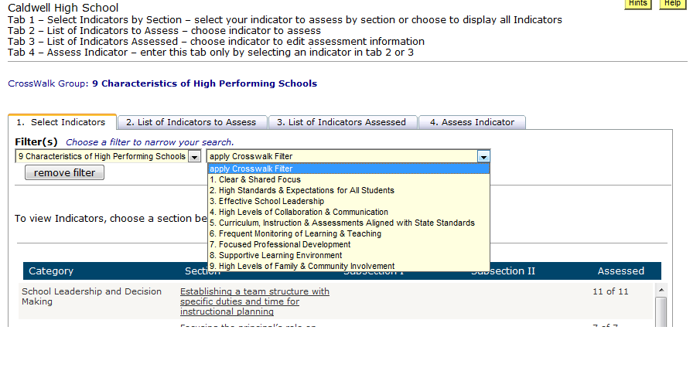

Slide 8
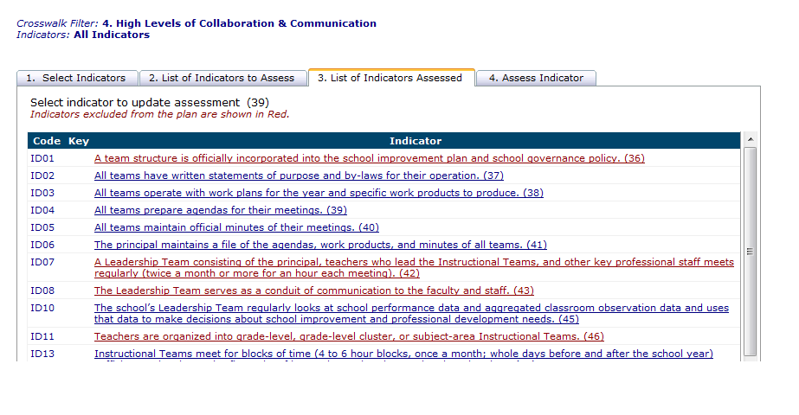

Slide 9
Other Crosswalks
Title I Schoolwide and School Improvement
Response to Intervention

