Slide 1
Coaching Review Page
Stephanie Benedict, CII – Client Relations Coordinator

Slide 2
Districts and coaches can access the Coaching Review link from the dashboard.

Slide 3
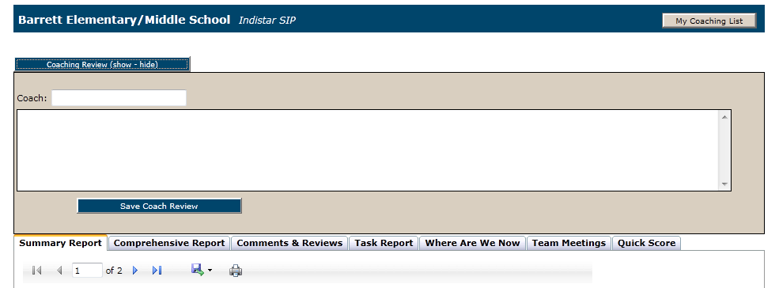
-Choose a school or district to view -Click to open the Coaching Review feature -Seven tabs of reports/information -Each report can be printed or exported

Slide 4
Summary Report...overall summary report of all work, information and activity that a school or district has completed.
Comprehensive Report...detailed report of all assessments, plans and monitoring information.
Comments & Reviews...Coaching comments, reviews and responses; history and ability to send or respond anew.
Task Report...detailed list of all tasks created.
Where Are We Now...overview of a school or districts plan, in graph form.
Team Meetings...detailed meeting minutes as entered by the school or district.
Quick Score Report...a quantitative rating summary of the school or district’s progress, based on key factors within the tool. (And coming soon...the Coaches Critique, to be used as a quality check of a school or district’s work; to be used in conjunction with the Quick Score.)

Slide 5
Coaching Review vs. Coaching Comment
Technically there is only a slight difference between a coaching comment and a coaching review.
-Comments can be tagged to Steps and/or indicator id’s, where coaching review comments are more general.
-The Coaching Review page and message area make it easier for a coach or district to tab through areas that need reviewed and send comments without having to go back and forth.
-Coaching Comments & Reviews can be viewed and responded to from the Coaching Review link, but an additional link can still be found off of the Main Menu page.

Slide 6
Summary Report
The Summary Report gives the coaches and districts ‘summary’ information about the following, for each school:
-Leadership and Leadership Team
-Meetings
-Assessments
-Plans
-Implementation
-Submitted Reports
-Coaching Comments & Responses

Slide 7
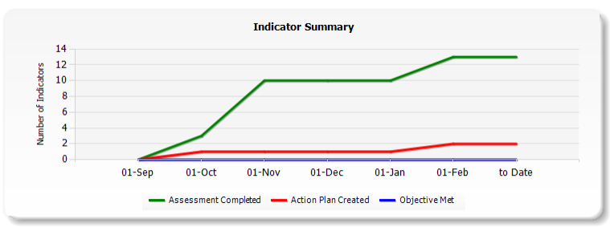
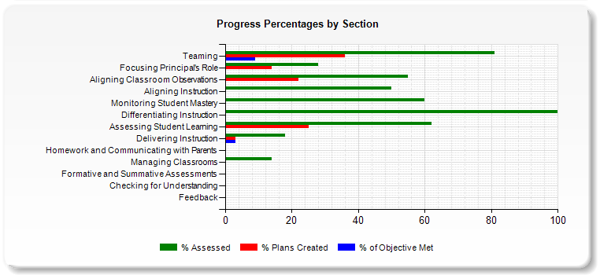
Comprehensive Report, Tasks Report and Where are We Now? Report
-The Comprehensive Report shows all information entered for indicators: assessments, plans, tasks, implementation.
-Tasks report shows all information for tasks...goals, description of tasks, responsibilities.
Where are We Now? Report is a great way to visually track a team’s progress. Through a series of graphs, coaches and districts can see progress made in assessing, planning and implementing not only plans, but even simple tasks.

Slide 8
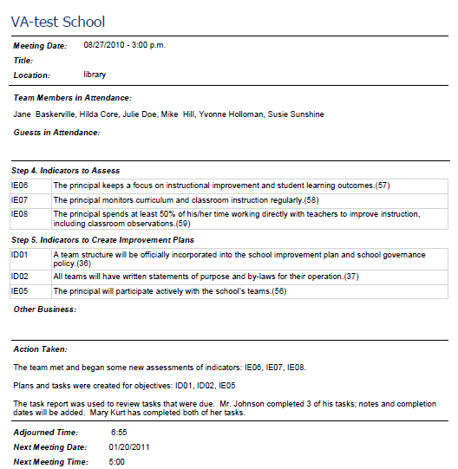
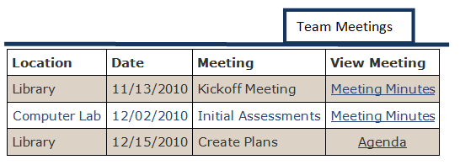
Team Meetings
Coaches will be able to not only view Meetings that have been set up by a team, but those meeting minutes can be opened so that a coach or district may view what work was accomplished.

Slide 9
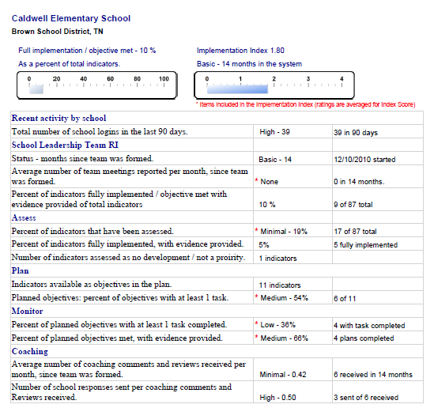
Quick Score Report (and Coaches Critique – coming soon)
Quick Score produces a quick rating of the school or district’s progress. Status ratings are weighted according to when a team was formed.
Status Ratings: Incipient, Basic, Advanced
Each team will be given an Implementation Index which is calculated by ratings for the following, as well as the school or district’s status.
-Number of team meetings
-Percent of Indicators assessed
-Planned objectives
-Planned objectives with 1+ tasks completed
-Planned objectives with evidence provided
And coming soon....the Coaches Critique will enable coaches to complete a quality check and submit to the state.

Slide 10
Questions

Slide 11
Wise Ways® Updates
Pam Sheley – CII, Director of Business and Client Services

Slide 12
In collaboration with content centers and field specialists, recent updates have been made to Wise Ways in the following areas:
-Social Emotional Learning (SEL)
-High School Indicators
-School Improvement Grant
Indicators (SIG)
-Special Education
-English Language Learners (ELL)
Example

Slide 13
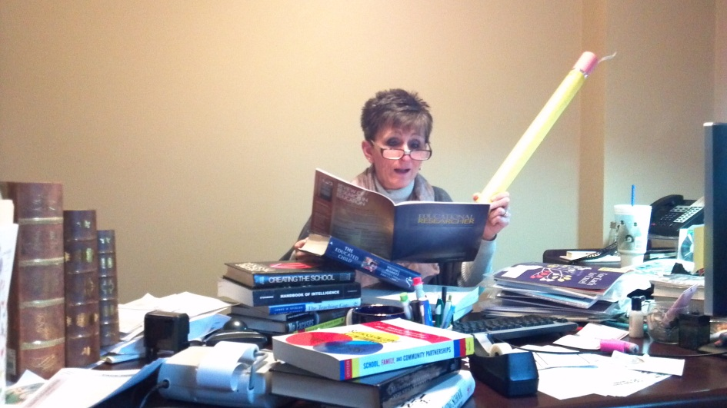
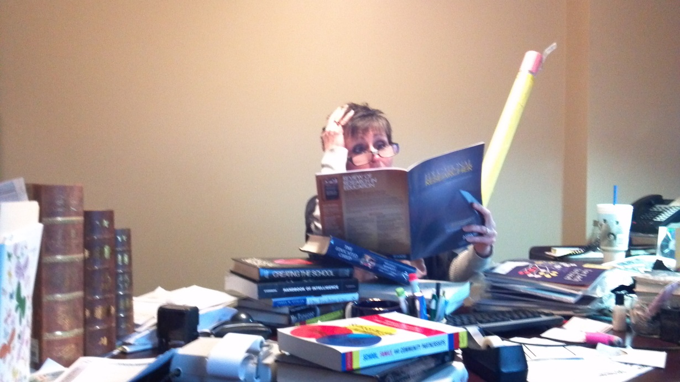
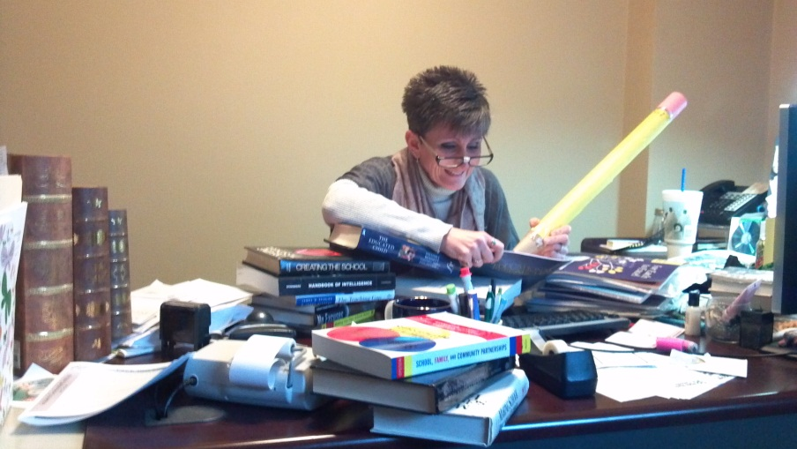
Where does the research come from?
How often is the research updated?
Can I send research to CII if I find something?
What are future areas of research focus?

Slide 14
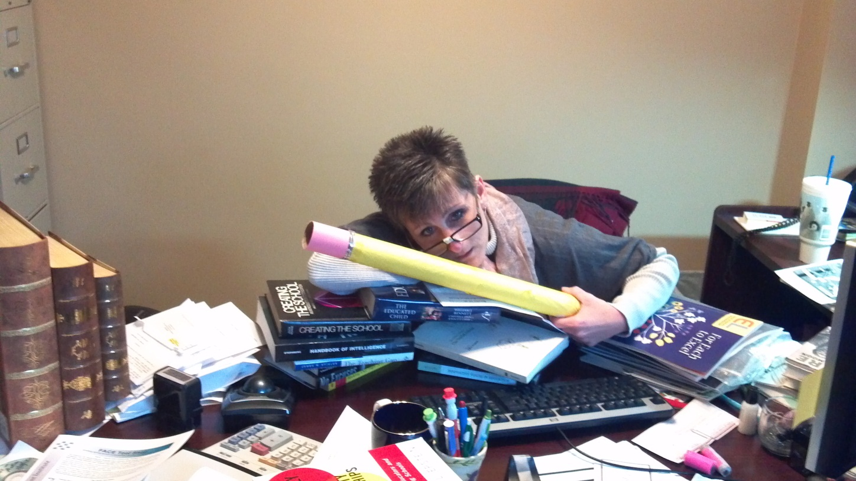
Questions

