Slide 1
How Education Line Offices Review School Forms Using... Reviewer Functionality
Sandra Poolaw – Education Program Specialist, Bureau of Indian Education

Slide 2
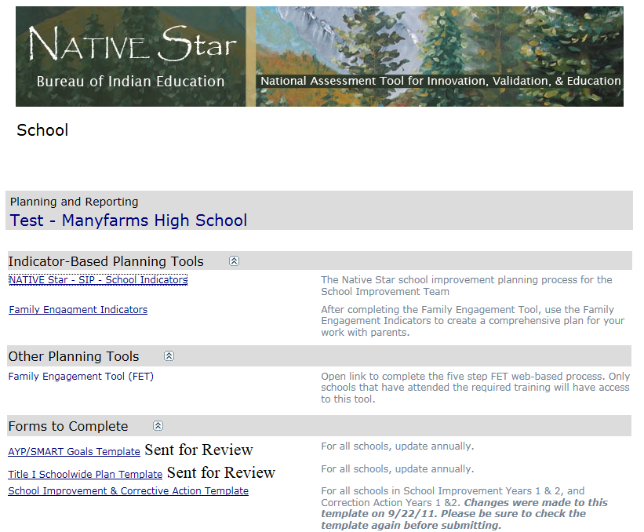
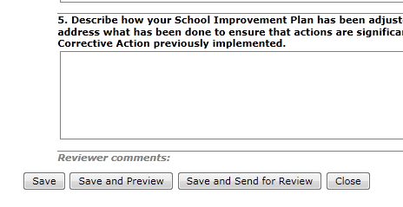
Schools complete forms and send for review.

Slide 3
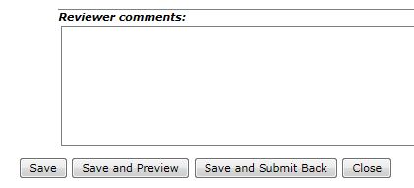
Education Line Offices review each of their schools forms right from the dashboard.

Slide 4
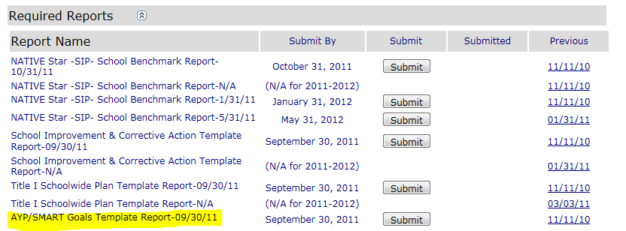
Forms can be reviewed, commented on and sent back to the schools for revision and/or submission.

