Slide 1
Reviewer

Slide 2
The Bureau of Indian Education (BIE)
There are 185 schools in the BIE system that are:
located on 63 reservations, and
in 23 states across the nation.
Of these schools:
60 are Bureau-operated
125 are tribally controlled
117 schools provide instructional programs,
56 provide instructional as well as boarding services; 7 of which are Off Reservation Boarding Schools (ORBS) that provide both instructional & boarding facilities to students from many different states.
12 peripheral dormitories provide only boarding services (these students attend the local public school).

Slide 3
The Bureau of Indian Education (BIE)
Unlike the majority of the states, the BIE school system is not organized into districts.
BIE funded schools are organized under 22 Education Line Offices or Agencies. The largest ELO/agency serves 17 schools, 10 of which provide boarding for students
Education Line Officers do not have the same line authority over the LEA/schools in their agency, as do district superintendents in the public school system

Slide 4
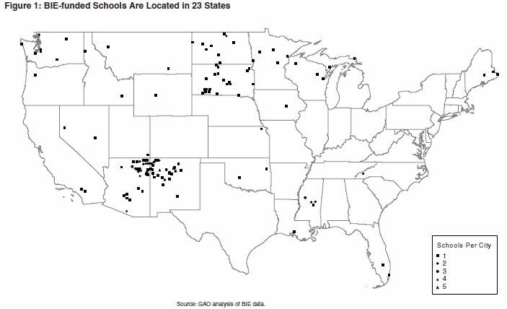
Beatrice Rafferty School Passamaquoddy Tribe
Quileute Tribal School
Miccosukee Tribal School
Sherman Indian High School
United States Accountability Office (June, 2008). Improving Interior’s Assistance Would Help Some Tribal Groups Implement
Academic Accountability Systems. Retrieved from http://www.gao.gov.

Slide 5
Native Star is A Systems Approach: The Ladder of Support
Student
Family
Peers
Teacher
Teacher Instruction Teams
Family Engagement Team
School Leadership Team (Native Star Team)
ELOs, Native Star Specialists, and School Boards
ADDs (DPA, Admin, & School Operations) and NS Core Leadership Team
BIE Central Administration

Slide 6
Levels of Access
Principal and Process Manager – Enter and edit information
Guest Login – Read-only school progress reports and plans
Education Line Officer (ELOs) and Native Star/Education Specialist
Read-only and enter coaching comments in school process
Enter and edit information in ELO process
Associate Deputy Directors (ADDs)
Read-only and enter coaching comments in ELO process
Read-only in school process
BIE Central Administration and DPA Native Star/Education Specialists
Read only in ELO and school processes

Slide 7
Coaching Reviews and Comments
The coaching review and comment feature was added to Native Star for very specific reasons.
Coaching reviews and coaching comments are a way provide specific comments to a school about the work it is doing relevant to Native Star.
Coaching Comments provide ongoing support through a commentary between the Native Star Specialist and the school.
The Coaching Reviews process was requested by Education Line Office staff to provide additional documentation for annual compliance

Slide 8
Coaching Reviews and Comments
Although the focus of the coaching reviews and the Review function were not meant for compliance purposes, its use has resulted in documentation for the annual reporting process

