Slide 1
Aligning Native Star (Indistar) with What Works to Turn Around Failing Schools
Indistar Summit, Biloxi Mississippi February 29, 2012
Dr. Joel D. Longie Director Academic Achievement Programs Bureau of Indian Education

Slide 2
Background
The Bureau of Indian Education manages 187 schools and dormitories, two federally operated post-secondary institutions, and 25 tribally controlled colleges and universities across 23 states and on or near 63 American Indian Reservations.
Similar to many state departments of education, we grapple with the challenges of helping schools attain Adequate Yearly Progress (AYP), including serving a student population for which the majority are economically-challenged, many have special needs, and a large number of students are categorized as limited English proficient.
2

Slide 3
Sense of Urgency 60% Percent of our Schools are in Restructuring
2/17/2012
BIE Math, Reads and FOCUS Institute
3

Slide 4
TIME IS OF THE ESSENCE… Student achievement, as measured under NCLB, is not keeping up with the rising academic standards.
For 2010-2011 Thirty-seven percent of Georgia schools failed to make AYP under NCLB.
For 2010-2011 sixty-nine percent of Bureau of Indian Education schools failed to make AYP under NCLB.
For 2010-2011 eighty-seven percent of New Mexico schools failed to meet AYP under NCLB.

Slide 5
What it Takes
Its really not a difficult activity that needs superior intelligence to do or understand. We can fix low performing schools. We can double student performance in our lowest performing schools and in the process take huge chunks out of the achievement gaps.
However, school turnaround is different than school improvement. An ELO, principal, and staff must create significant change and make tough decisions that may cause push back and strong resistance from all levels.
2/17/2012
.

Slide 6
Ten Core Elements to Turn Around BIE Schools
1. Sense of Urgency
2. Ambitious Goals
3. Aligned and Rigorous Curriculum
4. Student Assessment Data and Analysis
5. Effective Instructional Practices
6. Intensive and Ongoing Professional-Development
7. Effective School Leadership
8. Human Capital
9. Positive School Culture Focused on Achievement
10. Parental and Community Engagement

Slide 7
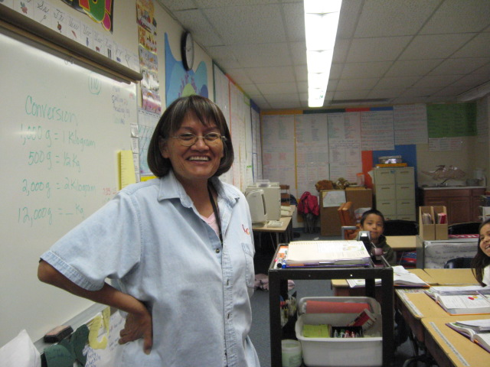
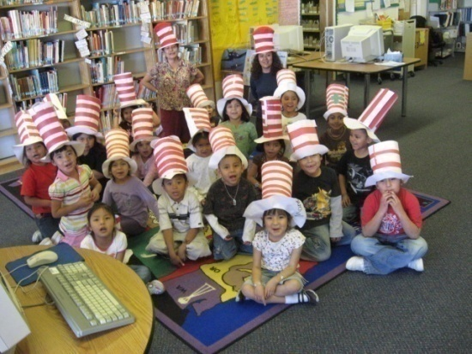
Native STAR
Ms. Evelyn John,
Teacher & Native Star
We have aligned these 10 core elements with the BIE’s Native STAR Indicators of Effective Practice for Education Line Offices.
Kindergarten TiisNazbas

Slide 8
Rigorous Goals

