Slide 1

Real Leading.
Real Teaching.
Real Learning.
On video. For you. To see.
Notes:
Before we dive into the demonstration of this tool, we wanted to give you a little bit of context for its development.

Slide 2
A Long History {briefly}
Maureen, I can’t get the text on here to animate, because it it w/in a smartArt Graphic.
Notes:
We promised to keep this brief, so we’ve distilled all of the work that CII and ADI and all of you have engaged in over the past couple of years into these milestone events:
The research on what makes a difference in teaching and learning and school improvement is investigated and combed
As a result, Sam & company isolate very specific detailed practices that will improvement school and student performance when implemented well
Sam includes these practices in the often-consulted {and award-winning?} Mega Systems Handbook
But there is greater vision for these Indicators and Indistar is developed– a school improvement planning tool that focuses teams on the indicators and their implementation
And then, Sam’s NEXT vision is pronounced

Slide 3

“We need a way to show what these things look like when they’re implemented well.”—Sam Redding

Slide 4
And that is exactly what we did.
{though no where near fast enough for you-know-who}
Notes:
Which brings us to where we are: Indicators in Action

Slide 5
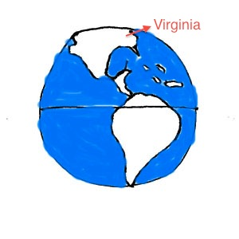
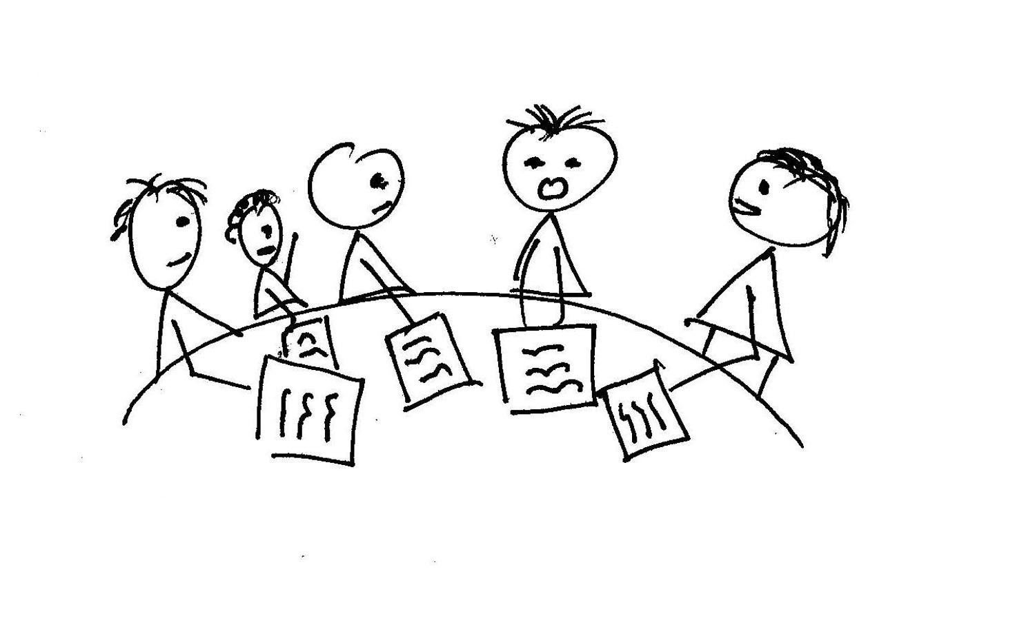
One Step Further {straight into the classroom}
INSERT VIDEO WHILE WE NARRATE (silent), starting with “went straight to the classroom—and used a rigorous process for selecting and identifying…”
Illinois
Notes:
Already, we’ve heard what kind of impact Indistar has had on your ability and capacity to support districts and schools in achieving and sustaining IMPROVEMENT.
But what if… we could take things just one step further, and give you and the teams and the leaders and the teachers who you are working with a place to see what many of the indicators look like IN ACTION.
We went straight to the classroom—teaching and learning—and used a rigorous process for selecting and identifying classrooms where these practices, these indicators of success, were happening.
Our good friend Virginia opened its door to us and we sent a team to videotape and interview over the course of two trips, several days each. We also used some existing footage that ADI had in its archives.

Slide 6
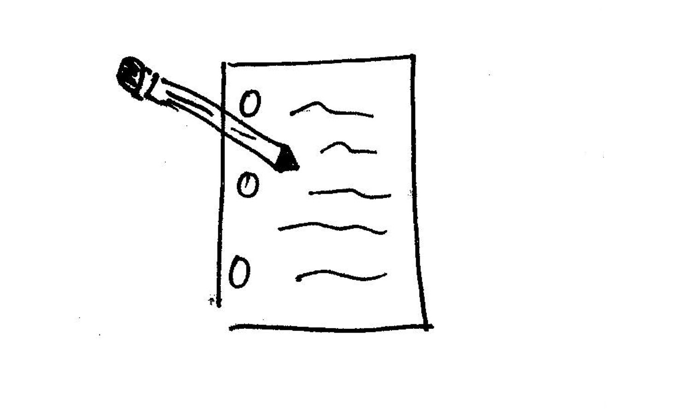


The Context {how the indicators work together}
Notes:
Simultaneous, we were writing. While several of these indicators stand alone, the power of them lies in their cohesion…all working together. So we knew this had to be more than a click and view kind of thing—although we have plans for that as well. So we gave them context, extracting from The Mega System and its references, to pull together a course of sorts—a place where users gain content knowledge and gain that visual impact.

Slide 7
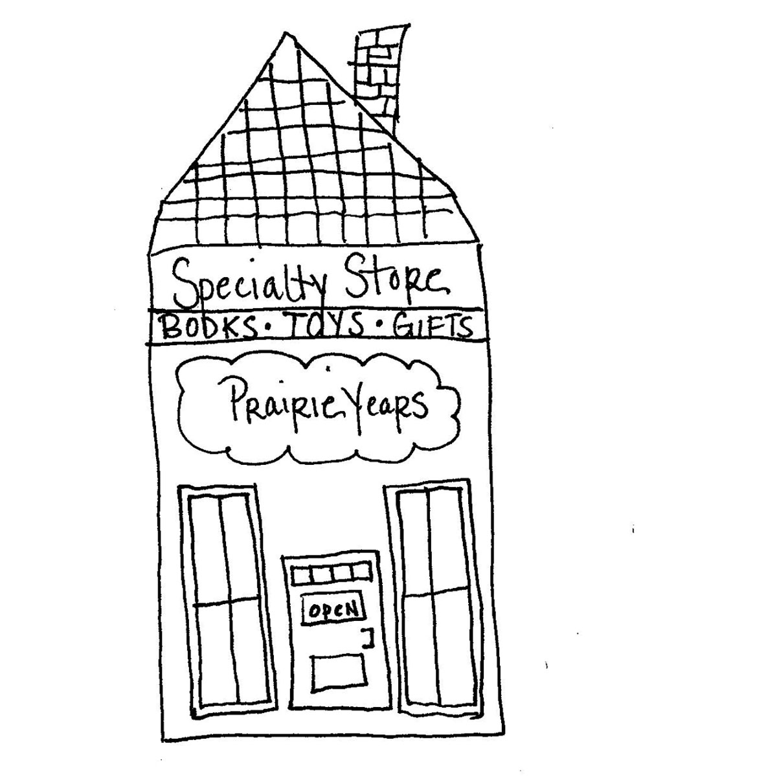

The Production {personalized and engaging}
Resemble anyone you know?
Notes:
Once we had the scripts and the footage, we worked hard to make sure it would be fun and easy to engage with. Design and technology is not anything we had much experience with, but boy, do we know more than we ever did before.

Slide 8
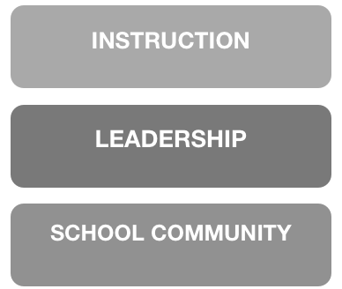
The Product {three courses}
Notes:
WHERE WE ARE
So what we are so excited to present you with today is the first of three Indicators in Action courses, INSTRUCTION. The other courses, Leadership and School Community are in production.

Slide 9
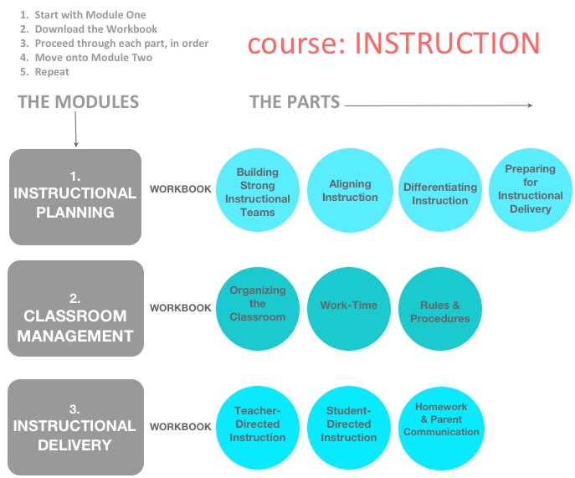
Notes:
INSTRUCTION is comprised of THREE MODULES—Instructional Planning, Classroom Management, and Instructional Delivery.
Accompanying each module is a workbook, which contains a print out version of the indicators that are covered, all of the tools and templates that are referenced, and some additional content.
Within each module, are individual parts. You’ll see that Instructional Planning includes four parts, Classroom and Instructional Delivery are each comprised of three parts.
There is definitely a sequence to this course, so you should start with module one, instructional planning, and move through each part in order. Then move onto module two, classroom management, and so on..

Slide 10
Access Modes {we made it easy}
The Web www.centerii.org/action
DVD’s
Flash Drives
Notes:
Now that we’ve reviewed how I in A was developed and how it is organized, let’s demonstrate it.
We’ve covered all of the bases when it comes to ensuring access--It is available on the web, we’re providing it on DVD’s and you will receive it on flash drives as well.
Let’s start at the website.

Slide 11
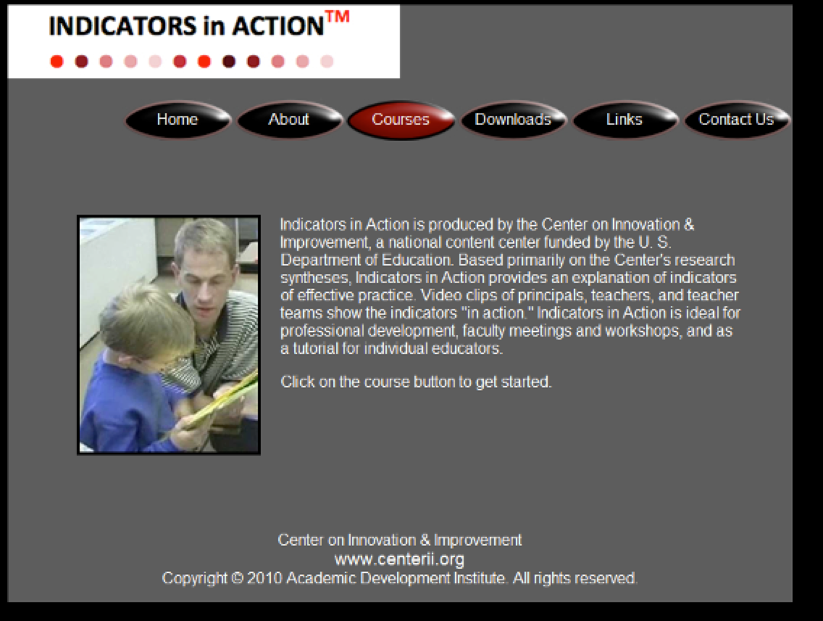
The Website {www.centerii.org/action}
Notes:
If we have live access, we won’t need this screen shot, just ability to go straight to the web…
This is what you’ll see when you come to the homepage.
We’ll point out a couple of the buttons now, the rest are pretty self-explanatory
Courses button will take you to the three courses, of which Instruction is up and ready to go.
Downloads button will take you to electronic versions of all the tools and templates that are references in the courses and their modules
We’re going to demonstrate a bit of Instructional Delivery for you now, so let’s return to the courses page and select “Instruction”
From there, we’ll select “Instructional Delivery”, and the part we’ll view is “teacher-directed instruction”
Now, for demonstration purposes we’re going against our recommendations for viewing, which is to view each module and each part in the order they are listed. So keep that in mind if this seems out of context.
(Rachel–you go ahead and select the module/parts/clips you think we should demonstrate…I just put in ID here because I like it best :)
So the first thing you’ll do is download the workbook. (CLICK ON TO SHOW WHAT WORKBOOK LOOKS LIKE)
Once you’ve downloaded the workbook, you’ll select the first part of the module…so we’ll select t-d instruction and again, for demo purposes, we’ll start here at slide xx

Slide 12

Stay in Touch {send us your feedback}
What works and what doesn’t?
How are you using it?
When and with whom does it work best?
What’s missing?
Notes:
Just like all things in education, we know there is room to continuously improve and make this product useful to you.
That’s why it is critical as you engage with this and use it, you provide us with your feedback, let us know how you’re using it, when it works best, what’s missing, and what else you need.
Sam wouldn’t have it any other way.

