Slide 1
Getting better together
Assessing the Indicators
(Click to begin module)
Notes:
Welcome to Getting Better Together – Assessing the Indicators Module

Slide 2
LEARNING TOGETHER
In this module we will learn how one Leadership Team—
Engages in the assessing an indicator process
Deconstructs the indicator language
Close reads a Wise Way
Models a culture of candor
Identifies the evidence present in a fully developed indicator

Slide 3
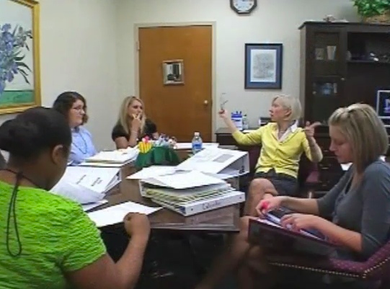
High Point Elementary School
Leadership Team members:
Principal
Indistar Process Manager
Teacher from each grade-level
Special Education Teacher
Counselor
Parent
Notes:
High Point Elementary is a schoolwide Title I building located in a suburban area. The school serves a diverse group of Pre-K through grade 3 students of who are 85% free and reduced lunch eligible. Its Leadership Team includes the school Principal, an Indistar Process Manager, a teacher representative from each grade level, a special education teacher, the school counselor, and a parent who is also a school board member. This is the Principal’s first year at the school, however, several members of the team were on the Leadership Team last year.

Slide 4
Review Data
Celebrate Improvements
Discuss Practices
Notes:
This year the High Point Leadership Team wants to assess some new indicators which may become new objectives in their school plan. Over the past month the Leadership Team conducted their annual needs assessment. They reviewed a variety of data and celebrated the improvements they made over the last year. They discussed several categories of Indicators to determine which of those effective practices may help address the areas which the data revealed could be strengthened.

Slide 5
Where are we now?
Research confirms:
Self-assessment can promote learner responsibility and independence
Self-assessment encourages a focus on process
Self-Assessment…the First Step toward Improvement
Notes:
The team began the first meeting of the year with a review …They discussed what it means to self assess their individual and collective practices.
Self assessment – it’s a noun – self assessment is an evaluation of oneself or one’s actions and attitudes, in particular, of one’s performance at a job or learning task considered in relation to an objective standard. In Indistar language, the standards are the success indicators of effective practice.
The research on self assessment confirms the following;
Self-assessment can promote learner responsibility and independence.
AND
Self-assessment encourages a focus on process, and so does Indistar. We acknowledge the tool is really cool, but it’s the PROCESS that is imperative!

Slide 6
When assessing an indicator, the Leadership Team :
Deconstructs the Indicator
Utilizes the Wise Ways research
Engages in a culture of candor
Acquires a deep understanding of the practice
Notes:
The team revisited these steps in the assessment process, in particular, to help the new principal understand the first and critically essential actions in the continuous improvement cycle.

Slide 7
First Steps – Deconstruct the Indicator Language and Close read the Wise way Research brief
Wise Ways…a built-in reference tool
provide a synthesis of the research…and real, how-to, high-leverage strategies for attaining full implementation
Notes:
The High Point Elementary Team revisited the benefits gained when every member deconstructs the indicator language and close reads the Wise Way Research brief prior to coming to the Leadership Team meeting. Those benefits include building a common understanding of and vocabulary for that effective practice. Doing so helps the team focus on “ways” to “wisely” strengthen and improve their current practices. In addition, the Wise Ways provide examples of evidence that will assist the team in determining if they are fully implementing the indicator or what they need to do to reach full implementation.

Slide 8
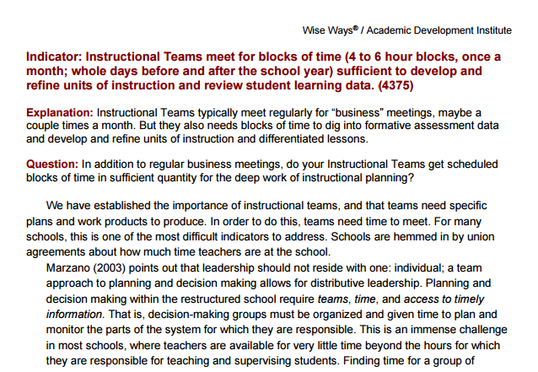
Activity 1a: Deconstruct the Indicator
Close read
Deconstruct
Encourages teams to measure practice
Common knowledge base
Click to restart after activity.
Notes:
15 - 20 Minutes – Deconstruct the Indicator Cloze Activity
Materials Needed – Activity 1A Handout
Remind participants that
the team members can access meeting agendas and WWs by using the Leadership Team login and password. If you do not have that, you can ask the team process manager or team leader.
the WW helps build a common knowledge base for the team.
the WW will equip the team with some basic background that enables them to measure their practice as no development, limited development or fully implemented.
team members, PRIOR to coming to the meeting, will “deconstruct the indicator” found at the top of every WW, and “close read” the brief with a pencil to annotate the words/phrases that impact their perceptions about how visible, and how well that indicator is practiced in their school/district.
when participants do this WW pre meeting work, assessing an indicator usually takes 15-20 minutes.
Now, as a group or individually, take 15-20 minutes to complete Activity 1A, and share out to check your understanding.
Presenter Tip - Have the CLOZE Activity with ANSWERS blown up on chart paper.

Slide 9
Activity 1b Your Turn to Deconstruct the Indicator and Close Read a Wise Way
Click to restart after activity.
Notes:
20 Minutes – Deconstruct the Indicator and Close Read a Wise Way
Materials Needed – Activity 1B Handout, pencil and highlighter
Alright, you have completed the CLOZE Activity which helped build your background on why and how to deconstruct an indicator.
In this activity, you will get a chance, using what you learned in the previous activity, to practice DECONSTRUCTING an indicator, and do a close read of the Wise Way research in which that indicator is couched.
When we teach students how to close read, we ask them to read with a pencil – to find impactful words and phrases and to use the margins to record their wonderings, observations, and reactions. Reading with a pencil to annotate text actually slows down our reading and inspires us to have an “in my own mind” conversation with the text. So, as you close read the WW, look at and beyond the literal meaning of the research – what does the research require and inspire us to do to bring that effective professional practice to full implementation?
In addition, close read to locate the types of evidence the research tell us will be present and observable in districts and schools that have fully implemented this indicator. Mark the evidence with a highlighter.

Slide 10
Notes:
This is the third year that High Point Elementary is engaged in a continuous improvement planning process supported by a full complement of research based effective practice indicators. The Leadership Team has learned to embrace and model a culture of candor when they meet. Doing so enables them to leave the blame game at the door and to direct a unified, laser focus on logical step by step solutions instead of the problems which confront them all.

Slide 11
Activity 2a Engaging in a Culture of Candor
“to get candor,
you reward it, praise it, and talk about it…
most of all you, yourself, demonstrate it” (Welch,2005)
Click to restart after activity.
Notes:
20 minutes
Materials – Activity 2A Handout - 6 TIPS for Creating a Culture of Candor
If working in a group, each of the 6 tips on the handout can be jig sawed out and each group can report out on the “gist” of each tip. If working individually, read each of the 6 tips and try to synthesize the gist of each tip. Lets take about 5 to 10 minutes to work through this activity and then we will take a few to report out.

Slide 12
Activity 2b - TELLING IT LIKE IT IS
PROS
CONS
Click to restart after activity.
Notes:
10 Minutes
Materials – Activity 2B Handout – T Chart
What might happen when you, in speaking with others are,…frank, open, honest, candid, truthful, sincere, forthright, direct, plain, blunt, straightforward?
With your tablemates or as an individual, take 5 to 10 minutes to complete the T Chart by generating a list of the pros and cons of telling it like it is.
Then take a few minutes to share out some responses with the larger group.

Slide 13
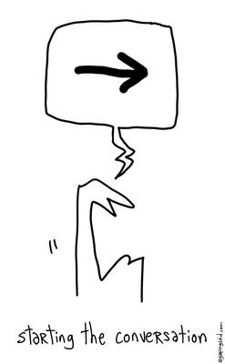
Now We’re Ready to Roll Up Our Sleeves
and start the improvement conversation
Notes:
The High Point Team understands the value of deconstructing the indicator, close reading the WWs and the importance of engaging in a culture of candor – hopefully, you do as well.
NOW they and we can roll up our sleeves and get to the work of assessing our professional practices against the research based indicators of effective practice.

Slide 14
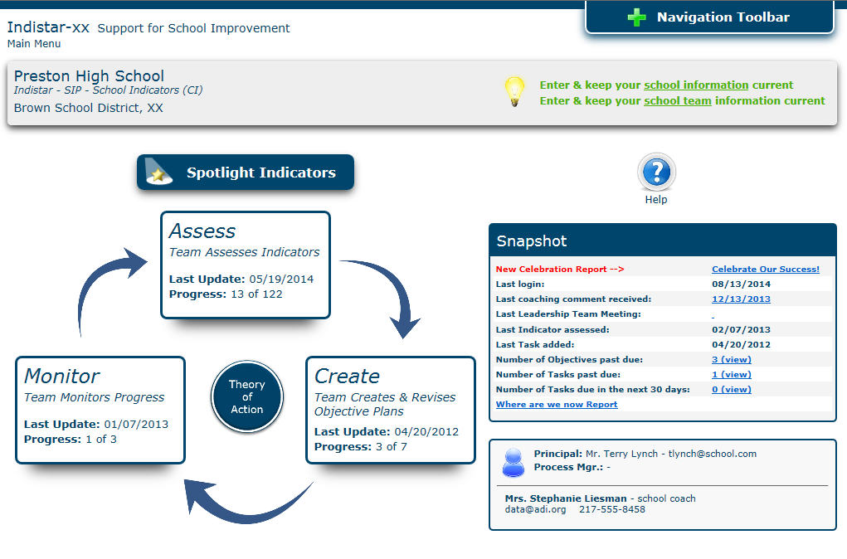
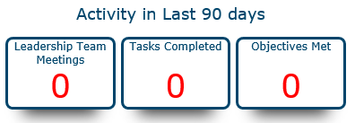
Teams can find indicators to assess here on the main menu.
Notes:
This is where the High Point Team begins and so will you and your team.
Take a moment to look at the icons and information on this screen shot.

Slide 15
The Leadership Team might ask themselves…
1
What instruments must be created to gather the data?
5
Who will make the data available?
6
What does it look like now?
4
How would we know the extent to which the indicator is implemented?
What data must be analyzed to determine the level of implementation?
What is the straight-forward, literal meaning and intent of the indicator?
2
3
Notes:
Look at the questions on this slide - The High Point Elementary Team asks these of themselves and your team might as well…
Remember
that the indicator language was broken down by each team member prior to coming to the meeting.
that during your close reading of the WW, you made annotations which identified impactful words and phrases.
that you began to think about the observable tangible evidence/data present in your settings that support your feelings about the level of indicator development – no development, limited development, or fully implemented.
Consider
how you will synthesize the evidence.
from whom will you need to obtain the evidence/data.
Summarize your current state of implementation as measured against the research in the WW.
Caution, there is a real temptation to begin planning for improvement here – but this is a just the facts, state of the union, condensed summary of your current practice.

Slide 16
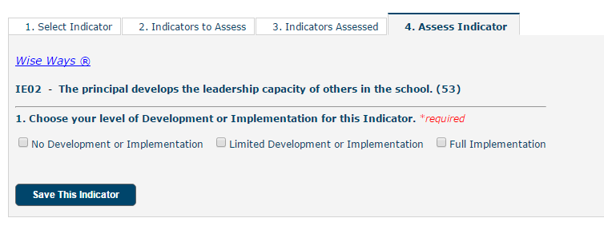
Assessing Indicators
Utilizing Wise Ways and candid conversations, teams will determine if indicators are:
Fully Implemented
Limited development
No development
Notes:
You will be asked to measure your current level of indicator development on a 3 choice meter. Your self assessment is rooted in the research and what you know to be true about their current practices.

Slide 17
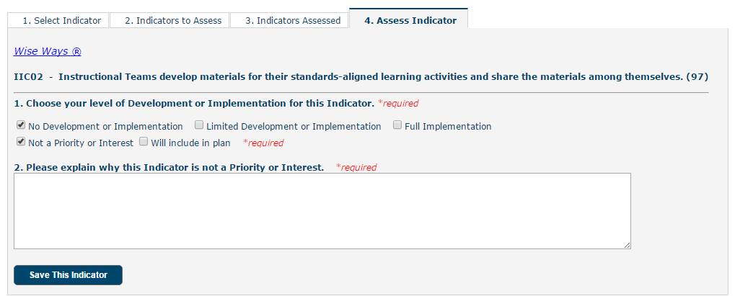
No Development or Implementation
If the team determines there is no development or implementation, it then decides if the indicator is:
not a priority (provide explanation why)
a priority and will be included in the school improvement plan.
Notes:
If after a candid discussion, you decide to choose an implementation level of NO DEVELOPMENT, the platform prompts you to decide whether or not that specific indicator is a priority for you to work on – if not a priority, an explanation of why its not a priority is required.

Slide 18
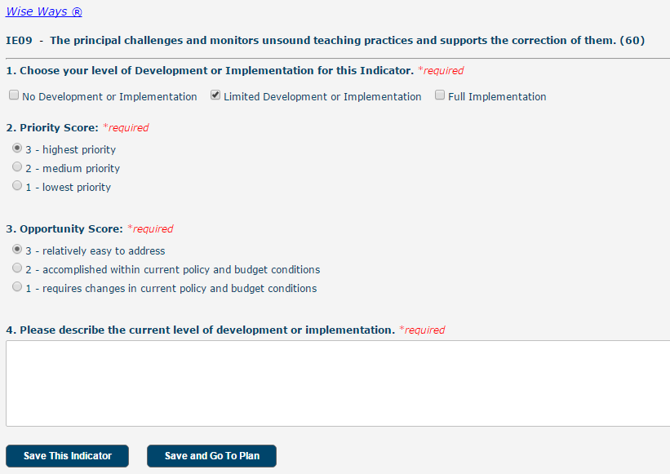
Will Include in Plan/Limited Development
If the team determines that it will include the indicator in their plan OR if the team assesses the indicator as Limited Development, then the team will determine:
Priority of the indicator
Opportunity to reach full implementation
Description of current implementation
Notes:
The Indistar platform calculates an Opportunity x Priority formula which results in an Index Score. The INDEX SCORE can help your team decide to which indicators you should devote your planning energies.

Slide 19
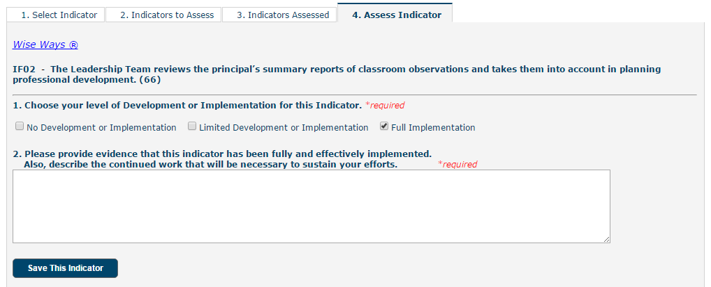
Full Implementation
If an indicator is determined to be fully implemented, the team must provide:
Evidence of full implementation
Description of sustainability efforts
*Indicators marked as fully implemented or not a priority will not move into the planning process.
Notes:
Being fully implemented at this stage of the process does not win anyone any extra points. In fact, if your team deems itself fully implemented on an indicator, it must provide reasonable and convincing evidence to prove full implementation. Full implementation DOES NOT suggest that your team never again engages with that indicator. In fact, teams must consistently monitor their progress gained and attained to ensure that growth is sustained over time.

Slide 20
Fully Implemented? Where’s the evidence?
Behavioral
Visible
Tangible
Click to restart after activity.
Notes:
Have the BEHAVIORAL,VISIBLE, TANGIBLE, appear AFTER the Table discussion.
Tell participants that
an assessed indicator that has been judged to be fully implemented MUST be supported by evidence.
2. Ask the participants to
turn and talk to an elbow partner or on your own, come to a consensus on a definition for evidence. (examples – obvious to the eye or mind, proof, truth, visible sign, confirmation, validation, documentation, corroboration)

Slide 21
Activity 3 Let’s Revisit the Wise Way
With your tablemates, use the Wise Way to generate a list of the visible, tangible and/or behavioral evidence needed in order to mark this indicator “fully implemented”.
Click to restart after activity.
Notes:
10 Minutes
Materials – Activity 1B Handout
Ask participants to
return to the WW they close read with annotations.
Ask them to
now engage in a discussion at your tables, or individually, revisit the WW used earlier in this module to determine what types of visible, tangible and/or behavioral evidence does the Wise Way say will be present if this indicator is judged to be fully implemented.
Look for examples – obvious to the eye or mind, provide proof, truth, look for visible signs, confirmation, validation, documentation, corroborating examples that would defend a fully implemented indicator.

Slide 22
What We Learned Together
In this module we learned how one Leadership Team—
Engaged in the assessing an indicator process
Deconstructed the indicator language
Close read a Wise Way
Modeled a culture of candor
Identified the evidence needed to declare an indicator fully developed

