Slide 1



Getting Better Together with Coaching

Slide 2
Learning Together
In this module, we will…
Examine the role of a coach in general
Examine the role of a coach in relation to district and school improvement
Examine the role of a coach for districts and schools using Indistar
Explore the Indistar online platform to see where a coach enters comments, reviews, or critiques
Explore the Indistar online platform to see where a coach finds information to review the work of the Leadership Team

Slide 3
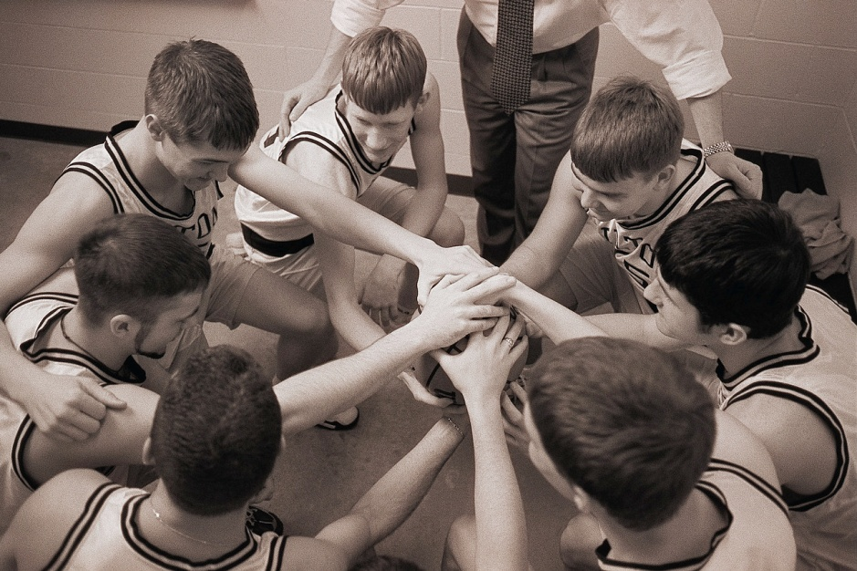
What is a coach?
Notes:
When someone says “coach” different images come to mind. A coach might mean an old fashioned means of transportation or a large, sleek modern bus line. A woman might immediately think of expensive purses and accessories. Someone who is sports-minded will think of a coach of his or her favorite team. Or someone might think of a life coach or counselor. While these are all correct, that is not the type of coach we are referring to. We are referring to a coach for a school or district. Even this statement needs clarification: we will not be addressing instructional coaches, although some of these principles may apply to instructional coaches. We are specifically referring to improvement coaches – those who work with Leadership teams in the overall improvement of the school or district.

Slide 4

Notes:
Okay –maybe you didn’t think this is a module to teach you how to coach basketball, however, I do want to emphasize that this is also not about instructional coaching. That is a valuable role for a coach to have in a school, but I want to be clear that this is about overall school or district improvement. The role of the coach in this context is to work closely with the Leadership Team to develop both a broad view of the performance of the school and a laser-like focus on the details that make a difference in student outcomes. Throughout the module, we will primarily discuss the school level, but everything that is discussed in this module can also be applied at the district level if you are working with a superintendent and the district Leadership Team.
So, in general broad strokes, what are some characteristics of this type of coach?
Robert Hargrove wrote, “A coach is someone who sees what others may not see through the high quality of his or her attention or listening; is in the position to step back (or invite participants to step back) from the situation so that they have enough distance from it to get some perspective – in other words – it will be the role of the coach to be able to get beyond the immediate details of what they think is going wrong and try to get them to think deeper or back out of the details in order to see a larger systemic issue; helps people see the difference between their intentions and their thinking or actions; and helps people cut through patterns of illusion and self-deception caused by defensive thinking and behavior.”
If you’ve been coaching in a school before, does any of this resonate with you?

Slide 5
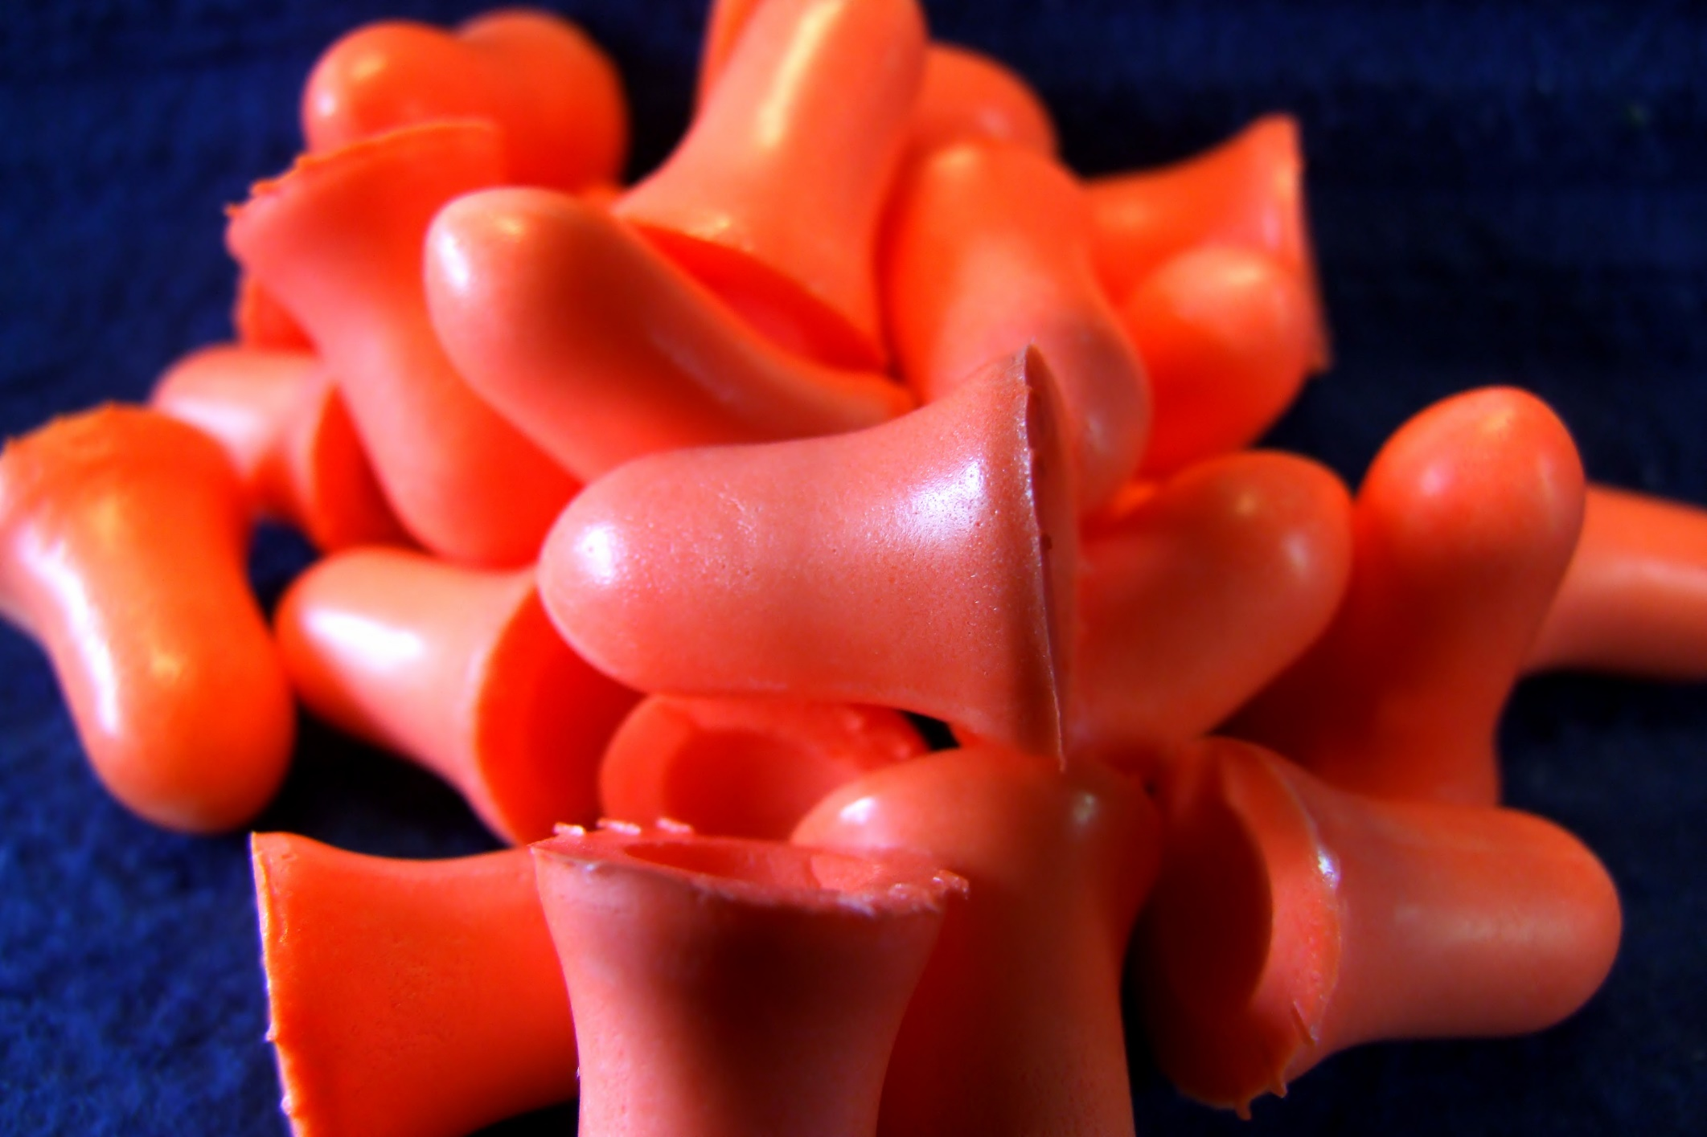

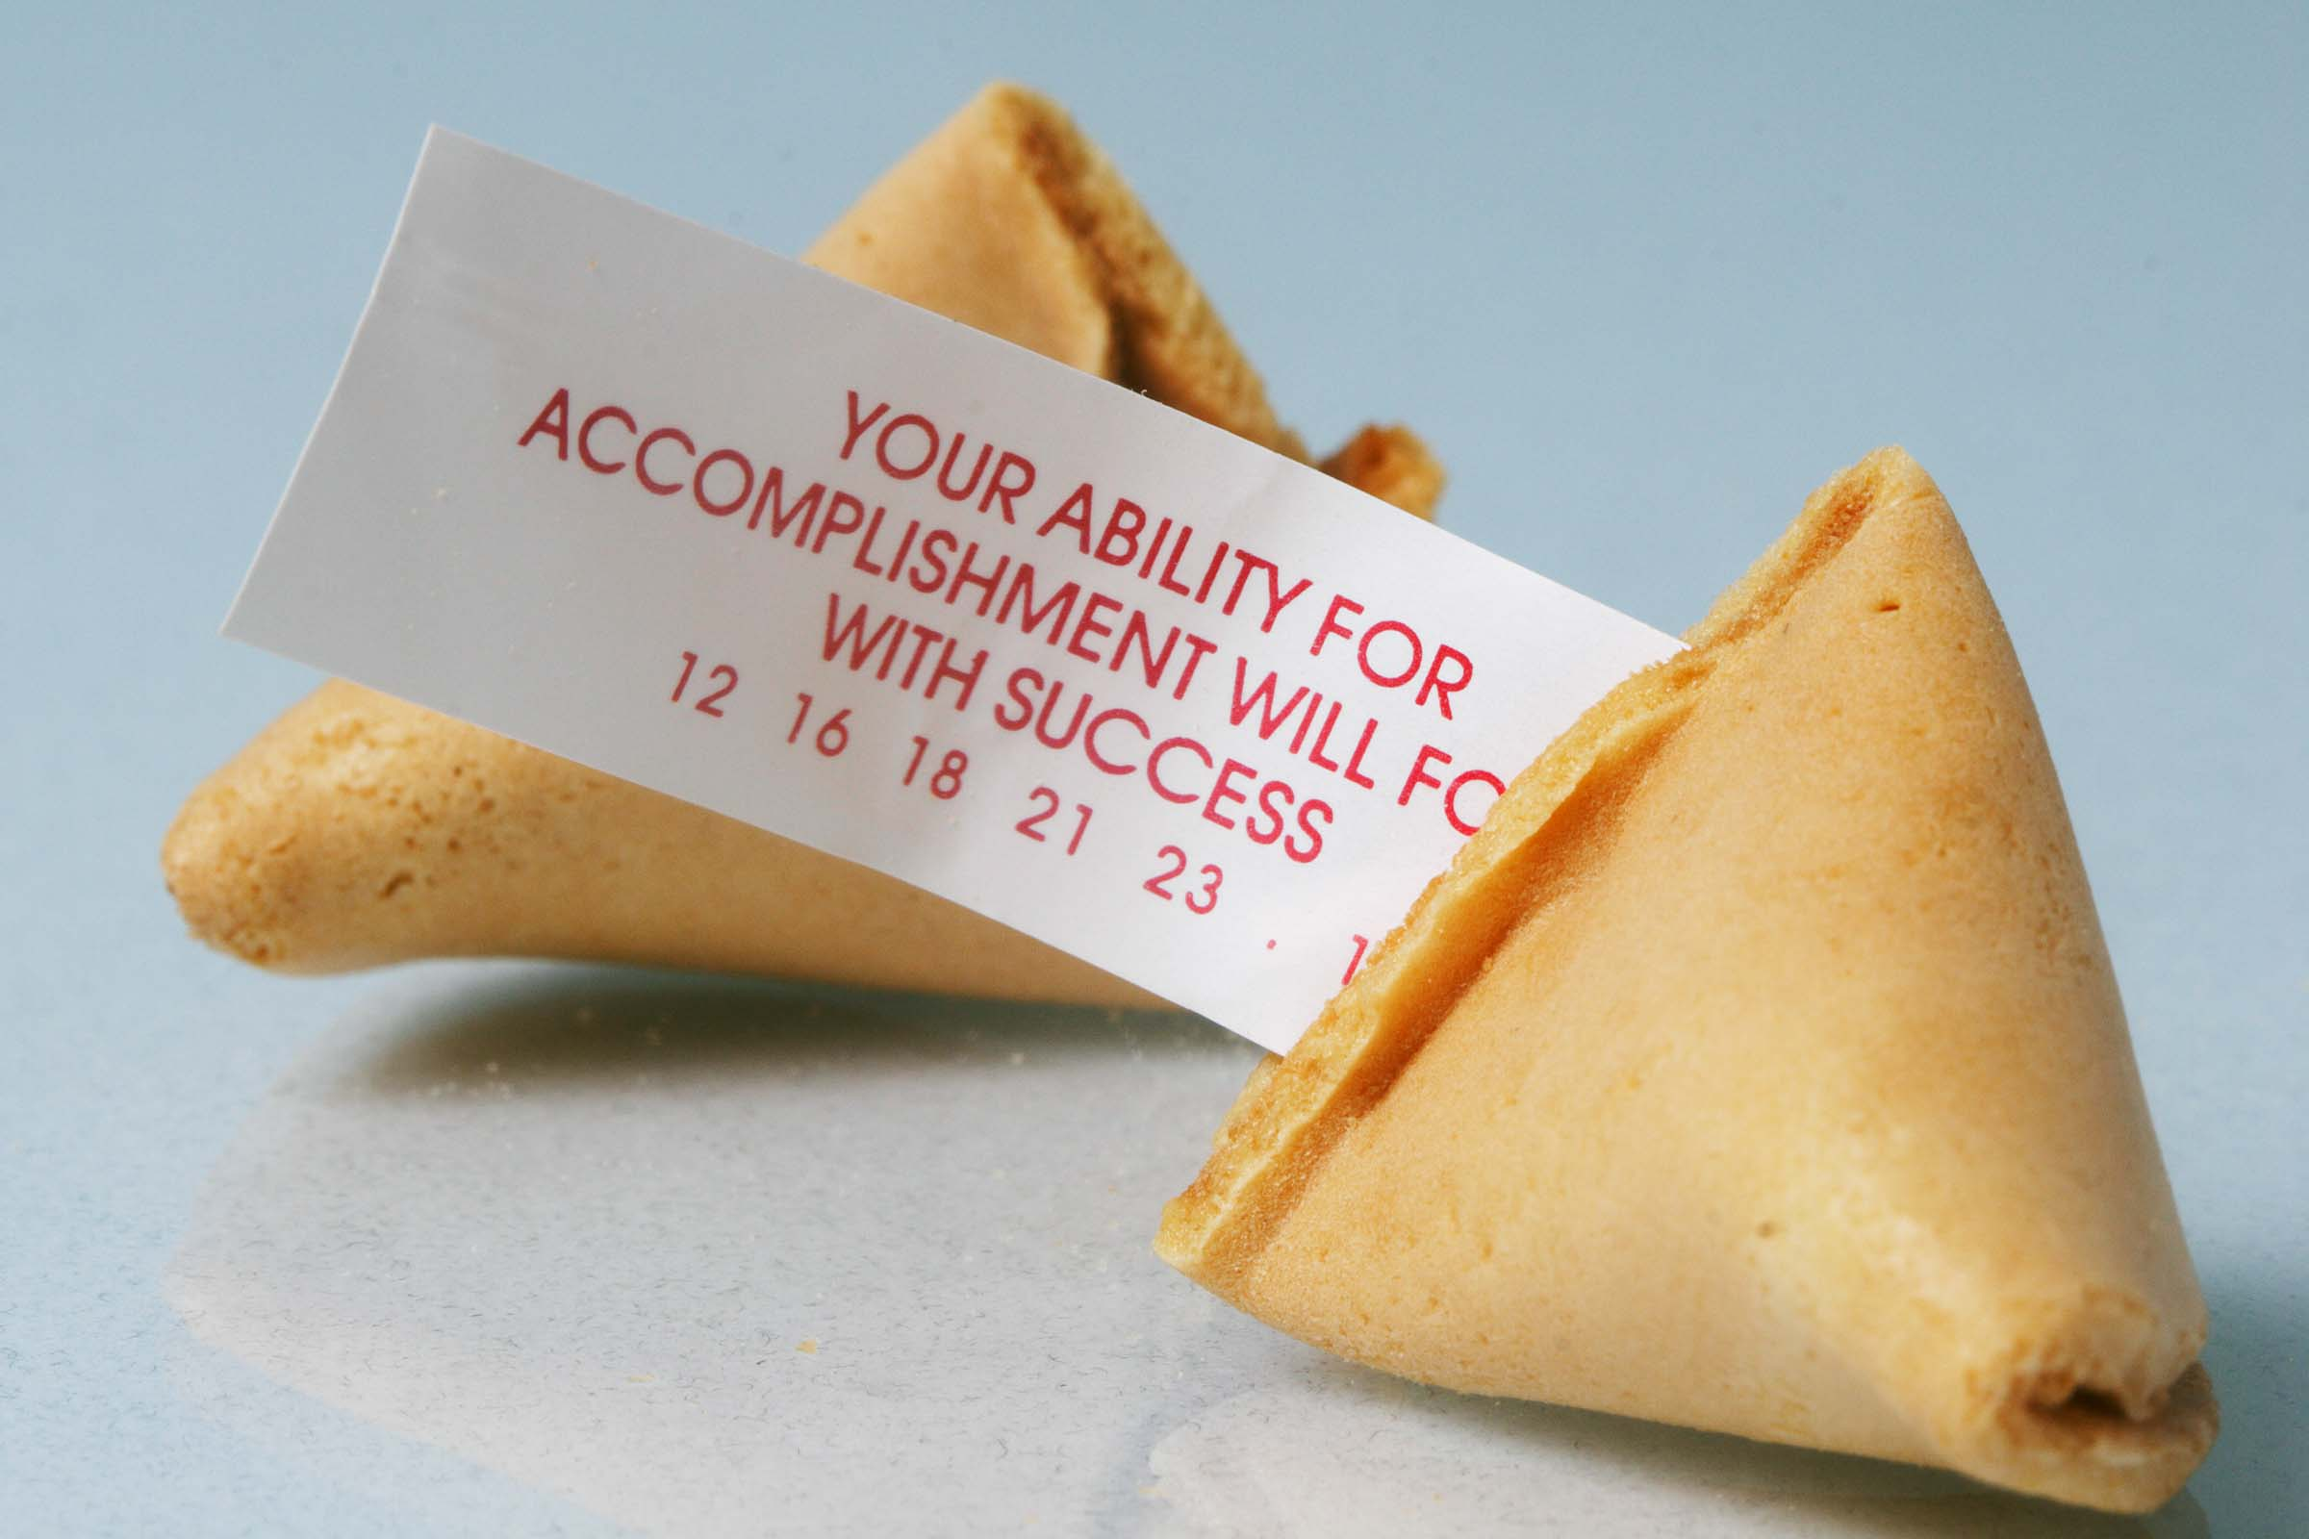
Notes:
If that didn’t, I know this quote from Blended Coaching will – “A coach is someone who tells you what you don’t want to hear so that you can see what you don’t want to see so that you can be what you’ve always wanted to be.”
Everyone has goals of where they want to be – and sometimes we fool ourselves into thinking we are closer to that goal than we really are – so the coach’s role is to keep that clear perspective and honest appraisal of where the team wants to go in relation to where it is now.

Slide 6

A coach is not necessarily an expert who trains others in a way of doing something; a coach helps build the capacity of others by facilitating their learning.
(Aguilar, E. The Art of Coaching, p. 19)
Notes:
Before you begin to back away and feel you aren’t qualified to coach thinking– I’ve never turned a school around before, consider this from the Art of Coaching – “A coach is not necessarily and expert who trains others in a way of doing something; a coach helps build the capacity of others by facilitating their learning.” We’ll talk about this more as we get into the specifics of coaching with indicators, but it is not the role of the coach to tell the team what to do. It is the role of the coach to take off either the rose colored glasses or the blinders to allow the team to see what they’ve not seen before, think deeper about what they are trying to accomplish and lead them to seeing a bigger picture of what they need to achieve.

Slide 7

Why you coach
The work of the coach is to make a difference for the students.
Notes:
And ultimately, it really is All about the students.

Slide 8
Activity
At your table or with a partner, think about this question and then discuss:
How do you see yourself, as a coach, supporting better outcomes for students?
Click to restart after activity

Slide 9
Coaching is about supporting through change. You can think of coaching as finding the perfect girdle: it gives a little pressure and a lot of support.
Notes:
Coaching a team through any change process—and school improvement is all about change – is a lot like finding the perfect girdle—although, I’m not sure girdles are worn much today! It gives a little pressure and a lot of support.

Slide 10

What is Coaching?
Coaching is a long, intimate conversation, a series of signals and responses that move toward a shared goal. A coach’s true skill consists not in some universally applicable wisdom that he can communicate to all, but rather in the supple ability to locate the sweet spot on the edge of each individual [learner’s] ability and to send the right signals to help the [learner] reach toward the right goal, over and over.
Notes:
So, how do you provide that pressure and support? Coaching is about establishing a relationship with that team. The relationship is built on trust—the team has to know that you have their best interest at heart, that you understand not only them as a team and individuals, but you understand the context and the story of their school. They have to know that you are as committed to the goal as they are and that you will follow through on what you say you will do.

Slide 11
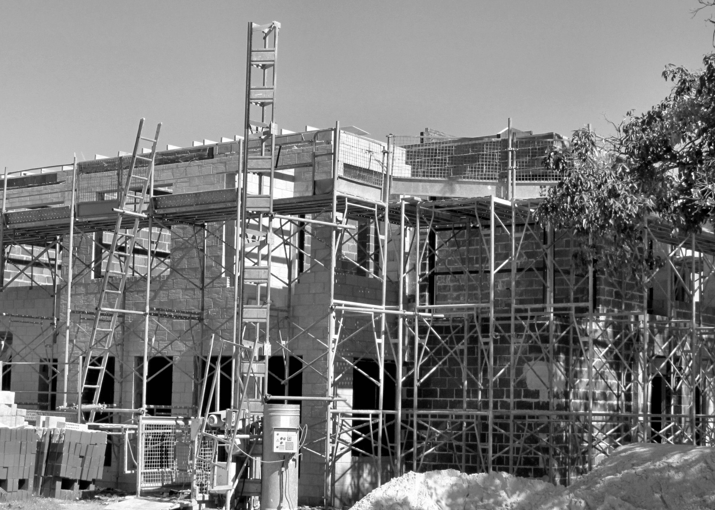
Coaching for school improvement
Notes:
Much like a teacher in the classroom who tries to find the “sweet spot” for their students, as a coach, you will be attempting to find the sweet spot for the Leadership Team. That sweet spot lies somewhere between the comfort zone and the fear factor. Think of scaffolding. Building on what they already know to reach greater heights. Think of the learner’s current level of understanding and mastery and then stretching the learner just enough to keep the task both challenging and attainable, and then upping the ante.
We learn best when engaged in the learning; engagement requires and appropriate level of challenge to sustain interest. We call this “deep practice.” Deep practice does not assume that the driver of success is innate talent, but success comes from the accumulation of small efforts, with scaffolding that moves the sweet spot as the team gains mastery. It is the place where we make mistakes, we self-correct, we move forward. The coach is the “eyes” that can keep the process moving because you can see the larger picture of where the school is going and where they need to be.

Slide 12


What Makes a Good Coach?
“The test of a good coach is that when they leave, others will carry on successfully.”
Author Unknown
Notes:
A good coach eventually, works him or herself out of a job. As you are working with the Leadership Team, you are not taking on responsibilities yourself, but you are leading, guiding, and ensuring that the team can face each of the challenges themselves. And as they gain success, you are celebrating and noting that the team grows stronger and more capable of seeing the things that you see, figuring out the direction they need to go. Think of parenting. As a parent, we encourage and prompt our child to ride a bike. At first, we put training wheels on so that no matter what – they can’t fail. As the child gains confidence and experience, we take the training wheels off, but we still hold on to the back of the seat and run along side him as he pedals…but suddenly, you realize that you can no longer keep up. Your child has taken off on his own and is navigating without you. We would never want to continue to try holding on to the back of the bike – just as we don’t need to hang on to coaching a team that has learned to navigate the school improvement process without your continued constant attention and guidance. Celebrate those moments! It means you have done your job well!

Slide 13
Activity: Important Qualities of a Coach...
Self-responsible and self-challenging
Good listener
Comfortable with discomfort
Willing to take risks and make mistakes
Good model for respect and partnership
Non-defensive
Continual learner
Ability to clarify vision and concepts
Consistent
Pioneering spirit and long-term perspective
Dialogues with colleagues
Encourages others
Facilitates involvement of others
Review the list. Decide which qualities you already possess and which qualities you feel you still need to improve.
Discuss with a partner one of your strengths and one of the areas in which you feel you can improve.
Click to restart after activity
Notes:
So, let’s get a little personal. What are some qualities that a good coach should have? Take a look at this list. We’re going to do a quick activity here. Review the list on your own. On a sheet of paper, create two columns. One the top of one column write: Qualities I have. On the top of the second column write: Qualities where I need improvement. Write down from this list where the qualities would go for you. Don’t worry – everyone has something they need to work on. When you are done, turn to a partner (if you are in a group) and pick one of your strengths and one of your weaknesses to share with the partner. Explain why you chose each of those items and placed them where you did.

Slide 14


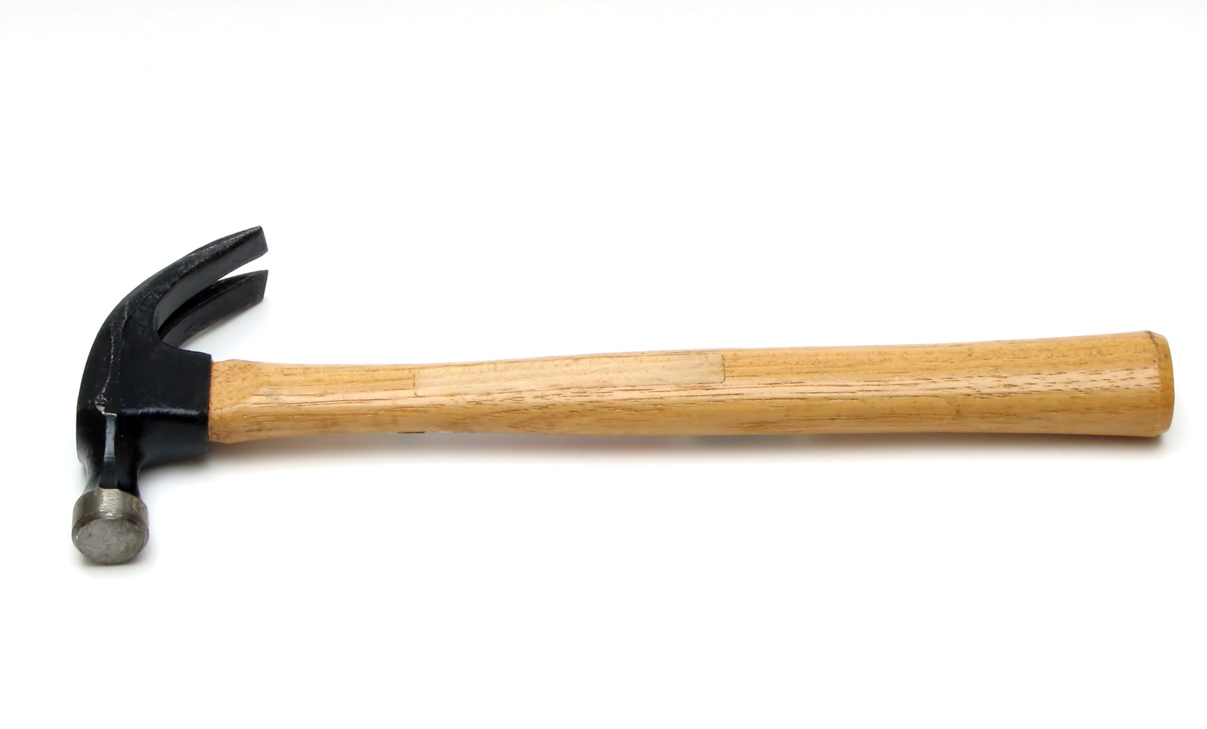
Perception
Notes:
One last note about the qualities of a coach and the relationship you build with a school. If you view the school or the team as “broken” or “needs fixing” then you are going to create a relationship that puts you in the role of a “fixer” and the team becomes defensive because someone from the outside is coming in and trying to “fix” them instead of work alongside of them. If you see your team as learners, then the relationship becomes one of support and mutual respect.

Slide 15
Coaching with Indicators: Role of a Coach…
The Coach’s role in an indicator-based, continuous improvement process is always to:
build the capacity of the district or school team to function within a culture of candor
help teams accurately determine the level of implementation of effective practices and provide sound evidence
strive toward universal and consistent practice.
Notes:
If your Leadership Team uses an indicator based approach, how does this change what you do?
The actual relationship you form with the team, the qualities you should possess—none of that changes. What does change is some of the specifics of coaching.
Okay – so here is a quick overview of the role of the coach for a team that uses an indicator-based approach. Doesn’t look much different from what we talked about before. That’s because it isn’t. The basic tenants of coaching is still the same. You are building the capacity of the team. You are guiding their conversations to be candid and open. You are helping them see a big picture of where they are and where they need to be. And you are guiding them toward improving their professional practices.

Slide 16

The Coach’s role
Build the capacity of the Leadership Team to drive improvement of their own school.
Help the school see the big picture.
Guide the small steps.
Celebrate “aha” moments and successes.
Challenge schools to do better.
Notes:
So, look through the following three slides and see if there is anything that you didn’t know before –
Building capacity.
Big picture.
Small steps towards big improvement.
Celebrate. Did we talk about that before? That’s important. You are going to recognize when something finally “clicks” with a team. And every opportunity to celebrate a success should be taken – schools have a lot of challenges. They need those moments to celebrate the things they are doing well.
Challenge the schools to do better. Even good schools have areas that can use some improvement. We can always do better until every single student is achieving all he or she can achieve.

Slide 17
Support the team in the process of assessing, planning, implementing, monitoring, and celebrating the plan.
Help the school understand the indicators.
Review the school plan.
Offer reminders and suggestions.
Make coaching comments.
Notes:
Support the team through the improvement cycle – and we will talk about this in more detail in just a little bit.
Help the school understand the indicators. As a coach, read through the list of indicators. See how they are organized. Which indicators naturally group together? What is the literal meaning of the indicator? How does the Wise Way (a short research brief attached to every indicator) support and define the indicator?
Review the work that team is putting in the system. You can’t be at every meeting, but you can see what the team decided to work on and how they are planning to work through an indicator.
Make coaching comments.
Okay – this was just the quick bullet points. We’ll go into more detail in just a minute.

Slide 18


Activity
At your table:
Draw what a coach is to a school
  Be creative. Think of analogies or metaphors. A coach is like. . .
  Examples:
A coach is like a ship captain because he steers the ship (leadership team) in the right direction, guides the ship (leadership team) through stormy seas (best laid plans), and protects the crew from pirates (day-to-day distractions) determined to impede the successful journey.
A coach is like a good running shoe because it provides adequate support, helps you get to the finish line faster, and protects against serious injury.
Click to restart after activity
Notes:
Okay – time to get a little creative to get those thinking juices flowing…and because I think you need a short break in all the lists.
Draw (don’t worry – you don’t have to be an artists) what you think a coach is to a school. Be creative. Think of a metaphor or analogy. A coach is like…
I’ve given you a couple of examples. Sorry if that is what you thought of and now you can’t use it!

Slide 19
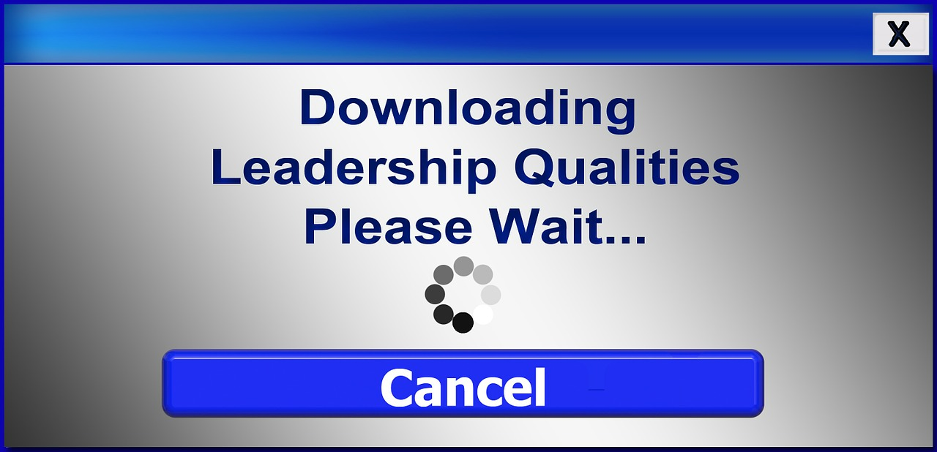
Now…About the leadership team
Principal
Team Member
Team
Member
Team
Member
Team
Member
Principal
Notes:
You might have noticed as we’ve gone through the presentation so far that I have been very careful to not say that you are working with the principal. Or, in the case of a district, the superintendent. Does that mean that you never speak to the principal or work directly with the principal? No. But, the majority of your work and effort is focused on the Leadership Team? Why is that? It isn’t because of the role of the principal isn’t important. It is. But, the principal, even a principal who has served the school for a long time and has no intention of leaving can’t do everything. There has to be a support team that works alongside the principal and helps to divide and conquer the work. And, for many schools, having a principal that stays more than a few years is a luxury. And for those schools, it is even more important for you to be building up the Leadership Team because that team must ensure that the good work that has been accomplished goes on with every change in administration.
In Indistar, we know that the Leadership Team is important. We have indicators about the structure and function of the team—and they usually come first. Without the team, change cannot happen.

Slide 20
Leadership Team Basics
Who is on the team?
Is the principal an active member of the team?
Is the team membership manageable?
Does the team meet twice a month?
Is the team meeting with agendas and minutes?
Notes:
How do you begin coaching a Leadership Team? There are some really basic items that are often overlooked. But, they can make or break a good Leadership Team. First – look to see who has been named to the Leadership Team. The principal should be an active member of the team. You can give feedback to the team on who is on it. Maybe you see that there is a large representation of primary grades, but not as many in the upper grades. Maybe they don’t include a special education representative, but there are large numbers of students in special education services.
How many people are on the team? While there is no “magic number” the team should include a good representation of the make-up of the school and should reflect the size of the school. However, even in a large school, I would not encourage teams to go much beyond 10-12 members. You want a strong core of people who are committed to attending every meeting and to the work.
Check to see if the team is meeting twice a month. How do you know? They should be entering their agendas and their minutes into the Indistar platform. If it isn’t recorded…it didn’t happen.

Slide 21
What else?
Check to see when the next meeting is being held.
Call the principal or process manager before the meeting to see if he/she has created an agenda and sent it out to all the team members.
Answer any questions he/she may have about the indicators the team will be addressing.
Remind the principal/process manager to print out the worksheets and Wise Ways.
Notes:
What else should you do—especially at the beginning of a new school year.
Check to see when the team is holding their next meeting. If you don’t see an agenda in Indistar, give the principal a call to see when the Leadership Team is meeting. Encourage them to set their meetings every two weeks for the entire year. It is too easy for meetings to become haphazard if they are not scheduled in advance.
Call the principal before the meeting to make sure an agenda was created and the Leadership Team was notified that they could find it on the Leadership Team page. If the principal has not already done so, he or she needs to share the login and password to the Leadership Team page with every team member.
If the principal has any questions in advance about the indicators the team will address, take time to answer questions.
And remind the principal that they can print out worksheets and Wise Ways in advance—however it is usually best to ask the team members to read the Wise Ways in advance of the meeting. They can also pull up Indistar right in the meeting if they have a process manager who is not afraid of technology.

Slide 22
Afterwards…
If you are able to attend the team meeting, observe who is there and how they function as a team. Does everyone speak? Is every opinion considered? Is there a culture of candor?
If you are unable to attend the meeting, call afterwards to remind the process manager or principal to enter their meeting minutes into the system as well as their work on the indicators.
Review the work.
Make timely coaching comments.
Notes:
If you are able to attend the first Leadership Team meeting – great! That will give you a lot of insight on the members of the team and how they function. If you see that they are struggling with how to function as a team, suggest to them that they go through Module 3: Getting Better in Teams to help them function as a well-oiled Leadership Team. They could go through it together at the next team meeting.
If you are unable to attend the meeting, that is okay as well. That is the beauty of Indistar. It allows you to see what took place in the meeting without actually being there. Check to see if the team has recorded the minutes of the meeting and planned the next meeting. See who was in attendance. Keep note of any members of the Leadership Team that are consistently absent. If there are members who do not show up, then maybe it is time to replace them.
Review the work they put in Indistar on the indicators. Which ones did they assess? How did they assess them?
Make coaching comments.
Okay – that is how you can get started coaching the team in Indistar. Now we’ll go into some of the specifics about the real work of the team – assessing, planning, implementing and monitoring their work on the indicators.

Slide 23

Reviewing the work of the team: A high quality plan
Is the link between two critical points: 1) where we are now, and 2) where we want to be.
A high quality plan also depends on a high quality planning process.
Where you are
Where you are going
Notes:
We’re going to go through the heart of Indistar and the heart of any improvement process. After we go through the cycle of assessing, planning, implementing, and monitoring, we’ll go through some examples of coaching comments, walk you through where you go in Indistar to put in coaching comments, reviews, and critiques and where to find all the information you’ll need to follow the work of the team you are coaching. So hang on – we’ve got a lot to cover without trying to overwhelm you.

Slide 24
Capacity of Leadership Team
Assessment of Indicators
Creation of Plans
Monitoring Progress
Review of Plans
A High Quality Planning Process
Notes:
You may have seen this cycle before. In any improvement process, the cycle follows the same route – and it is a continuous process. One of the differences between Indistar and the old way of doing school improvement plans is that it is a continuous process. When you get through one indicator, you keep working on another. After an indicator has been completed, a team can cycle back through the indicators again after a period of time to see if they are still fully implemented or if it needs to be addressed again. Schools can always get better—even if they feel they are doing pretty well.
So, in the cycle, the Leadership Team in every conversation and every action, they are building capacity. They assess the indicators candidly using the Wise Ways for guidance. They create plans for the indicators they feel they need to improve. They work through the plans, monitoring their progress along the way. They review their plans to see if they need to create more tasks or if they have reached full implementation. And with every indicator they complete, they’ve built their capacity to take on more. A continuous cycle.

Slide 25
How the coach fits in
Provide guidance; Offer resources; review meeting minutes
Capacity of Leadership Team
Assessment of Indicators
Creation of Plans
Monitoring Progress
Review of Plans
Coaching comments, coaching comments, coaching comments!
Explain indicators; Challenge schools to “think deeper”
A High Quality Planning Process
Provide encouragement; Celebrate successes
Assist in task creation; Provide guidance on reality; Offer resources
Notes:
So, what is the role of the coach in this cycle? Keep the team on track. Make sure they are meeting. Review their work. Offer guidance on what the indicators really mean. Encourage the team to dig deeper. Look over the tasks. Be the outside lens. Encourage them to keep moving forward. And give comments.
So, lets take a closer look at each of the main components of the cycle and some specifics about how you support the team.

Slide 26
Coaching Comments about Assessment of Indicators
Limited Development or Implementation
Please describe the current level of development or implementation
Full Implementation
Please provide evidence that this indicators has been fully and effectively implemented. Also, describe the continued work that will be necessary to sustain your efforts.
Notes:
Assessment of the indicators is the first part of the cycle. The team has a choice – are they doing it or are they not?

Slide 27
Coaching comments about assessment
Limited Development
Did the school rank the indicators as a priority?
Did the school give an explanation of what they are currently doing so they know how to build from where they are to where they need to be?
Full Implementation
Is there evidence that the school’s response is…
  Aligned with the Indicator
  Comprehensible
  Sufficient in Detail
Notes:
Review how the team assessed themselves on the indicators.
If they chose limited development, did they give a good description of where they are currently?
How did they rank the priority and opportunity?
Did the team decide the indicator was fully implemented?
What evidence did they give?

Slide 28
Activity
At your table or with a partner
Read Scenario 1
Read the Wise Way for this activity
Compose a coaching comment for the school’s assessment of the indicator and evidence given.
Click to restart after activity

Slide 29

Coaching through the planning phase
finish
start
Notes:
While it is important for a Leadership Team to fully understand the indicator and to assess their school in a candid manner (no brownie points for saying they are doing everything well!), the real work of the Leadership Team and where you will put your coaching skills to work is in the planning and implementation of the plan. Look closely at how the team said an indicator turned into an objective will look when it is fully implemented in their school. While this may seem like a small part of the total process, it is really the heart of planning. You can’t figure out how to get somewhere if you don’t know what the final destination is. Take any objective. The team made it a priority by saying they are going to create tasks to work toward full implementation, so it is important. Did they take the time to fully visualize what it would look like if it was happening on a consistent, regular basis – with quality – in their school? Is the statement personal? Does it reflect the vision and mission of the school? Is their vision in line with what the Wise Ways say effective schools do?

Slide 30
Do’s and Don’ts to look for in Tasks
Let’s build a list that we can all use
Sequential
Specific and practical
Steps that build the understanding and capacity of people to demonstrate full implementation
Steps to gather the data needed to know that the objective has been met
Notes:
Next, look at the tasks the team has created. You know where the Team is starting – you read that in Assess: What it looks like currently in your school. That is the starting point for the team to work from. You know where the school is headed – the final goal because you’ve read it in the What it will look like when fully implemented. Start and End. Now, look at the tasks. Using common sense and an outside view, will the tasks created get the team from where they are to where they want to be? Sometimes a team will create part of the plan to get a start, but may not be able to create the whole plan because they want to see where they are when some of the tasks are completed. They calibrate after a little experience. Other teams may put random tasks of effort into the system, but have no real clue on how to get from start to finish. That is where the coach is a valuable outside lens. There are some very practical guidelines when looking at tasks.
Are they sequential?
Are they specific and practical?
Do they build the understanding and capacity of the staff to work toward full implementation?
Do they include tasks to gather the evidence needed to support full implementation?

Slide 31
More Do’s and Don’ts
What to look out for:
AND
All tasks assigned to one person
Tasks that encompass a whole school improvement plan
What else do we need to include in our list of what to look for in a task?
Notes:
Does a single task encompass more than one step in the process (are there a lot of ANDS)
Are the tasks assigned to all one person – especially be wary of everything assigned to the principal
Does one task try to encompass the entire school improvement plan?

Slide 32
Activity
At your table or with a partner, think of a few more “do’s and don’ts” to be aware of as you review tasks that are written as part of a team’s plan for an objective. Remember, be specific.
Click to restart after activity
Notes:
Think of a few other “warning” don’ts and “good job” do’s that we can add to this list.

Slide 33


Evidence and Sustainability
Notes:
Once the team works through all the tasks they’ve created for an objective, they have to decide if it is fully implemented. They can decide that it isn’t – there aren’t any penalties for saying it isn’t quite there yet and the team needs to go back and add tasks. Applaud their candor and tenacity in wanting to get it right. But, if the team decides it is fully implemented, then they should have been collecting their evidence along the way. The evidence should be clear, and should prove to themselves and the stakeholders in their school community that they are fully implemented. Read over their evidence. Does it support the objective? Does it match what they said when they began their plan that it would look like when fully implemented with quality in their school? Beware of evidence that says…we will. That suggests that they did not fully complete the objective. The only place future tense should be found is in how they plan to sustain the objective. If the school has completed the objective with quality remind them to celebrate!

Slide 34
Forms of communication
1. Coaching comments/reviews are a way for the coach to, very specifically, comment to a district or school Leadership Team about the work they are doing relevant to the indicators in Indistar.
2. Coaching comments/reviews are a running commentary between the coach and the Leadership Team.
3. Coaching comments/review that are stored within Indistar are a history of where the district/school has been and where it is going that new members of the team, a new principal, or a new coach can review to catch up very quickly on what has happened in the past and what direction the team is headed in.
4. Coaching comments/review are viewable by the WHOLE Leadership Team where a phone call, a site visit conversation, or an email are typically directed to one person.
Notes:
It is tempting at this point to give all the reasons why a coach doesn’t really need to put coaching comments into Indistar. Perhaps you visit the school on a regular basis and have a good relationship with the principal. Maybe you call often and talk to the principal. You might even say that you email on a regular basis. However, the coaching feature of Indistar was added for very specific reasons:
Coaching comments given within Indistar are a way for the coach to, very specifically, comment to the team about the work they are doing relative to the indicators.
Coaching comments given within Indistar are a running commentary/conversation between the coach and the Leadership Team.
Coaching comments that are recorded within Indistar create a history of where the team has been and where it is going so that new members of the team or a new principal or a new coach can review the comments and catch up very quickly on what has happened in the past and what direction the team is headed in.
Coaching comments within Indistar are viewable by the WHOLE Leadership Team where a phone call, a site visit conversation, or an email are typically directed to one person – and once that person is gone, the emails disappear with him or her.

Slide 35
From “Coaching with indicators”
The Coach interfaces with a Leadership Team in many ways—meeting onsite for consultation, meeting via conference call or webinar, talking individually with the principal and other staff, and sending emails. But coaching comments embedded in the Indistar system provides a means for documenting key points of advice and congratulation—always with specific reference to the indicator and the team’s work. The coaching comments allow the team to respond with its own questions and clarifications, and the dialogue between Coach and team is maintained. This provides a rich tracking of the thinking of the coach and the team, and is useful in future work and in cases where a new Coach or new team members may come on the scene. Also, the Coach periodically conducts a more thorough review, using the Coach’s Review feature and examining a variety of reports conveniently provided.” (Sam Redding)

Slide 36




Structuring the dialogue
Length
Timeliness
Tone
Use of bulletin board vs. coaching comments
Notes:
Now that we’ve talked about the improvement cycle and your role in coaching through that cycle, we want to talk about the specifics of the comments you create. You don’t have to be an J. K. Rowlins or a William Faulkner to write good comments, but there are some tips we can provide to help you craft comments that are well received and serve the team well.
Here are a few general tips:
Beware of two pitfalls in the length of the comment: The comment that is too brief (Hey, that was great!) and the comment that is too long. You want to give enough information in your comment that it benefits the team. It gives them something concrete to work on. It gives them specifics so they know exactly what you mean. However, writing the first chapter in your novel is not appropriate either. Keep your comments succinct and to the point. You will have other opportunities to give them more feedback – you don’t have to do it all in one comment.
Timeliness – Think of a project you’ve worked on. Maybe it took weeks. Maybe it took months. Imagine finishing the project and 2 months later receiving a comment from your boss that the project was done incorrectly. Now what do you do? What if you had received feedback during the planning phase of the project? How about while you were implementing the project? Feedback that is given as soon as possible is going to be of value to a team. Feedback given months later? Not so much.
Always be aware of the tone of your writing. Keep in mind that the team, when reading your comments, cannot see your face or hear the tone of your voice. Maybe you put in a comment that you meant as a joke, but when it was read by the team, they did not get your joking tone. Keep your comments as clear as possible. If you are unsure, have someone else read your comment before you hit the save button.
One last general comment, if you need to remind your team of due dates or other “business” types of reminders, use the bulletin board feature. Keep the coaching comments related to the work in the indicators.

Slide 37
Dialogue components
Encouragement
  Positive , specific, aligned to indicator or over-all work
Push-back
  Suggestion for improvement and challenging in a supportive way
Ask Questions
  Prompts that guide discussion toward improvement
Explanations and Guidance
  Pointing out errors and redirecting
Next Steps
  The coach probes, nudges, questions, applies “strategic impatience” to guide the learner in the productive direction toward the goal
Notes:
So, how can you craft a coaching comment that conveys exactly what you want to say and directs a team to improvement? There are some components that can be a part of every coaching comment.
Encouragement or a positive statement. Look at the work of the team and find some area they are doing very well. Give very specific praise.
Push-back – or helping them with deep practice. Give some suggestions for ways they can delve a little deeper. Challenge the team in a supportive way.
Ask questions that cause them to think.
Give any explanations or guidance you feel would benefit the team. Maybe it is clear there was something in the indicator they didn’t quite understand.
Suggest some next steps for the team that you can review after their next team meeting.

Slide 38

Encouragement
Three qualities for appreciation to count 1) it must be specific; 2) it should be delivered in a way the receiver values and will understand; 3) it must be authentic.
(Stone & Heen, Thanks for the Feedback, p. 38)
Notes:
Keep in mind that just throwing out a “way to go” comment isn’t helpful to the team at all. While every team craves praise, they want to know that they earned it and why and how they earned it. They can’t build on success if they don’t know what they did successfully.

Slide 39

Push-back
Feedback needs to include where it comes from (from what are you drawing your conclusions) and where it is going (what do they need to do with the feedback).
(Stone & Heen, Thanks for the Feedback, p. 57)
Notes:
Only giving praise will eventually ring hollow. Teams are strong. They don’t want to just know what is going right. They want to know where they need to improve. Your main purpose of being involved with the Leadership Team is to challenge them to GET BETTER. You aren’t there to be a cheerleader – although you should praise when appropriate. You are there to be a coach – and a coach challenges. Pushes back. Points out errors in thinking. Creates stronger, smarter, more efficient teams.

Slide 40

Notes:
Each form of feedback – appreciation, coaching, and evaluation – satisfies a different set of human needs. We need evaluation to know where we stand, to set expectations, to feel reassured or secure. We need coaching to accelerate learning, to focus our time and energy where it really matters, and to keep our relationships healthy and functioning. And we need appreciation if all the sweat and tears we put into our jobs and our relationships are going to feel worthwhile.
(Stone and Heen, Thanks for the Feedback, p. 35)

Slide 41
Helpful tips on writing comments
It is descriptive rather than evaluative.
It is specific rather than general. (The team obviously put a lot of thought into indicator IIA01—your tasks for implementing seem right on target. Vs You are doing great!)
Notes:
So, here are just some general suggestions when writing comments. You might want to create a little “cheat sheet” to keep on your desk as you start writing your comments—a kind of rubric for you to evaluate your own comments. You can write down both the components of the comment – praise, push-back, questions, explanations, and next steps and then also this short list to check yourself against. Think in your mind, Is my comment…and then look over this list. Is it descriptive?
Is it specific?

Slide 42
It is directed toward behavior or circumstances the receiver can do something about. (You’ll have to have a bigger budget to complete that task. Vs Let’s work together to come up with some creative solutions to finding more time in the calendar for meetings.)
It is well-timed. (Think of projects you have worked on. Is it better to get feedback right away or 3 months later?)
It is clear.
It is direct.
It is free from jargon.
Avoid language that might be okay in a face-to-face conversation, but doesn’t translate well into writing.
Notes:
Is it directed at behavior that is within the team’s control? Is it directed at behavior rather than people?
Is it well-timed?
Is it clear?
Is it direct?
Is it free from jargon?
How is my tone?
Remember, if you are unsure about how it sounds, ask someone else to look it over.

Slide 43

Growth mindset
Notes:
Think back to earlier in the module where we talked about the relationship you are building with the Leadership Team. If you recall, we said that if you look at your team as “broken” and needs fixing, it will set a tone that is not conducive to a constructive relationship. Teams are like teachers and students. They can have a growth mindset or a fixed mindset. The feedback that you give a Team must encourage the growth mindset: There is always a way for them to adjust what they are doing and find new and better ways to improve their professional practices and their outcomes. If YOU believe that, they will believe that as well.

Slide 44

A little practice
Notes:
Okay, now that we’ve filled your head with lists and suggestions, we’ll show you some examples of coaching. We’ll look at the indicator, the team’s entry, the coach’s response, and how the team adjusted. These are from real teams, real coaches, and real plans.

Slide 45
Before
How it will look when fully met: Increased parental involvement with students reading in and out of school setting.
I applaud your team for the efforts to increase parental involvement. Have you decided on specific activities? This is the place to enter the details so the entire school can see the goal.
Indicator: School Leadership and all teachers implement strategies such as family literacy to increase parental involvement.
After
How it will look when fully met:
Parents will have the opportunity to participate in ELL classes in the morning and evenings once a week. The school will schedule “Read to Your Child Night” each fall, and reading will be promoted at home by book/magazine subscriptions provided by community partners.

Slide 46
Indicator: Instructional teams identify key curriculum vertical transition points to eliminate necessary overlaps and close gaps.
After
How it will look when fully met:
Each department will meet with representatives of all eight feeder schools in the summer to vertically align and map curriculum. Learning communities with departments and representatives of feeder schools will meet on a monthly basis to discuss data and curriculum….
Before
Current Level of Development:
Curriculum exchanges only happen once a year during the summer. There are many overlaps between feeder schools and our school. We have eight feeder schools and a highly mobile population so most of the first semester is spent reviewing information from last year.
For next year, we plan to meet with the feeder schools more and will vertically align curriculum.
The last sentence appears to be a plan for the future. Your team should review this sentence and construct a specific vision for “meet with feeder schools more” looks like and include this information in the How it will look when fully met section. Think about: When will you meet? Who will meet? What will you meet about?

Slide 47
Indicator: All teachers design units of instruction to include pre- and post-tests that assess student mastery of standards-based objectives.
Before
Task:
Data notebooks will be utilized in order for students to maintain a current profile of progress in areas of weakness.
This appears to be quite a large task! Your team may want to review and see if it can be broken down into smaller, more manageable pieces. Think specific, manageable, doable.
After
Task:
Purchase materials for Data Notebooks for 250 students.
Schedule a one-day workshop during the summer for teachers.
Schedule follow-up training monthly.
Students will create data notebooks during English class by August 15, 2011….

Slide 48
Activity
At your table or with a partner:
Read the Scenario 2 provided on the web page as a handout.
Read the Wise Way that is provided for the indicator.
In pairs or at your table, compose a coaching comment in response to the school’s entry using the components we’ve discussed.
Click to restart after activity

Slide 49

Navigating Indistar as a coach
Notes:
Just briefly, we’re going to go over where you go as a coach to get information, review the work of the team, and input your comments. As you get more comfortable with Indistar, you will decide which reports give you the information you want, as well as the most convenient method within Indistar to give your comments to the team.

Slide 50
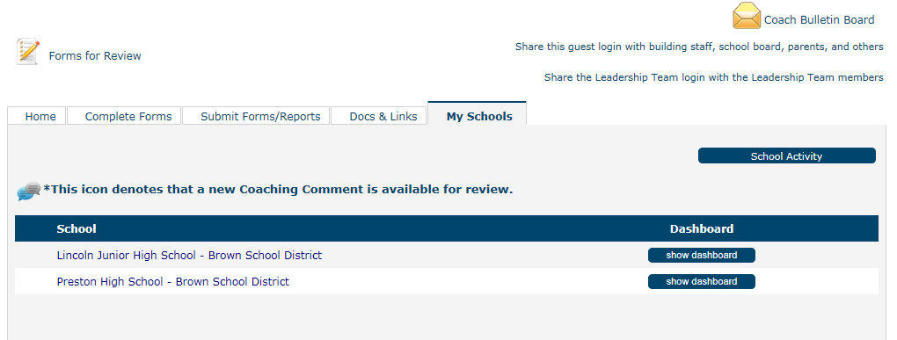
Where to go in the system
2.
1.
4.
3.
5.
6.
Notes:
You will be given, if you haven’t already, a login and password that is specific to you. This login and password will get you into the right access level as well as connect you to the teams that you are coaching. This access level gives you view only access to all the work of the teams you coach as well as access to provide coaching comments. You will not be able to change any of the teams information – you can only read it.
When you log in, you will see your dashboard with a list of the schools or districts that you coach.
So…what do you find on this page.
Coach Bulletin Board: The bulletin board will display messages from the state or the district and it is where you can send reminders to your Teams about upcoming events.
Forms for Review: If your Team has any forms that are required to be submitted and IF the form is to be reviewed and approved by the coach, you will find those forms here for you to review. If the Team is not required to fill out any forms or if the forms are not to be reviewed, then this will not show up on your dashboard.
The School Activity button takes you to a report which shows you activity across all the teams that you coach. You can also create a 13-month Bar Graph from the report page. It is a great place to look for trends across your teams.
If a team has responded to one of your coaching comments, the conversation icon will appear next to the name of the school or district.
This is the list of schools or districts that you are coaching.
When you are ready to review the work of the team, you will select which school or district you want to view and then select Show Dashboard. This button will take you to the District’s or School’s dashboard. Remember, it will be view only for you. You can’t change any of the information.

Slide 51
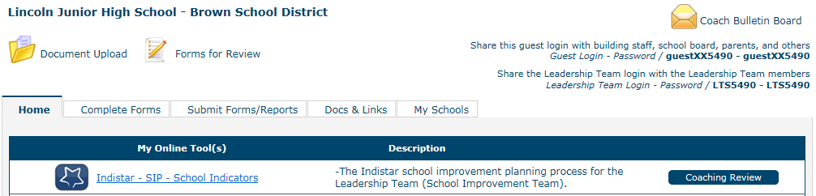
Finding your way
1.
2.
3.
4.
Notes:
Now you see the district or school’s dashboard.
This is the document upload. Teams may upload forms that are required for the state. You can view the documents, but you cannot make changes or upload new files into the folder. We don’t encourage teams to upload LOTS of documents for their indicator evidence here. A team just needs to say that they have a document (if necessary) but they don’t have to upload that to the system.
Notice the Guest Login and the Leadership Team login. Remind the Team that all members of the team should have the Leadership Team login information and the Guest Login should be distributed to all the members of their school or district community. Every teacher. Every parent. School board members. Staff.
Submit Forms/Reports. This tab will show you what a team has due within any time period and it will provide a pdf link to any report or form they have already submitted for the current year as well as a pdf of any report or form they submitted in the prior year. When a team submits a report of their work on their indicators, the system takes a snapshot of their work. They don’t fill out any extra forms, they just hit the button. It is important for a team to have periodic “check in” times throughout the year so a pdf can be created of their work at that particular point in time. It is a great reference point later.
The Coaching Review button is probably where you will spend the bulk of your time. Let’s go there next.

Slide 52
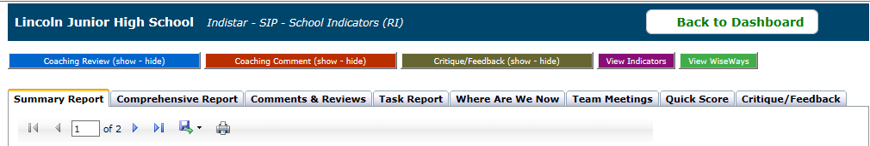
Your work
1.
2.
3.
4.
Notes:
You’ve hit the mother-lode!
Across the top of the page, you will find Buttons that lead you to where you will enter your comments. There are choices – but not all of them may be available to you.
Coaching Review. This is perhaps the most popular of the choices when it comes to creating and giving comments to your team. The coaching review is an overall comment on any of the work that the team is doing. It can be about a group of indicators. It can be about a meeting agenda. It can be directed toward the make-up of the team…any of the work of the team. Many coaches use only the coaching review to make comments – and that is okay.
Coaching Comment. The coaching comment is meant to be used when you are making a comment specific to one particular indicator. Some coaches prefer this to the review; however, you can make a comment about a particular indicator in the review as well. It all comes down to a matter of preference and how you are comfortable using the system. Try them both out.
Critique/Feedback. Not every state uses the critique/feedback feature. If this button does not show up on this page for you, it simply means that your state has not required you to complete a critique. If the button does show up, then the state has created a form that they would like you to complete periodically that review the work of the team relative to the questions the state has posed.
View Indicators and View Wise Ways. These buttons will allow you to see a complete indicator list as well as the Wise Ways for the indicators as references for your convenience.

Slide 53
The team’s work
1.
2.
3.
4.
5.
6.
7.
8.
Notes:
The bulk of everything you need to know about the work of the team can be found all on this one page. We created this page specifically to save coaches time and effort of clicking through the system to find the information they needed to guide the work of the team. So, what can you find here?
The Summary report gives you very quick information about who is on the team, how many meetings the team has had, how many members on average show up to the meetings, how many coaching comments a team has received, how many indicators have been assessed and planned. It is a quick overview of the team and their work.
The Comprehensive report. It is just as it say. When it comes to the indicators, this is the show it all report. How an indicator was assessed. How it is prioritized. Who is assigned. Due dates. Tasks. Evidence…it shows it all. As you can imagine, as the team works through more and more indicators, this plan can get pretty BIG. So, how do you know what the team has worked on lately? You can filter the report down to activity that was in the last month, or last 3 months…however you need to filter it.
Comments and Reviews. This tab shows you all the comments that have gone back and forth between the coach and the team. Remember when we said if you put your comments in the system, it will keep a running history? This is where you find that history. If you are not the first coach to the school, this is a great place to go and catch up on what has been discussed before.
Task report. If you just want to see all the tasks that the team has in place, this is the report to check. It is a good place to see if there are any tasks that are past due or coming due in the near future.
Where are we now. This gives information about the team’s work in graphic form.
Team meetings. The team’s agendas and minutes are kept on record here.
Quick Score. The quick score gives you a quick overview of what the team has done and ranks it against how long they have been in the system and how much work would be expected to have been accomplished in that amount of time.
Critique/Feedback. This tab will only show up if your state requires you to complete a critique. The completed critiques show up on this tab.

Slide 54
How do you know you’ve succeeded?
Start measuring your work by the optimism and self-sufficiency you leave behind.
Peter Block
Notes:
It’s a lot of information to digest, so the best suggestion would be to log in and explore the system. Find out as much as you can about the Team you will be coaching. And. . .enjoy the journey!

Slide 55
What We learned together
In this module we:
Examined the role of a coach in general
Examined the role of a coach in relation to district and school improvement
Examined the role of a coach for districts and schools using Indistar
Explored the Indistar online platform to see where a coach enters comments, reviews, or critiques
Explored the Indistar online platform to see where a coach finds information to review the work of the Leadership Team
Notes:
Please take a moment and fill out the What We Learned Together form available on the website.

