Slide 1
(Click to Play “Detailed Navigation / Part I: Website and Indistar® Overview)

Slide 2
Detailed navigation
Part I – Website and Indistar® Overview
Notes:
Welcome to Detailed Navigation of the Indistar system
Basically, figuring out…..
Where are we at…
Where do we need to go
What buttons should we push
Where can we find that!
We will break this module up into 3 parts:
An Overview of our website, resources, and Indistar
The Indicator Process
And 3. Additional Tools to support the work.
Let’s get started!

Slide 3
Notes:
Everyone knows about Indistar right?
Oh….you don’t?
But you do! Indistar is a continuous improvement platform that helps guide school and district Leadership Teams in charting, implementing, and managing improvement on research-based effective practice. When a state adopts the Indistar tool, we encourage them to make it their own unique system:
States can create a new name and brand, choose a set of indicators that best fit their schools and districts, and plan progress monitoring according to what might work best in their state.

Slide 4
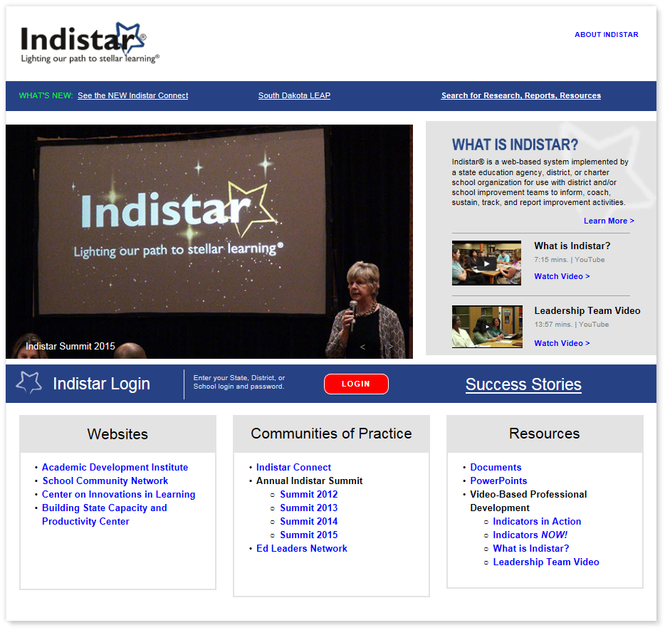
Notes:
Some states have a direct link to the Indistar login portal on their state education website page. If you are unsure if your state has this direct link, please be sure to contact a state administrator.
But, you can always go to www.Indistar.org! Our website has great resources for schools, leaders, teachers, parents, coaches, and leadership teams!
We have included links to a new search engine where you can find a ton of research-based information on instruction, leadership, turnaround, family and community engagement…the list goes on.

Slide 5
Notes:
Additionally, educators can find Indistar tools such as powerpoints and training modules, activities, and professional development tools.

Slide 6
Notes:
Or….Join a community of practice, such as Indistar Connect and connect with other users across the nation.

Slide 7
Notes:
What is Indistar? And the Leadership Team video are great tools to help inform your team, teachers, and community on how you are working together to make a difference.

Slide 8
Notes:
If you have time, read or share one of the incredible success stories! It’s hard not to be inspired and encouraged by the successes of schools and districts just like you!

Slide 9
Notes:
Now, when you are ready to login, you will find the red LOGIN button in the middle of the page.

Slide 10
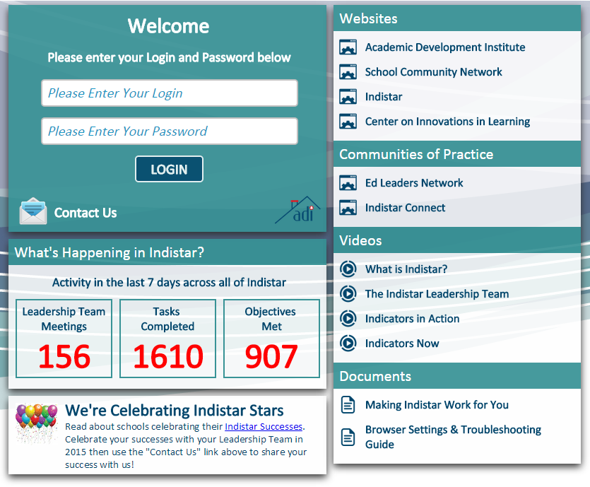
Logging In
Logins and Passwords may be given by the State Administrator(s)
Various Access levels …some with editing rights, …and some for just reviewing progress.
Notes:
To login in to the system, you must acquire a login and password from your state administrator. There are varying access levels…some with full editable rights, and those with view-only access to a school or districts progress.

Slide 11
Guests
(Read-only) To be shared with parents, teachers, and community members.
Wise Ways®
Indicator Lists
Latest Updates/Progress
View-only Charts/Reports
Celebrate Our Success!
Where are We Now
Comprehensive Report
Summary Report
Accomplishments Report
Leadership Team
(Read-only) To be shared with Leadership Team members.
Wise Ways®
Indicator Lists
Latest Updates/Progress
View-only Charts/Reports
Same as guest
Coaching Comments
Leadership Team Agendas and Meeting Minutes
Team Roster
Principal/Superintendent & Process Manager (Full/Editable Access)
Wise Ways®
Indicator work
All Reports
All Forms
Submissions/Due Dates
Coaching Comments
Agendas and Minutes
Notes:
There are three different main access levels to the system.
The first level is for Guests. Guests will have read only access to the school and/or districts work and progress in planning and implementation of effective practices. Guests can also see research and resources used by the Leadership team to help drive their decisions. The login and password for the guest page should be shared with anyone who has a stake in the improvement and achievement of your school or district….parents, teachers, and community members.
One step up from the Guest login, is the Leadership team access. As members of the leadership team, it is important to be able to have access not only to the planning and implementation process and details your team is working on, but also Meeting Agendas & minutes, Coaching Comments and feedback, and Wise Ways research …for a little pre-reading before you sit down with your team to discuss the implementation of those effective practices.
And of course, someone must have full and editable access to get all of that information into the system. Principals and superintendents will share their login access with a local process manager. Although the leaders of the building are responsible for leading the process and making sure everything is on target, and submissions are on time, we suggest that a process manager is chosen at each building to help maintain the system. Responsibilities include preparing meeting agendas, entering minutes, keeping the team on task with help of leadership, and entering assessments, plans, tasks, and updates in the system.

Slide 12
The Dashboard
● Parts & Pieces ●
Notes:
Let’s take a look at the Dashboard.

Slide 13
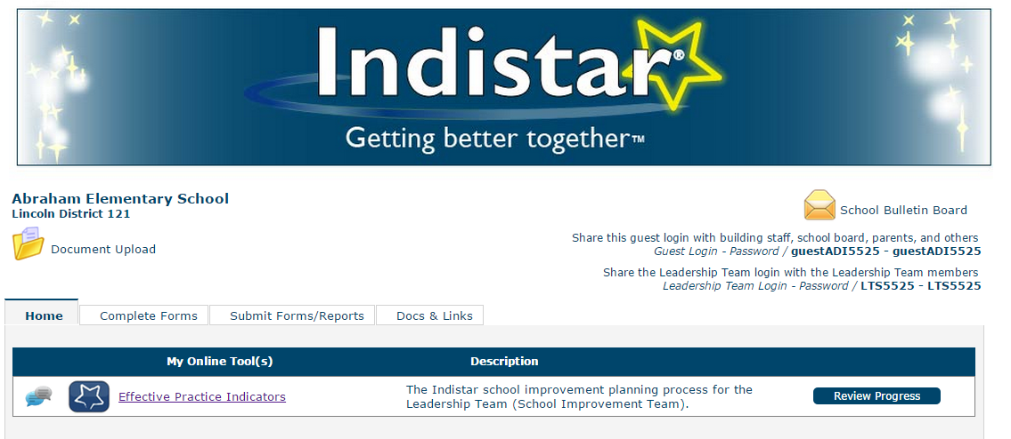
The Dashboard
Notes:
Once you have logged in , you will go to what we call the ‘dashboard’. Once again, don’t forget, each state get’s to make Indistar their own.
So…you might have a different banner
You might have a different name,
But the process will be the same….no matter where you are!
Let’s take a brief look at the parts and pieces first, then get into the details as we navigate around.

Slide 14
The Dashboard
TAB 1
Home Tab – Link to Indicators of Effective Practice, where either school or district leadership teams will work to implement research-based effective practices.
Notes:
Tab 1 is the HOME tab where you will find Link to Indicators of Effective Practice, where either school or district leadership teams will work to implement research-based effective practices.

Slide 15
The Dashboard
TAB 2
Complete Forms – Link(s) to supplemental forms created by your state to help schools and/or districts fulfill state or federal requirements.
Notes:
Tab 2 is the Complete Forms Tab. Here you will find Link(s) to supplemental forms created by your state to help schools and/or districts fulfill state or federal requirements.

Slide 16
The Dashboard
TAB 3
Submit Forms/Reports – The tab will display all state-set due dates and submission periods for a school or district. Both the indicator progress work and most form requirements may be submitted here.
Notes:
Tab 3 is the Submit forms & reports tab. The tab will display all state-set due dates and submission periods for a school or district. Both the indicator progress work and most form requirements may be submitted here.

Slide 17
The Dashboard
TAB 4
Docs & Links – Housed on this tab are research, resources, and website links to help aid a leadership team as they work through the continuous process.
Notes:
Tab 4….Docs & Links. On this tab, you will find additional research, resources, and website links to help aid a leadership team as they work through the continuous improvement process.

Slide 18
The Dashboard
TAB 5
Coaching – Districts will be able to access each of their schools’ on this tab, in order to check progress and provide coaching support and feedback, as well as reports for overall progress.
My Schools or Districts – Coaches will utilize this access point to gain view-only access of each of their schools’/districts. Coaches can check progress and provide coaching support and feedback, and even run some activity reports to view overall progress of their sites.
Notes:
If you are a district or a coach assigned to help support schools, you will find another tab labeled as my schools, my districts, or coaching. This tab will give districts and coaches access to review progress as well as provide coaching comments through an internal coaching feature.

Slide 19
The Dashboard
DOCUMENT UPLOAD
Document Upload – Where teams can:
upload evidence of implementation as they work through implementing effective practices and indicators
Upload assurance (signature) documents and some supplemental forms that cannot be directly submitted to the state using tab 3.
Notes:
Document Upload – Where teams can:
upload evidence of implementation as they work through implementing effective practices and indicators
Upload assurance (signature) documents and some supplemental forms that cannot be directly submitted to the state using tab 3.

Slide 20
The Dashboard
BULLETIN BOARD
Bulletin Board - Where districts, coaches, and state administrators can send:
General Announcements and reminders about upcoming due dates, trainings, and webinars
Upcoming changes
or additional state announcements
Notes:
Bulletin Board - Where districts, coaches, and state administrators can send:
General Announcements and reminders about upcoming due dates, trainings, and webinars
Upcoming changes
or state announcements

Slide 21
The Dashboard
GUEST LOGINS
Additional access level logins:
For Guests such as parents, teachers, and community members
For Leadership Team members
Notes:
Additional access level logins may always be found on a school or districts dashboard for easy access.
1 is For Guests such as parents, teachers, and community members
The second one is For your school or districts’ Leadership Team members
Be sure to work with your leadership and leadership team members to distribute these logins appropriately.

Slide 22
Notes:
Teams
Guests
Research
Dashboards
Coaching
Wheew! A lot already, I know. So let’s Stop!, and take a few minutes to discuss what we already know.

Slide 23
Discussion
Take a few minutes and discuss the following:
Does your team have a process manager?
Have you received your login and password from a state administrator?
How will you distribute your guest and leadership team logins?
(Click Play to proceed)
Notes:
As a group, let’s take a few minutes to discuss the following questions:
Does your team have a process manager?
Have you received your login and password from a state administrator?
How will you distribute your guest and leadership team logins?
(Facilitate discussion for a few minutes. Raise hands if you have a pm; if you have a login; discuss if not, who will provide them; pick a few people to answer how they will distribute or make public)

Slide 24
(Click to Play “Detailed Navigation / Part II: The Improvement Process)

Slide 25
Detailed navigation
Part II – The Improvement Process
Notes:
Welcome to Detailed Navigation Part II
The Improvement Process
In the next few minutes, we will take a look at how the process works inside of the system. There are 3 main components to the process:
Personalization of the system – your information, your team, your goals, your work!
The indicators….Assessing where your school or district is regarding full and effective implementation of research-based indicators
Creating plans and tasks for objectives that still need a bit more work
And monitoring the implementation and sustainability of your work.
And the last component….additional support tools such as a place to keep meeting agendas and minutes, a messaging center where your team can interact with the district or a coach supporting your work, and additional resources and reports to help teams self-monitor their progress.

Slide 26
HOME
Complete Forms
Submit Forms/Reports
Docs & Links
(Coaching)
Link to Indicators of Effective Practice and State-created description
Additional Supplemental indicators
Planning Tools
Family Engagement Tool
State-suggested Resource Tools
Notes:
Let’s go back to Tab 1…the Home tab.
Here, you will find a Link to Indicators of Effective Practice
You may find an Additional link Supplemental indicators…if you state has decided to add those separately from the main list may also be found here.
And some schools might even have additional planning tools… such as School Community or Family Engagement planning or another state-suggest resource tool.
Not all schools and districts will have additional planning tools but everyone should have the link to their state chosen indicator set. If you do not have an indicator link, please contact your state administrator.
So…Let’s click on the indicator link and see where we go to next.

Slide 27
The MAIN MENU
● Overview ●

Slide 28
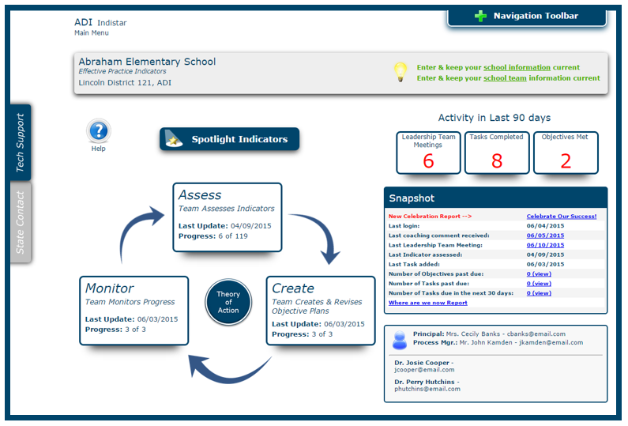
Notes:
This is what we call ‘the Main Menu’. The heart of your system….where schools and districts can keep track of their indicator work and progress. I will give you a small tour before we come back and get into the details.

Slide 29
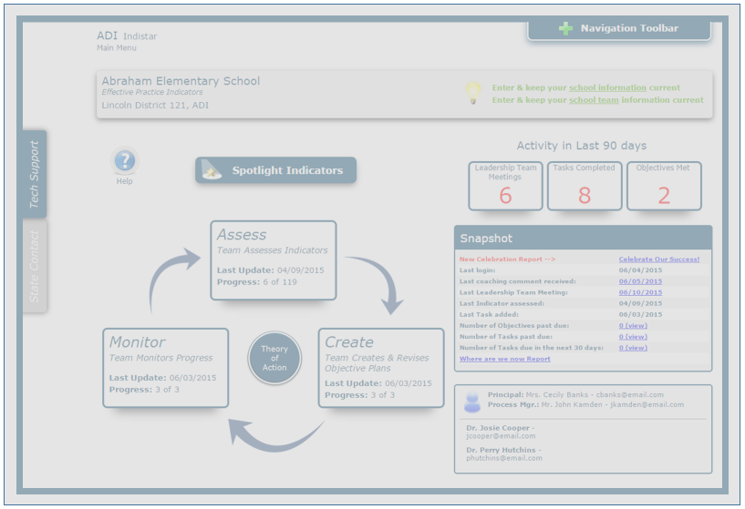
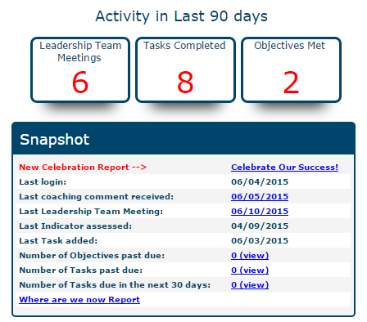
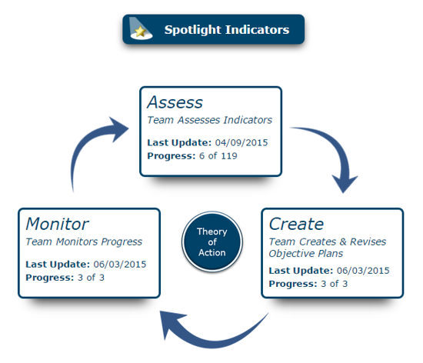
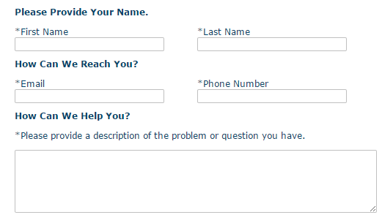
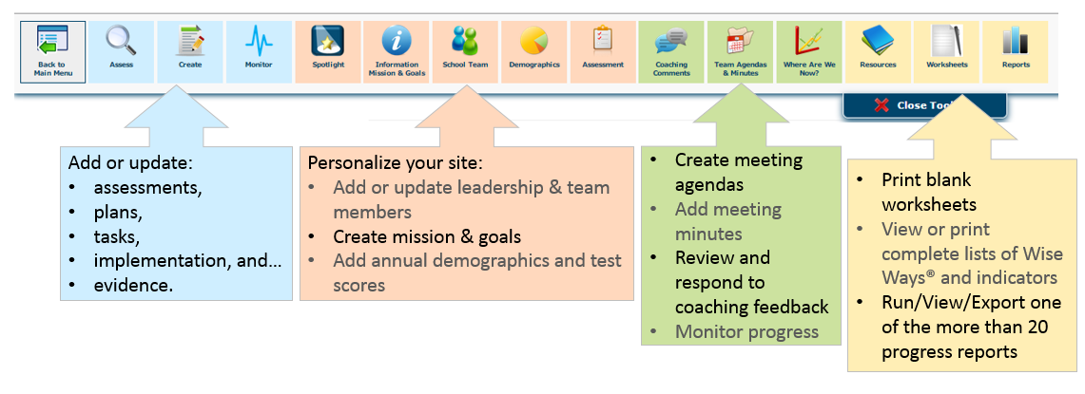
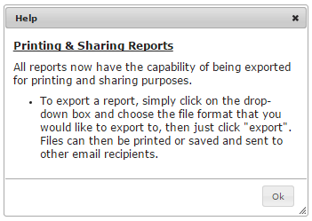
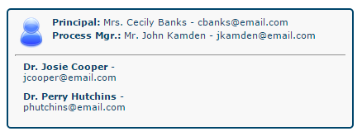
Main
Menu
SAVE often!
Notes:
6 Of course, you have your school or district information,
7…..including contact information for leaders, process managers, and coaches.
8 In the center of the page, you will find everything pertaining to Assessing, planning, monitoring and personalizing your indicators. For some extra insight on how this continuous improvement process works, be sure to check out the Theory of Action!
9 As leaders and process managers work to keep the team on track and keep the work moving forward, a great place to take a look at what’s happening is the Snapshot report, as well as Recent Activity. Both are useful in seeing the progress you are making as a team, as well as maintaining target dates for tasks and objectives
10 & 11 If you find yourself facing uncertainty or have any issues while using the Indistar tool, here are some great tips! The HELP button is different on each and every page, to really help guide our users around the system.
12 & 13 For assistance regarding expectations, evidence, or implementation, you can easily find your state contact information by clicking the pop-out to the left.
14 And if you find an error or just can’t get something to work, feel free to contact our Tech Support folks. We are always here to help.
16 There are many other features inside of the tool as well. By simply clicking on the Navigation Toolbar at the top of any page, you can easily move about the system.
Of course, to get back to the main menu, just click the first icon.
The blue icons will allow you to Add or update: assessments, plans, tasks, implementation, and…evidence.
The Peach section of icons is where our users can Personalize their site:
Add or update leadership & team members
Create mission & goals
Add annual demographics and test scores
Wanna Create meeting agendas
Add meeting minutes
Review and respond to coaching feedback
Monitor progress
... choose one of the corresponding green buttons.
And last, but not least, the yellow section will navigate you to
Print blank worksheets
View or print complete lists of Wise Ways® and indicators
Run/View/Export one of the more than 20 progress reports
As with any piece of technology, please be sure to always SAVE often.

Slide 30
Personalization
Notes:
With all of this stuff, where should you start? Let’s take a look…

Slide 31
First few steps
Just click the icon to navigate to each page
Registration Information
Personalization – Mission and Goals
Leadership Team information
Demographics
Assessments/Test Scores
Notes:
With a new tool, it’s easy to get lost. So let’s take is slow and get the first few important steps out of the way. Keeping your local site information, missions, and goals updated in the tool is not just a suggestion, it is necessary. Email notifications can’t happen if we don’t know who to send them to. Also, having an up to date leadership team roster is a must as you work through creating your plan.
Demographics and Assessments scores…well, we will briefly go over those pieces too. They are not required in some states but just in case they are in yours, we will run through that process as well.
Let’s get started!
OH & Don’t forget, everything is easily accessible by using the Navigation Toolbar at the top of any page. So….let’s click on Information, Mission, & Goals,

Slide 32
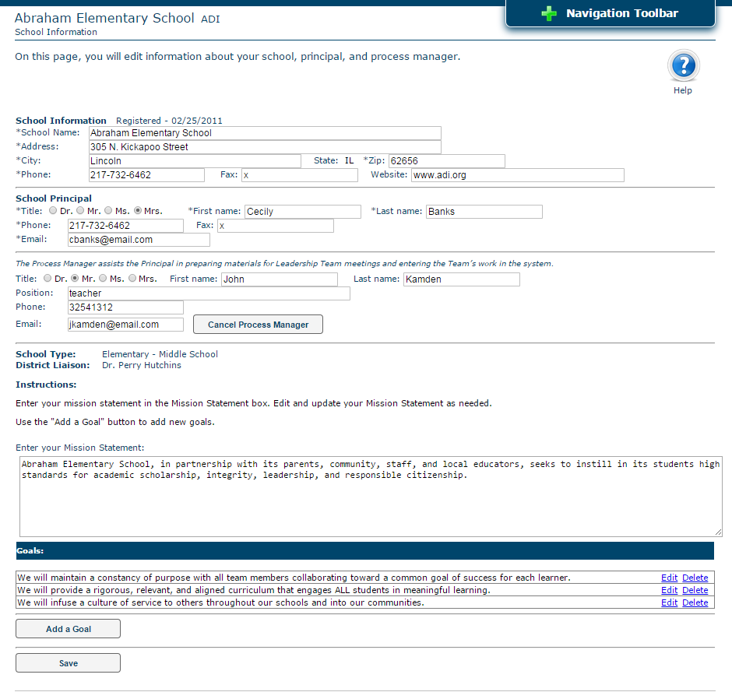
Leadership/Process Manager: to edit or update, simply change the information and click SAVE.
Note: Coach updates can not be made by a school or district process manager. Please contact your SEA if that information needs to be updated.
Mission: enter/edit school or district mission and click SAVE.
Goals:
(New) Click ‘Add a Goal’, enter goal, and SAVE.
(Edit) Click ‘Edit’, make changes, click UPDATE…then be sure to SAVE.
Notes:
There are three main parts to this page….
registration details such as leadership and process manager contact information
School or District Mission statement
And Goals
Built into the Indistar process are email notifications. If your school sends a supplemental form for review, receives coaching support or feedback, or submits a final report to the state, email notifications will be sent to let you know what to do next. If the leadership or process manager email or contact information is not kept up to date, you may not receive these important emails. So…step 1: Check out your site information, make any needed updates and be sure to click SAVE.
You may also notice a coach listed here or on your main menu page. A local site does not have the ability to change a coach but you can always contact your state administrator if the information is not correct, and we will work to get that fixed.
Missions and goals….this is optional. You are not required to do this, but…it is always great to have a mission, to have large goals as a school or district. Many of our previous users have added both mission and goals to really personalize their site. This is your tool, your process, your success! Missions and goals can be adjusted as your leadership team sees fit.
Creating a Mission in the system is pretty easy. Just type in the text and SAVE. Goals can be added one by one, making sure to save each time. If you need to edit or delete a goal, simply click EDIT on the existing goal, delete or make changes, then click on the UPDATE button before saving at the bottom of the page.
Just a little extra information on Missions and Goals. As we briefly discussed before, there are two additional access levels. The Guest and Leadership Team access levels will be able to see your missions and goals on their sites. They will be read only, but it will help visitors to know what you are working towards. So give it a try at your next meeting!

Slide 33
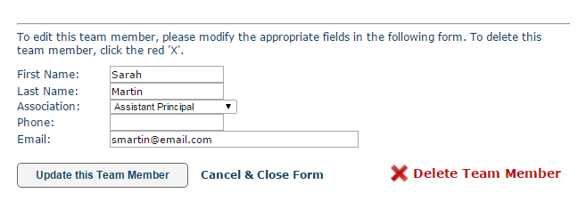
Add a Team Member:
Complete required information
SAVE
Update a Team Member:
Choose the team members
Edit
SAVE
Delete a Team Member:
Choose the team members
Click ‘Delete”
SAVE
*Note: Any plans that the team member was assigned to will need to be re-assigned to another team member. in the CREATE step.
Notes:
Next, let’s add our team. Find the ‘School or district team’ icon on your Navigation Toolbar.
Adding your team roster is one of the first things you should do as a team or process manager. In fact, if you don’t the system will not let you into certain areas until this step has been completed. Team members are assigned to specific duties as your team works through the continuous improvement process, so it is necessary to have them in the tool.
To add a new team member, simply click the button labeled ‘Add a Team Member’, complete all required information, and SAVE.
To update a team member, choose the team members name from the list, edit, and SAVE.
Team members may also be deleted if they are no longer on the Leadership Team. Just choose the team members name, click ‘Delete’ and SAVE. Any plans that the team member was assigned to will need to be re-assigned to another team member. As a reminder, placeholders labeled ‘removed’ will remain next to any plan that had a team member that was deleted, until a new one is assigned in CREATE.
Make sure to update your team member list as needed.
Next up, Demographics and Assessment Scores.

Slide 34
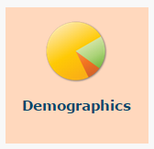
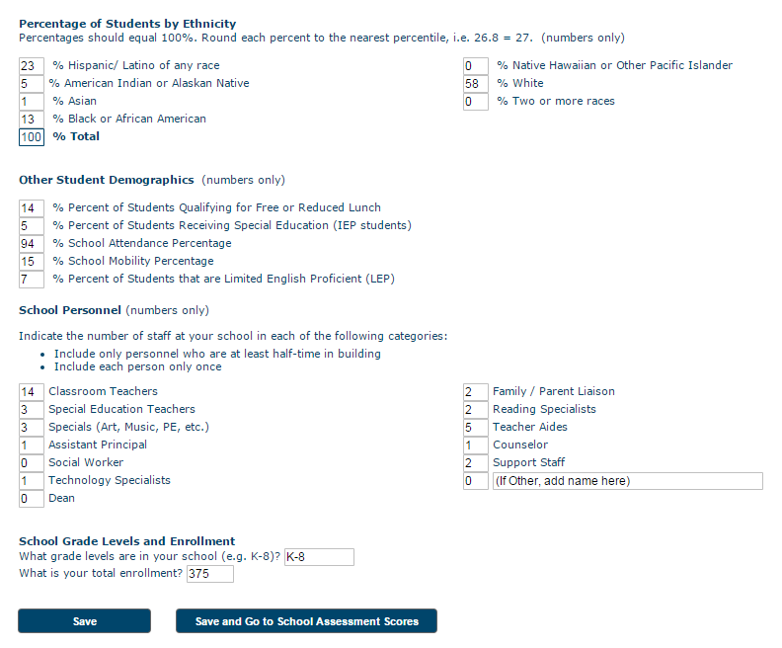
Demographics is a step that is optional in some states Please check with your state administrator if you are unsure about the requirement.
Use numbers only, no percentage signs
Update annually, or as needed
Be sure to SAVE when you have completed you updates.
If you would like to continue on and enter annual assessment scores…just click ‘Save & Go to Assessment Scores’
Notes:
Let’s look at Demographics first. Again, this step is not required in all states, but it is in some, so be sure to check with your state administrator to see what the requirements are in yours!
This one is pretty simple. Using numbers only….no percentage signs…just fill in the data. Although this is not a required step for all states, it might be convenient to have this information handy as your work thru this process. Taking time to add Student demographics, staffing information, and enrollment details here might save you a few minutes in the future.
As I will repeat often, always be sure you save your changes before leaving the page.
The next step is adding assessment scores…which is also not required in all states, but might be useful to have on hand as your team discusses implementation of the effective practices. You can move forward by going thru the Navigation Toolbar….or clicking on SAVE and Go to Assessment Scores at the bottom of your page.

Slide 35
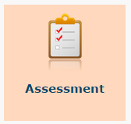
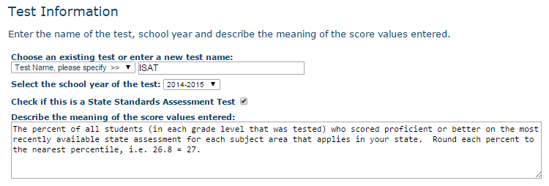
Entering State Assessment scores into this tool is NOT a requirement in all states. Please check with your state administrator if you are unsure about yours.
Enter New Test:
Click on
Enter Test Information -> Create Test
Click Test Subjects ->Add each Subject
Click Test Results ->
Click to add scores for each subject by grade level
Click to save
Edit/Delete Tests:
Choose test name
Update or delete ( ) as needed
Notes:
Entering assessment scores is also pretty simple. The hardest part might be finding the data to add over here. And that is why some states don’t make this a required step….because most schools have it somewhere else.
But, if you do want to go ahead and add the testing details, it’s just a simple 3 step process.
Click on ‘create a new test’ and Enter test details…year, name, and meaning of test. In the example here, you can see we chose the ISAT. If this is a state standards assessment test, you can click the checkbox to pre-populate the description. Or write your own if it is not a state standard test.
Step 2—Add subjects. Just click on a subject from the dropdown and click ‘add subject to test’. Repeat as needed. Make a mistake, just click the red x to remove it. When you are ready, go to the next step…. Adding the results
To add the results, just click the plus sign next to each subject area and fill in the scores for any appropriate grade level. Click the checkmark to save.
If you ever need to adjust scores or subjects on a test, just click the name of the test and adjust as needed. If you want to remove a test, click the red x.
It really is that easy!

Slide 36
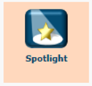
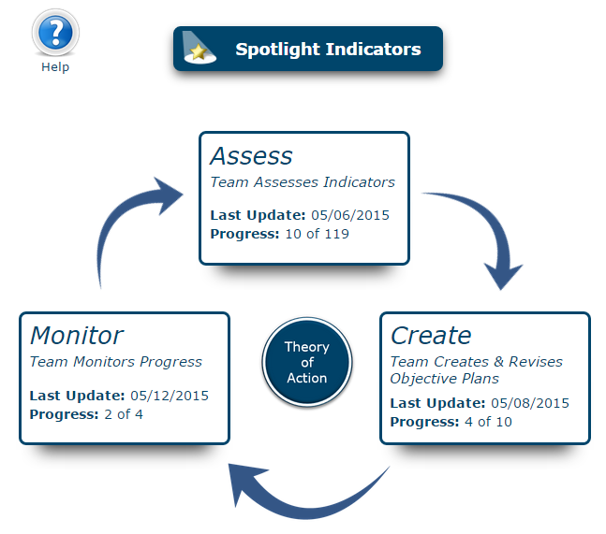
Spotlight indicators
Notes:
Spotlight Indicators page can be found by clicking on the Spotlight icon from the main menu page or the Navigation Toolbar.
Spotlight Indicators are a way to streamline and focus the work of the Leadership Team.

Slide 37
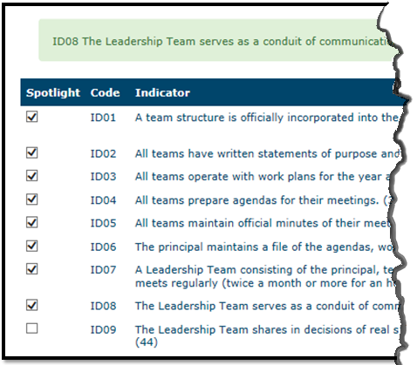
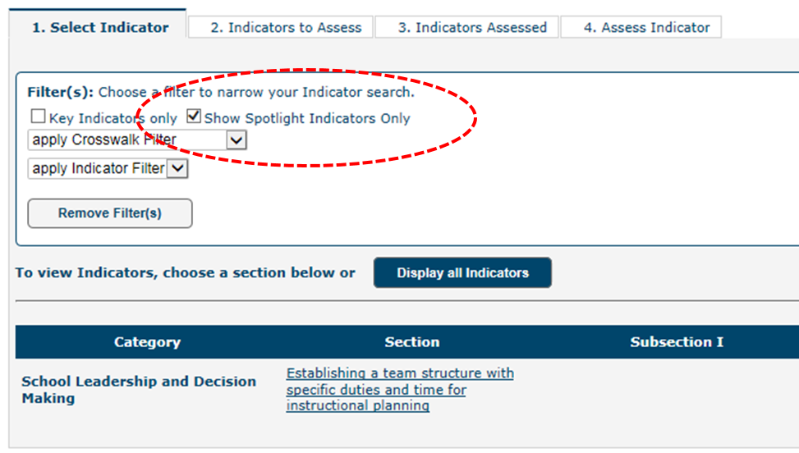
Choose indicators to mark as Spotlight indicators
Check filter to display only those chosen
Spotlight indicators will display in all steps (Assess-Create-Monitor)
Note: Once the Spotlight Filter is checked, it will remain so in all areas until unchecked.
Notes:
Once the Leadership Team has decided on which indicators will be their focus, they can simply go to the Spotlight Indicators page and click all indicators they would like to include.
Selected Spotlight Indicators will be included in the Spotlight Indicator filter on the Assess, Create, and Monitor sections .
Once the Spotlight Filter is checked, it will remain so in all areas until unchecked.

Slide 38
indicators
Assess ● Plan ● Monitor ● Update
Notes:
Back to the heart of the system….where Leadership Teams work to discuss and plan for indicators of effective practice

Slide 39
indicators
Utilize the Wise Ways research
Engage in a culture of candor
Acquire a deep understanding of the practice
Notes:
At each step of the continuous improvement process….Assess, Create, and Monitor….Leadership teams will utilize the Wise Ways research to help determine where they are and where they need to go. Teams engage in robust conversations, using a culture of candor, and of course acquire a deep understanding and meaning of each practice.
The Work of improvement takes time….it takes determination…skill….and most of the will. The want to do better for ourselves, our colleagues, and our students.
States will provide schools and districts with expectations for working thru the indicators. Besides the Spotlight indicator feature, a state may choose to add indicator Filters to help teams hone in on areas where they should start.

Slide 40
assess
Notes:
The three main steps come next….Assess, Create, and monitor. We will show you a brief video of how to move through each section:
VIDEO –
Assessing….by now teams should know what to do, so let’s talk about how to enter the data into the system.
When a process manager is ready to enter the details for an assessed indicator made by the leadership team, they will find the link on the main menu page, or inside of the navigation toolbar.
Here you can see the entire list of effective practices chosen by a state. Additionally, you may notice the Spotlight filter and other state-specific filters. Filters will help reduce and streamline the larger set of indicators into a more specific and manageable set. Be sure to check out filters available in your state.
Let’s choose an effective practice, find the indicator we want to add details for and enter the data. (choose 36)
Team members should always pre-read Wise Ways before the leadership team meeting discussions, but the link is also here if the team needs to quickly access the research.
The team will engage in a culture of candor and decide if they are at No Development, Limited Development, or Full Implementation.
If the team decides no development or limited development, you will need to choose both a priority score and an opportunity score. Then simply describe what is happening right now in regards to this indicator. This becomes your starting point….Point A. Point B is your goal which is what your team will create next.
If the team determines the indicator is in fact fully and effectively implementated and sustainable in the school or district, simply provide evidence and describe the sustainability efforts that will continue.
Only indicators marked as needing more work will move on to the Create step. Fully implemented indicators will not, but it is always important for the leadership team to annually revisit and reassess any indicators marked as fully implemented to be sure the practices are still taking place and are sustainable.

Slide 41
create
Notes:
VIDEO
The create step next and is two-fold. This is where teams will not only create their plan for what the objectives (previously referred to as indicators) will look like, but also create a series of tasks and target dates to help them achieve implementation. Let’s take a look.
All indicators assessed by the team as limited or no development will become available for planning. We now refer to them as objectives. Teams do NOT have to plan for all objectives at once. The index score …which is the priority score times the opportunity score from the Assessment step may guide a team to pick out some quick wins, as well as hi-priority indicators.
As you can see, several objectives now display in the CREATE step. Some already have plans and tasks created, and others do not. To begin a plan, the team will decide on a team member to manage and monitor the work of completing the objective. Additionally, the team will set a target date for completion, and

Slide 42
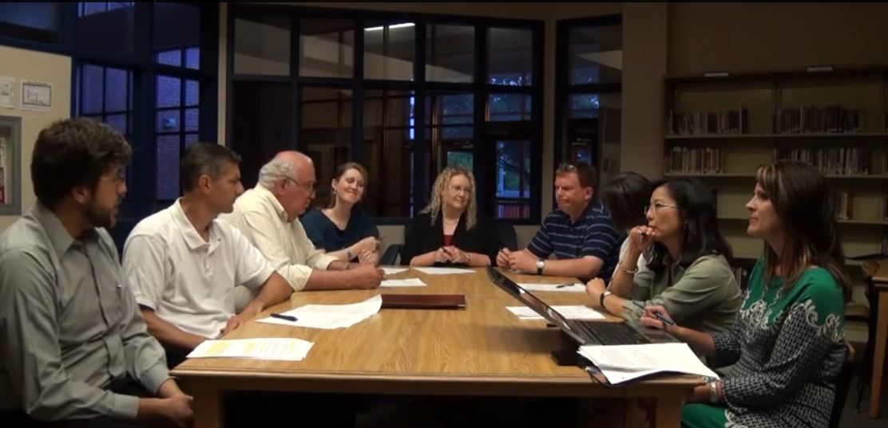
monitor
Notes:
And finally, monitor. Of course it is critical for teams to monitor implementation. You can’t have a great plan and expect it to be successful if you don’t have follow thru. Monitor should happen at every team meeting! Reviewing tasks, target dates, and plans consistently will help improve a teams overall success in the meeting room and in the classroom.
Monitoring in its most simplified form is just checking things off your list. Is it done? Check! Do we need more time? How much?
Keep target dates realistic
Keep goals within site.
As tasks get completed, objectives become met! Successes happen!

Slide 43
Monitor – checking things off
Notes:
VIDEO
Let’s take a look at Monitor.
As tasks get done, we can check them off.
When all tasks that the leadership team created to meet their objective are completed, the team will then need to re-evaluate the objective. Using the Wise Ways, reviewing their completed tasks, evidence, and sustainability, the team will decide if the objective has been achieved. They system will pop-up a screen where the team will check if they are
Fully and effectively implemented.
The team can choose to decide later, after more review
Choose to add more tasks
Or mark the objective complete. If the objective is complete, the team will provide evidence of full and effective implementation and their sustainability efforts that will continue to take place.

Slide 44
Updating your work
Notes:
As teams work thru the system, sometimes questions come up about updating your work.
Here is a brief overview about updating your work:

Slide 45
What can be updated?
Assess
Create
Monitor
State-set time period to allow teams to reassess indicators already at full implementation.
Priority Score
What it will look like when fully met – description
Mark Tasks complete
Opportunity Score
Current Description of implementation
Person assigned to manage plan
Target date for completion
Add /Update Task description
Person assigned to complete task
Task target date
Delete tasks
Mark objective as met
Tag objective as needing new task
Flag to Reassess
Previous work will be archived for viewing
(Note: initial development level cannot be changed unless going from full to limited)
Notes:
As your team works thru the improvement process, you may have a few questions as you move thru the tool. Be sure to reference the HELP buttons for assistance.
Additionally, here is a brief list of what can be updated in the system.
In assess, you can always change priority & opportunity scores, as well as your current description of implementation. The initial level of development cannot be changed unless you are moving from full implementation to limited development.
IN create, teams can update plans, tasks, assignments, and target dates any time during the process. The system is always open for your team to edit as needed.
To add notes or completion dates to tasks or objectives, go to Monitor. Tasks can also be deleted here if necessary.
And how….and when does your team get to reassess the indicators? Each state has set a ‘Flag to Reassess’ date. On the anniversary that the indicator or objective was marked fully met, the indicator will roll back into the ASSESS step as needing to be re-assessed. Don’t worry about losing previous work! All previously entered information including tasks, plans, and notes will stay attached to the indicator by an archive link.

Slide 46
Support
Meeting Agendas ● Coaching Comments ● Reports ● Resources
Notes:
This process can’t be successful if there aren’t supports and places to monitor your progress. Keeping track, staying on task, receiving support…all of the crucial things to make this process run a bit smoother.
Meetings Agendas and minutes is where we will head first.
Did you know that best practice according to research is that successful Leadership teams meet twice a month for an hour or more each time.? Did you also know that research says that part of their success is based ?on the fact that they create meeting agendas and keep minutes. It’s easy and worthwhile. In fact, it will help your team stay on task and also help coaches see what your team is working on.

Slide 47
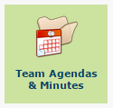
Meetings

Slide 48
Notes:
To find the Meetings feature inside of the platform, just click on your Navigation Toolbar at the top of your Main Menu page
And click on Team Agenda and Minutes
As you can see, you can view or update previously created meetings, or
Create a new meeting. Let’s start there. (click button)
To create a new meeting, you must first add a
date
Time
And title.
Location is optional but does come in handy.
We have created the meeting template for you. The first 5 pieces are standard…
Roll call
celebrate successes
review and respond to Caoching comments
approve last meeting minutes and
wrap-up any old business.
When you are creating the agenda, you will need to add any indicators your team has decided they will assess or plan
As well as any additional business you may need to discuss.
Let’s add some indicators to our agenda.
(click button),
Notice, you can view the indicators as a whole list, only those you have Spotlighted, or by effective practice.
(choose effective practice)
Once you see the indicators, mark those you would like to assess or plan for and click on ‘Add Selected Indicators’
Repeat that process as needed.
Need to remove an indicator…simply click remove.
Add Other business and Save.
The next step to prepare process managers for the meeting is to print out some reports and an agenda for notetaking. Many process managers simply pull up the tool on their computer and take notes as the team makes decisions. For others, they like to write it down and enter notes at a later time. Which ever is more comfortable for you, is the right way. Blank worksheets are available to print if needed.
To print any of the documents, simply click the link and print or export.
The Comprehensive and Tasks Reports are essential to a good meeting. When reviewed continuously, these reports will help teams be aware of who has what responsibility, which tasks are past due, and keep track of those coming due very soon. Make sure to include this review at each of your leadership team meetings.
Remember, it is no longer necessary to print agendas, Wise Ways research documents, or indicator lists for your Leadership Team members. Members should be given the Leadership Team login access codes located on your Indistar dashboard, where they will be able to access all of this information on their own.
(Go back to My meetings)
Once the meeting has convened, simply return to the meeting page and choose your meeting date.
Go to tab 3
Enter team members or guest in attendance
Mark each section of the template your team completed
Add notes from Other business
And an adjourned time
If you would like to begin creating an agenda for your next meeting, you may do so at this point
Or simply check the box to create it at a later date.

Slide 49
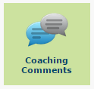
Coaching comments
Notes:
Let’s talk about coaching comments.
No one can do this job alone. It takes a team, …sometimes a village. The Indistar tool has a built in support system because we know coaches and district personnel can’t be there every day to help support you.
Coaching Comments is kind of like ‘instant message’. Whether a state administrator, district superintendent, or coach, each has access to provide feedback, suggestions, and support to leadership teams by simply logging in
Navigating to Coaching Comments (or the Coaching Review page on their Dashboard….we’ll get to that in a bit)
And type in the message. It can be a simple suggestion about a specific indicator…..
It might be a larger perspective comment…has your team talked about all students,
All teachers,
Can you be more specific about your evidence pieces you plan to collect…
Suggestions! Feedback! Kudos! And Support!
Leadership Teams should be sure to read, discuss, and respond to coaching comments at the next team meeting!

Slide 50
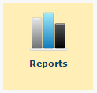
reports
Notes:
Moving on….so your team has been working….assessing, planning, monitoring….
Where does it all go? Are there charts, graphs, reports to show our progress?

Slide 51
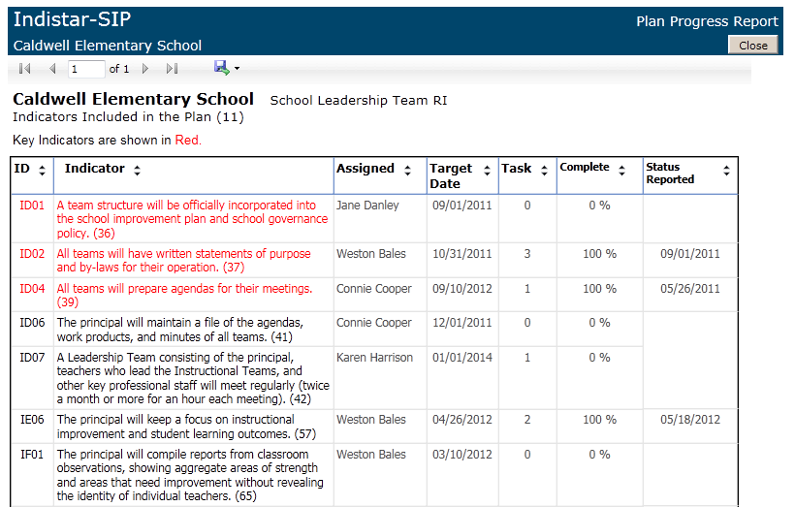
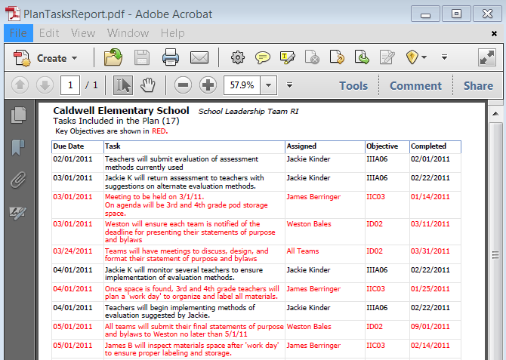
20 + varieties of reports
Contain live, up to the moment data
Can be viewed, printed, or exported to different formats
Notes:
You bet! In fact, there are more than 20 reports you can run to display anything from your team roster, your most recent team activity, and even a summary of where you are! All reports contain live-up to the moment data!
The icon to the Reports page is of course in the Navigation Toolbar for the leadership and process manager’s to access.
But….did you know that we have selected the best reports to show your progress and added them to the Guest login pages!? Teams that work hard to create successes should share that progress and proudly display it! We just make it a little bit easier!

Slide 52
(Click to Play to Proceed to Part III: Additional Supports)

Slide 53
Part III - Additional Supports
Detailed navigation
Supplemental Forms ● Submissions ● Docs & Links ● Bulletin Board ● Coaching
Notes:
Well, now that we have gone thru everything on tab 1, let’s circle back around to the Dashboard and get a few more details on supplemental forms, submissions, uploading, the bulletin board, and for districts and coaches, let’s find out what useful tools the system has to make that process easier.

Slide 54
TAB 2
HOME
Complete Forms
Submit Forms/Reports
Docs & Links
(Coaching)
Form Title………………………………………Description
Supplemental questions to meet compliance requirements
Title programs
Grants …such as Race to the Top, SIG, or technology grants
SMART Goals
Assurances
Notes:
Back to the dashboard, tab 2 – Complete forms.
When you click on Tab 2 you will find all supplemental forms that your state is asking schools or districts to complete.
You will see a title and description for each form. Forms might be for Title 1 programs, grants like race to the top, sig, or even technology. A state may choose to add a SMART goals form, assurance or budget documents...any form they decide can be added here for convenience to help schools and districts save time, and meet compliance requirements.

Slide 55
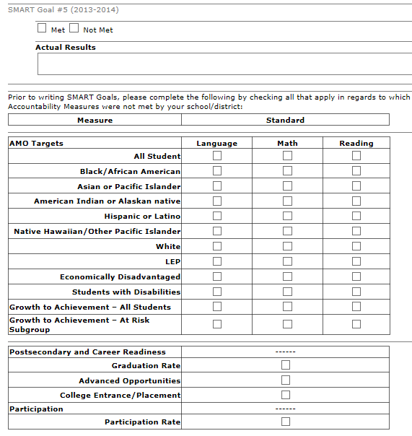
HOME
Complete Forms
Submit Forms/Reports
Docs & Links
(Coaching)
Type in your answers
SAMPLE -
Check boxes, choices, or dropdowns where appropriate
Always be sure to SAVE often
Notes:
Forms are pretty easy to work with.
Click on the link….
Type in your answers
Check the boxes or choices or dropdowns where appropriate
Some forms are only one page long, others may be multiple pages. As you work thru your form, please be sure to save often to avoid losing any information.

Slide 56
HOME
Complete Forms
Submit Forms/Reports
Docs & Links
(Coaching)
Reviewable Forms
Reviewable form icon
Notes:
A few other notes as you work thru your forms…
Some forms can be completed and submitted. Other forms are called ‘reviewable forms’ and they will have an icon next to them on page to identify them as reviewable.
These forms must be sent for reviewer feedback prior to submission. At the bottom of the form, click on the ‘SAVE AND SEND FOR REVIEW” button when you have completed this form.

Slide 57
HOME
Complete Forms
Submit Forms/Reports
Docs & Links
(Coaching)
Form Status
Green Arrow –
Make minor revisions (if any)
Submit final copy to state
Blue Arrow –
Make revisions
Submit final copy to state
Red Arrow –
Make revisions as suggested
Submit for second review
Notes:
An arrow will appear on Tab 2 letting you know the status. When the form is sent back from the reviewer, leadership and the process manager will be notified by email. Simply, go back to the form, make suggested updates and submit a final copy using the buttons on Tab 3 – Submit forms and reports.
Here is a summary of the arrow meanings:
Green – little or no revisions needed
Blue – revisions needed, then okay to submit
Red – essentially, a red arrow denotes that multiple suggested updates need to be made and once completed, a second review is required before submission.
This will be apparent on the email notification and by the red alert arrow next to the form name. Pending final approval, the user will make additional updates as needed and then submit a final copy to the state.

Slide 58
HOME
Complete Forms
Submit Forms/Reports
Docs & Links
(Coaching)
Don’t forget:
Some forms may need to be uploaded instead of having a submit button
Forms are always open – so update if you need to!
Notes:
And 2….be sure to check the description information next to each form name. As stated before, some forms may need to be completed, printed, signed, and uploaded using the Document Upload feature. That information should be outlined in your form description.
And….don’t forget….if you need to update a form at any time during the year, go ahead! Even if you have previously submitted the form, if your team feels that some information is out of date, re-enter it now! You will just be ahead of the game at the next submission period!

Slide 59
TAB 3
HOME
Complete Forms
Submit Forms/Reports
Docs & Links
(Coaching)
Name of Report
Due Date(s)
Submit button
Columns to house pdf link to submission reports
Notes:
Tab 3, submit Forms & Reports
As the leadership team works to implement the indicators of effective practice, they will add assessments, plans, tasks, and monitoring information into the tool. At certain time periods during the year, the state may ask or require schools to submit their indicator plans. Essentially, this is just a snapshot of where you are at that period in time. As long as the team meets on a regular basis, continues to move forward with their work, and a process manager updates the system after each meeting, you will simply need to go to Tab 3 and click the blue submit button.
The Submit Forms & Reports tab includes:
The name of the report or supplemental form
One or more due dates
Blue submit buttons … (Heres a helpful hint….if a form is reviewable, the blue submit button will not be visible until the form has been returned by the reviewer.)
And 2 columns….one to house the current school year submissions and one to display last years’ submissions.
If you make a mistake on the submission tab, don’t worry! Just contact your contact your state administrator for assistance.

Slide 60
TAB 4
HOME
Complete Forms
Submit Forms/Reports
Docs & Links
(Coaching)
Websites
Templates
Timelines
User Handbooks
Etc.
Notes:
Docs and Links is a place to hold State-specific resources to help guide school and district teams as they work through the process. These resources may include websites, templates, timelines, handbooks, as well as additional information your team may use to enhance their work as they move thru the continuous improvement cycle.

Slide 61
TAB 5
HOME
Complete Forms
Submit Forms/Reports
Docs & Links
(Coaching)
Notes:
As briefly stated before, Coaches and Districts will have an additional tab when they log in. This login gives easy access to view a school or districts dashboard, monitor progress and recent activity, and provide coaching feedback to support a leadership team’s work.
In this example, you can see a list of schools, an icon denoting any school who recently responded to a coaching comment, and a button to see a School Activity report.
Let’s see what happens if we click the School Activity button.

Slide 62
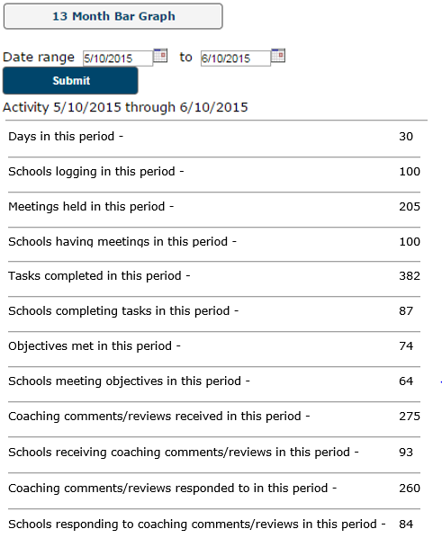
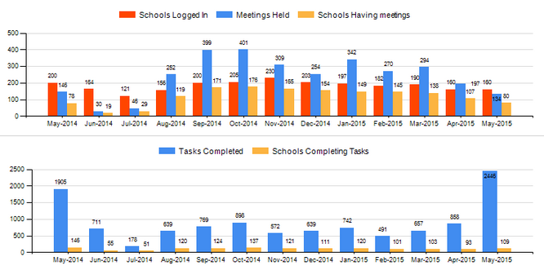
TAB 5
(Coaching)
Notes:
The School or District Activity page will display the most recent activity for all of your assigned schools and districts. Activity includes progress on the implementation of the effective practice indicators, meetings, & coaching support.
This report will default to the last month, but you may run your own date ranges if you wish.
Additionally, to track trends of overall progress or lack there of, check out the 13 Month Bar Graph report. The same activity data will track all the way back to last year. This is a great way to see what is and isn’t working across the board.

Slide 63
TAB 5
HOME
Complete Forms
Submit Forms/Reports
Docs & Links
(Coaching)
Notes:
The Activity Report gives you a big picture view of progress for all schools or districts to which you may be assigned. If you want to look at a specific site, just click ‘Show Dashboard’ and the page will change to a view-only version of the chosen site’s dashboard.

Slide 64
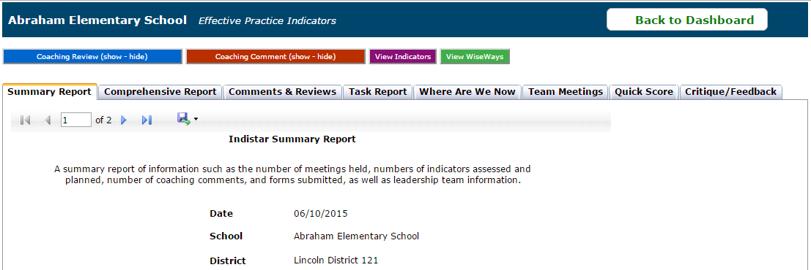
TAB 5
(Coaching)
Notes:
At that point, you may go directly into a school or district’s main menu page by using the indicator link…
Or…you could choose to look at the Coaching page by clicking the Coaching Review button on the right.
Here, you will see several reports to help you review the recent activities and progress made by the leadership team. A district or coach can provide feedback by clicking on the Coaching Comment, or Coaching Review buttons at the top to open a message center.

Slide 65
TAB 5
Coaching Review Coaching Comment
(Coaching)
*Coaching Critique
Notes:
Type in your message, double-check for accuracy, AND send.
When a comment or review is sent, the leadership and process managers will both be notified that a new piece of feedback has been received.
What’s the difference between a comment and a review? A Comment may be about a specific indicator or step, while a review may be more general in nature. That’s it!
Oh, And did you know…..that Some states have additional forms for coaches to complete once or more throughout the year. These are called Coaching Critiques and they are meant to be larger reviews of the school or districts progress with a series of set questions and text boxes. Once submitted, the critiques are available to individual schools, districts, and the state.

Slide 66
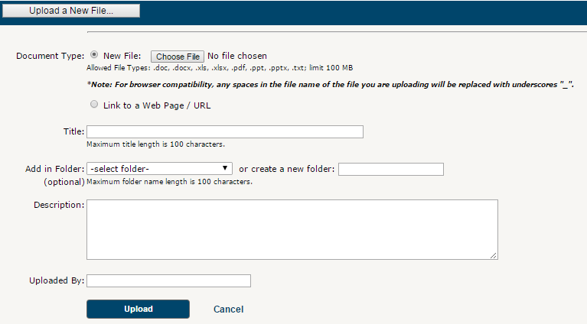
The Dashboard
DOCUMENT UPLOAD – add file
Choose File or add URL link
Add Title
Add in folder (existing or new)
Add Description
Add ‘uploaded by’ info
Click UPLOAD to save
Notes:
Don’t forget you have document upload. Whether you are needing to upload evidence of implementation or sustainability such as class schedules, school calendars, or surveys….
Or you are needing to get that Assurance document uploaded to the state…
It is pretty simple. Just click on the Document Upload icon from your dashboard… and click ‘Upload new file’. You will just browse out to find the file….name it….drop it in an existing folder or create a new one….and SAVE. It is that easy.
If you ever need to remove an old file, just click o the file name and hit delete. And it’s gone!

Slide 67
The Dashboard
DOCUMENT UPLOAD – delete file
Choose folder with file
Click on file name (link)
Choose ‘Delete Record’ at bottom
Click OK to save changes
Notes:
Don’t forget you have document upload. Whether you are needing to upload evidence of implementation or sustainability such as class schedules, school calendars, or surveys….
Or you are needing to get that Assurance document uploaded to the state…
It is pretty simple. Just click on the Document Upload icon from your dashboard… and click ‘Upload new file’. You will just browse out to find the file….name it….drop it in an existing folder or create a new one….and SAVE. It is that easy.
If you ever need to remove an old file, just click o the file name and hit delete. And it’s gone!

Slide 68
The Dashboard
BULLETIN BOARD - VIEW
BULLETIN BOARD
*
Notes:
And last but not least, let’s go back to the Bulletin Board
You should make sure to check here periodically for new messages. If a new message has been added since your last visit, an alert wil appear on the envelope and will disappear once you have read your message.
To view the bulletin’s, just click the icon
Bulletins will automatically disappear once they reach their expiration date set by the state. It is not necessary for a school or district to delete or save these messages.

Slide 69
The Dashboard
BULLETIN BOARD - SEND
Click on ‘Create New Message’
Enter Details:
Recipient(s)
Start & End Date
Senders name
Message
Be sure to SAVE!
Oh! And to ‘edit’ a message, just ‘Sent Messages’ and Edit!
Notes:
Bulletins may only be created by State Administrators, Coaches, and Districts. IF you are creating a message, simply click on the icon, choose ‘Create a New Message’, and complete the message details..including recipient(s), start and end date, and message body. Click SEND to generate bulletin to your schools or districts.
Need to add to or edit your text….extend out the expiration date? Just find the ‘Sent Messages’ button at the top and click edit next to the bulletin you wish to change.

Slide 70
Now…it’s time to roll up our sleeves… and get to work.
REMEMBER: WE WILL GET BETTER…TOGETHER.
Notes:
We know that learning a new tool can be overwhelming at times, but remember, the real work is in the conversations, the partnerships, and the communications. Don’t let the tool get the best of you! Just take your time, use Help buttons and the user handbook to guide you. You can do it!
And remember: We can get better…together.

