Slide 1

Getting Better in Teams

Slide 2
Learning Together
In this module, we will:
  Look at how highly effective teams operate
  Look at the indicators about teaming
  Look at the indicators that the teams work on
  See how teams magnify the talents of each member

Slide 3
meetings
Think back to the last team meeting you attended.
What was your role in the meeting?
Was there an agenda?
What was the purpose of the meeting?
Was that purpose accomplished when you left?
How do you know?
Notes:
Think back to the last team meeting you were in. It could have been an instructional team meeting, a leadership team meeting, a staff meeting…it doesn’t matter what type of meeting. Are you picturing it?
What was your role in the meeting? Were you the leader? A participant? A warm body?
Was there an agenda?
What was the purpose of the meeting?
Was that purpose accomplished when you left?
How do you know?

Slide 4
Table discussion
At your table or with a partner discuss your role in the last team meeting you attended.
What type of team were you on?
What was your role?
What is the purpose of the team?
Click to restart after activity

Slide 5
The Big picture
School
Deciding
Learning
Connecting
Notes:
In the first module, we discussed the big picture of a school and the functions that are found in every school. As a reminder, those functions include deciding, learning, and connecting. All teams have these three functions built into their work. Later, we’ll look at some indicators that specifically speak to some of these functions of teams. For now, I just wanted to remind you of the bigger picture of the work of a school and the teams within a school.

Slide 6
A closer look
School Teams
Leadership Team
Instructional Teams
School Community Council
Notes:
We can also look at the functions of a school divided up by the teams that are most likely found within any school. Your school may call them something different, but the work of those teams will be quite similar to these: the Leadership Team, Instructional Teams, and a School Community Council. While each of these teams have very specific roles within the school, there are some commonalities in the teaming process that are what we would call just good team practices. We’ll take a look at these good team practices first, and then come back to the specifics of each type of team.

Slide 7
The Teaming process
A team structure is officially incorporated into the school improvement plan and school governance policy.
All teams have written statements of purpose and by-laws for their operation.
All teams work with work plans for the year and specific work products to produce.
All teams prepare agendas for their meetings.
All teams maintain official minutes of their meetings.
Notes:
These indicators of effective teaming practices are quick and to the point. Either a team does these things, or it does not. But the first work of a team is to make sure these processes are in place so they can operate efficiently and keep records of what they have discussed and planned to do.
A team structure is officially incorporated into the school improvement plan and school governance policy. This may sound like a small thing, and schools may skip this indicators when working on the effective practice of teaming, however, if team structures are not intentionally written into school policy, then with a new administrator, everything can change. To insure that a team structure is built into how a school does business, it is important for the structure to be written into their policy.
All teams have written statements of purpose and by-laws for operation. Each team decides their own standards of behavior while a school may stipulate the purpose of a team and what it expects the team to accomplish. Without these simple statements, teams can flounder in deciding why they exist or what they are to accomplish.
All teams work with work plans for the year and specific work products to produce. Teams needs to know what they need to get done and when it needs to get done. We have all been on teams where a lot of talk resulted in very little action.
All teams prepare agendas for their meetings and keep minutes. These are simple procedures that all effective teams practice. Send the agenda out in advance so everyone knows what is happening and what will be discussed. Team members come to the meeting prepared for the business at hand. Minutes are taken at the meeting and kept in a place, such as Indistar, where everyone has access and a permanent record is kept of what took place.
These are all very simple procedures that keep all teams functioning in a manner that is productive and efficient.

Slide 8
Activity
At your table, have each participant answer these four questions:
Where is your hometown?
How many children are in your family?
What was one childhood hobby you had?
What was your first job?
Click to restart after activity
Notes:
We will do this activity at your table. However, this is also an activity that you can do with your team. It doesn’t matter if you’ve been a team for a long time, or if it is a team you’ve just formed. This quick exercise will allow you to begin to see each other as human beings with lives outside of the school instead of just seeing each other in the context of your position at the school. Don’t worry—no one is going to have to hold hands or fall into each other’s arms. You don’t have to use these questions, but they are personal without being TOO personal.

Slide 9
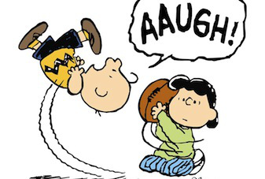
Culture of Candor
Notes:
In order for the Leadership Team, or any team, to operate, team members must feel they can trust the other members of the team. Even the small exercise we just did, begins to build that trust. How can you trust someone that you know nothing about in a small personal way. Group members must work to build trust. Someone (preferably all) in a group must initiate the process by making himself or herself vulnerable through either constructive trusting behavior or helpful feedback.
Great teams do not hold back with one another. They can admit mistakes or weaknesses without fear of reprisal.

Slide 10
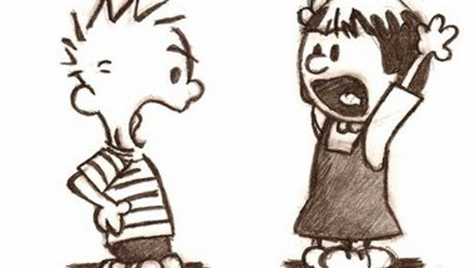
Don’t be afraid of conflict
Notes:
Effective teams have debates. Many people are uncomfortable with arguments, but with a few ground rules, arguments are productive and need to take place within the team. Members of the team should come prepared to argue for their point of view, but also be prepared to reach a conclusion by the end of the meeting. By the time the meeting is over, the course of action is decided on and everyone moves forward with what was determined by the team.

Slide 11

Rabbit holes
Notes:
In your discussion, debate, or argument, don’t get sidetracked by rabbit holes. Rabbit holes are those discussions that look on the surface to be about the topic, but very quickly go off on a side trail. Also, discussions that are between two people and that do not involve the rest of the team need to be scheduled for another time and place other than the team meeting. Recognize when you’ve started down a rabbit hole and table the discussion for later.

Slide 12

commitment
Notes:
After the debating and arguing, a decision is made. Everyone commits to the decision. Even if it wasn’t your idea. Even if it wasn’t what you wanted. At the end of the discussion, everyone commits to the decision and their role in making sure it is carried out. No exceptions. No half-hearted agreements. The time for making alternative points is over, the team moves forward as a unified front. Personal preferences are put aside for the good of the team and to achieve the goal.

Slide 13
Attention to results
As a team, how often do you:
Look at the goal?
Shift resources to make sure you can meet the goal?
Review the goal in detail and drill down to why it is or isn’t being met?
No matter what your role is in the school or on the team, everyone is responsible for meeting the goal.
Notes:
As a team, if you only pay attention to the end goal, you won’t know how you are doing until it is too late to make changes in the course of action. Teams need to be able to clearly define their goal (effective practice), determine how they are going to get there (indicators), and plan actionable steps (tasks) to do every day.

Slide 14

Review: Rules for the road to teaming
Notes:
We’re going to quickly go over what we’ve learned about the teaming process—your “rules of the road” before we drive on to what specific teams do.

Slide 15
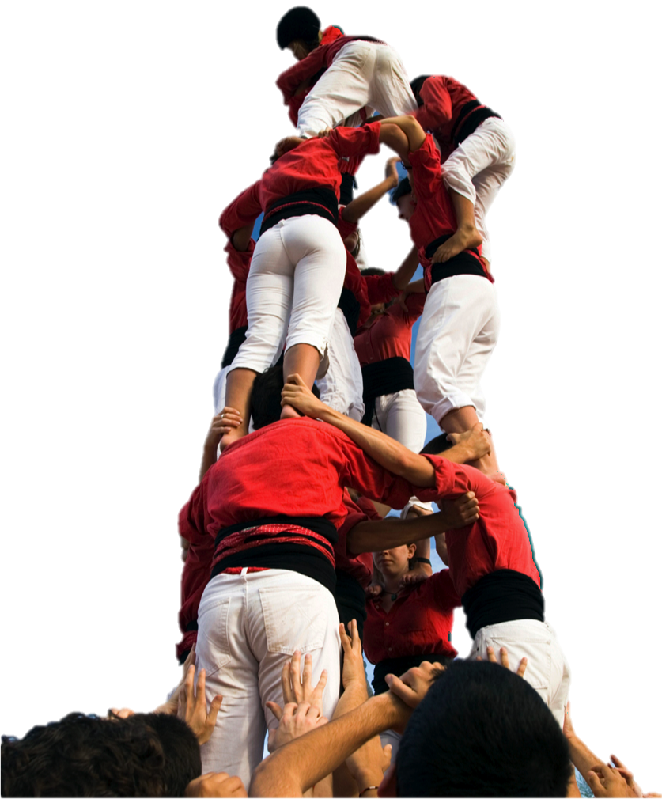
Teams trust one another
Notes:
Trusting teams:
Admit weaknesses and mistakes
Ask for help
Accept questions and input
Take risks in offering feedback
Appreciate and tap into one another’s skills and experience
Focus energy on issues, not politics

Slide 16

Teams Have healthy conflict
Notes:
Good teams
Have lively meetings
Get ideas from all the team members
Solve problems quickly
Put critical topics on the table for discussion

Slide 17
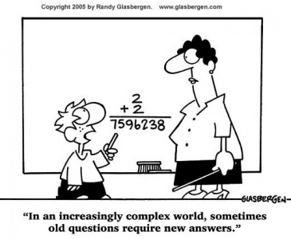
Teams Commit
Notes:
A good team
Makes sure priorities and direction are clear
Gets buy in from all team members
Learns from mistakes
Moves forward without hesitation
Changes direction when needed

Slide 18

Teams members are accountable
Notes:
A good team
Ensures poor performers feels pressure to improve
Identifies problems by questioning one another’s approach
Establishes respect among team members by holding everyone to the same high standards

Slide 19

Teams focus on results
Notes:
A good team
Retains achievement oriented members
Enjoys success and suffers failure acutely.
Avoids distractions
Puts the good of the team above the good of the individual

Slide 20

And Now…
A little story about teams…

Slide 21

Geese Fly
Notes:
Have you ever heard the honking overhead in the fall? Have you ever wondered why geese fly
in a “V” formation? Here are some answers, and some excerpts from Can You Teach Buffalo to
Fly Like Geese? by Bob Ash. Geese fly in a “V” and in a flock for a reason.
As each bird flaps its wings, it makes an
updraft for the bird right behind it. Flying in the “V” formation adds a 50 to
70% greater flying range to the flock as a whole, compared to what one goose could do flying on
its own. The synergistic effect lets all the geese help each other. The flock flies as far and as
fast as the group can, and the group can fly farther and faster than any one goose in the flock.

Slide 22
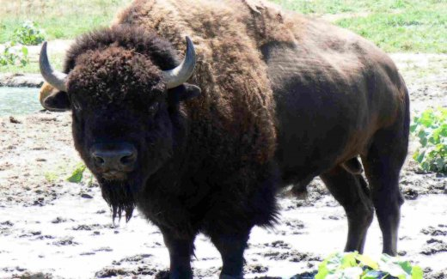
Buffalo don’t
Notes:
The lead buffalo guides the buffalo herd. They are allowed to wander off alone from time to
time. The lead buffalo sets the pace of the herd, either fast or slow, depending upon the leader. If
the leader is tired, the pace slows. If the lead buffalo stops, the herd stops.

Slide 23
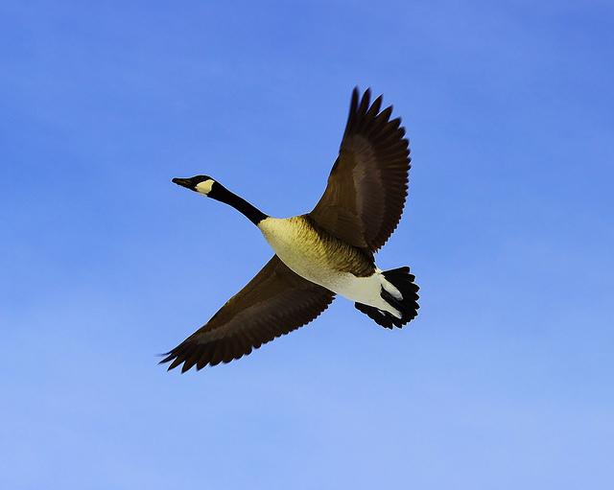
leading
Synergy is when the whole is greater than the sum of its parts.
Notes:
When the leader of the geese, the point goose, gets tired, it drops back, and another takes its
place. Sometimes the leader cannot do it all. Sometimes the leader needs help. Sometimes a
follower needs to be the leader. Stephen Covey writes, “Synergy is when the whole is greater than the sum of its parts.
The relationship, which the parts have with each other, is a part in and of itself. It is not only a
part, but the most catalytic, the most empowering, the most unifying, and the most exciting part.”
Geese have it; effective teams have it. Buffalo don’t.

Slide 24
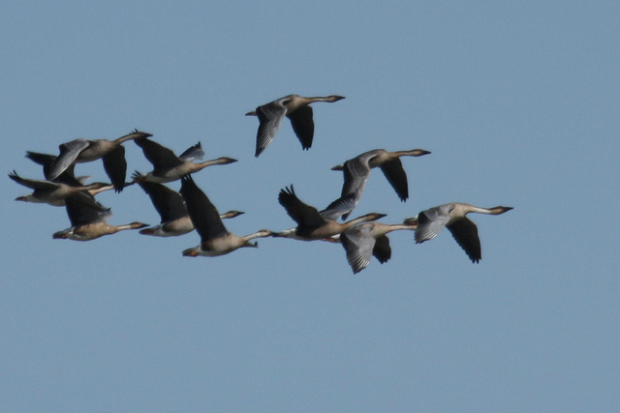

Gaggles and Teams
Notes:
We usually hear the geese honking before we look up and see them. What is all the noise for?
Geese honk for encouragement. Those flying behind others encourage those ahead to keep up
their speed. Every one pushes every other one to reach its full potential. If the lead buffalo does
not encourage, neither does any other buffalo. Effective teams often sound like a
gaggle of geese.

Slide 25
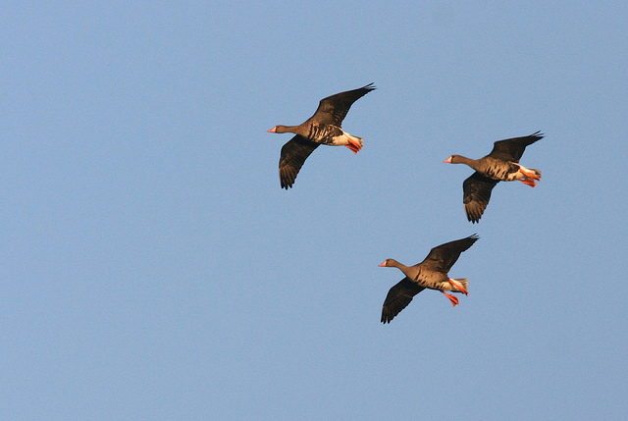
Notes:
If a goose falls or is hurt, two others will stay with it. They protect the fallen one and stay with it
either until it can fly and then they fly to catch up with the others.
However, if the lead buffalo leaves an injured herd member, so does the rest of the herd. Good
team members support each other.
Geese finish the flight. Buffalo go as far as the lead buffalo takes them. Effective teams finish the task. Too bad buffalo don’t fly.

Slide 26
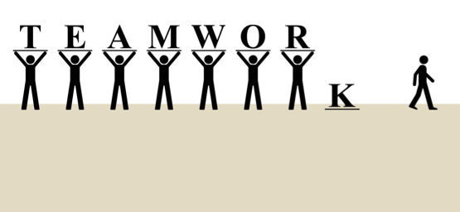
Team building
Notes:
Team-building is an effort in which a team studies its own process of working together and acts
to create a climate that encourages and values the contributions of team members. Their energies
are directed toward problem-solving, task-effectiveness, and maximizing the use of all members’
resources to achieve the team’s purpose. Sound team-building recognizes that it is not possible
to fully separate one’s performance from those of others.

Slide 27
Activity
Take a short quiz.
Think of a team that you are on or that you lead.
Answer the following questions based on that team.
All answers are either true or false.
There are no “wrong” answers.
There is a copy of the quiz in the materials provided on the website.
Everyone ready?
Click to restart when ready

Slide 28
Team building Quiz
There is a high level of interdependence among team members. The team is working on important tasks in which each team member has a commitment and for which teamwork is critical for achieving the desired results.
The team leader has good people-skills, is committed to developing a team approach, and allocates time to team-building activities. Team management is seen as a shared function, and team members are given an opportunity to exercise leadership when their experiences and skills are appropriate to the needs of the team.
Notes:
􀂃 There is a high level of interdependence among team members. The team is working on
important tasks in which each team member has a commitment and for which teamwork is
critical for achieving the desired results.
􀂃 The team leader has good people-skills, is committed to developing a team approach, and
allocates time to team-building activities. Team management is seen as a shared function,
and team members are given an opportunity to exercise leadership when their experiences
and skills are appropriate to the needs of the team.

Slide 29
Each team member is capable and willing to contribute information, skills, and experiences that provide an appropriate mix for achieving the team’s purpose.
The team develops a climate in which people feel relaxed and are able to be direct and open in their communications.
Team members develop a mutual trust for each other and believe that other team members have skills and capabilities to contribute to the team.
Notes:
􀂃Each team member is capable and willing to contribute information, skills, and experiences
that provide an appropriate mix for achieving the team’s purpose.
Each team member is capable and willing to contribute information, skills, and experiences
that provide an appropriate mix for achieving the team’s purpose.
􀂃 The team develops a climate in which people feel relaxed and are able to be direct and open
in their communications.
􀂃 Team members develop a mutual trust for each other and believe that other team members
have skills and capabilities to contribute to the team.

Slide 30
Both the team and individual members are prepared to take risks and are allowed to develop their abilities and skills.
The team is clear about its important goals and establishes performance targets that cause stretching but are achievable.
Team-member roles are defined, and the team develops effective ways to solve problems and communicate.
Notes:
􀂃 Both the team and individual members are prepared to take risks and are allowed to develop
their abilities and skills.
􀂃 The team is clear about its important goals and establishes performance targets that cause
stretching but are achievable.
􀂃 Team-member roles are defined, and the team develops effective ways to solve problems and
communicate.

Slide 31
Team members know how to examine team and individual errors and weaknesses without making personal attacks, which enables the group to learn from its experiences.
Team efforts are devoted to the achievement of results, and team performance is frequently evaluated to see where improvements can be made.
The team has the capacity to create new ideas through group interaction and the influence of outside people. The team pursues good ideas and rewards innovative risk-taking.
Each member of the team knows that he or she can influence the team agenda. There is a feeling of trust and equal influence among team members that facilitates open and honest communication.
Notes:
􀂃 Team members know how to examine team and individual errors and weaknesses without
making personal attacks, which enables the group to learn from its experiences.
􀂃 Team efforts are devoted to the achievement of results, and team performance is frequently evaluated to see where improvements can be made.
􀂃 The team has the capacity to create new ideas through group interaction and the influence of
outside people. The team pursues good ideas and rewards innovative risk-taking.
􀂃 Each member of the team knows that he or she can influence the team agenda. There is a
feeling of trust and equal influence among team members that facilitates open and honest
communication.

Slide 32
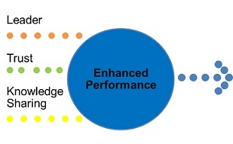
How did you do?
Notes:
Take a look at the questions that you put “False” beside. Those are areas in which your team can do better. I would suggest that you allow each of your teams and all their members to take the quiz to see areas in which they feel they could do better as a team. While you want them to keep moving forward in the work that they do, it is also important to make sure teams in the building are strong, effective teams that can get the work done.

Slide 33
Specifics
School Community Council
Leadership Team
Instructional Teams
Notes:
Those were all great pointers on how to develop a strong team, work together in a culture of candor, and make sure everyone has a voice on the team. The process of teaming. Now, we want to take a closer look at each of the three teams mentioned earlier: the Leadership Team, Instructional Teams, and a School Community Council. Even if your school does not call these teams by those names, schools typically have teams which are similar in function and make-up. We want to take a look at what these teams DO.

Slide 34
The Leadership team
  A Leadership Team consisting of the principal, teachers who lead the Instructional Teams, and other key professional staff meets regularly (twice a month or more for an hour each meeting).
  The Leadership Team shares in decisions of real substance pertaining to the curriculum, instruction, and professional development.
  The school’s Leadership Team regularly looks at school performance data and aggregated classroom observation data and uses that data to make decisions about school improvement and professional development needs.
  The Leadership Team reviews the principal’s summary reports of classroom observations and takes them into account in planning professional development.
  The Leadership Team serves as a conduit of communication to the faculty and staff.
Notes:
A Leadership Team should consist of the principal, representatives from each instructional team, and can also include other staff such as special education personnel or counselors. The team meets twice each month, monitors school-level student learning data and guides the process of continuous school improvement. The Leadership Team maintains a school culture that is friendly, supportive, and focused on children’s learning. Indicators of effective practice keep the Leadership Team focused on their role in the school.

Slide 35
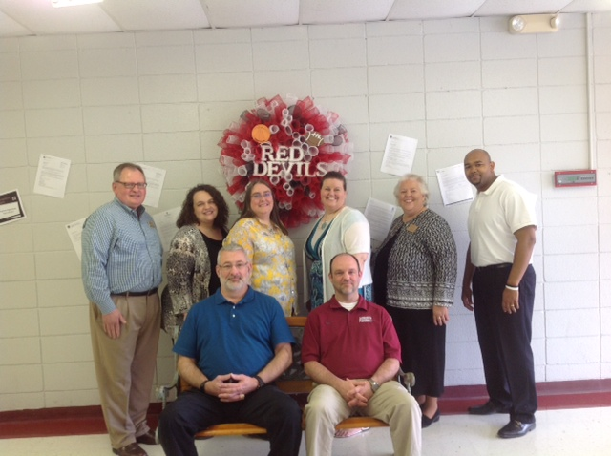
Augusta, Georgia school leadership team
Notes:
Here are some examples of real leaderships teams doing the work described in the indicators. In Augusta, Arkansas, the leadership team says, “We are always sending the work that we do in leadership teams to the teachers. We want them to know which indicators we are focusing on, what we are looking at, and what research says. Our meetings always end with tasks to complete and action items to address, and we share that information immediately with all teachers.” The Augusta team is a conduit of communication to the faculty and staff.

Slide 36
Todd County Elementary School
Notes:
The leadership team at Todd County Elementary on the Rosebud Sioux Tribe reservation in Mission, South Dakota follows
the guidance of Indistar and its research, meeting twice per month for 1½ to 2 hours. Their teams says that “Every other Wednesday we meet
at the same time, same place. Our meeting times are selected before the year begins, roles are established and rotated each month for keeping time and taking minutes. Our agenda for each meeting is established at the end of the previous meeting. There are no surprises, only expectations for hard work.”

Slide 37
Enemy Swim Day School
Notes:
Enemy Swim Day School is located in the upper northeast corner of South Dakota. Their leadership team was very excited to be given access to a tool that they believed would keep them focused and put all the pieces of a school improvement plan in one convenient place. After almost four years of using the system, Enemy Swim is still excited about Indistar because its faculty are seeing its anticipated potential fully realized. This leadership team guides the improvement planning in Indistar; however, all the staff is involved with the work. Information from other teams informs the leadership team on what to include in Indistar, which provides the means for the school to keep all the work focused on their four priorities: academics (with technology), Dakota culture and language, individual potential, and family and community collaboration.

Slide 38
Washburn Elementary School
Notes:
At Washburn Elementary school in Maine, the principal challenged her Leadership Team to dig deeply into the indicators, using Wise Ways to stimulate and challenge their thinking. They identified some indicators that were “Limited Development or Implementation” and sought ways to improve their implementation. The principal engaged her entire staff in this process. Team leaders solicited input and opinions from all teachers in the school and brought back to the Leadership Team a broad array of information that informed their discussions and ultimate decision making.

Slide 39
Table Discussion
Does your school have a Leadership Team?
Does it have the right people on it?
How are the members chosen? How long do they serve on the team?
Do you meet regularly and discuss matters of real significance?
How is the work of the Leadership Team communicated to the rest of the staff? The community?
Click to restart after activity
Notes:
Those were real leadership teams expressing what work they do in their schools. What is the work of your leadership team? Does you school have one? Does it have the right people on the team? Do you discuss matters of real significance?
Take about 10 minutes and discuss these questions at your table.

Slide 40
Instructional Teams
Instructional teams develop standards-aligned units of instruction for each subject and grade level.
Instructional teams develop materials for their standards-aligned learning activities and share the materials among themselves.
Instructional teams use student learning data to assess strengths and weaknesses of the curriculum and instructional strategies.
Instructional teams use student learning data to plan instruction.
Instructional teams use student learning data to identify students in need of instructional support or enhancement.
Instructional teams review the results of unit pre-/post-tests to make decisions about the curriculum and instructional plans and to “red flag” students in need of intervention (both students in need of tutoring or extra help and students needing enhanced learning opportunities because of their early mastery of objective).
Notes:
Instructional Teams (grade-level or subject area) of teachers meet at least twice each month
to develop and refine Unit Plans and examine student-learning data relevant to the scope of the
team. Instructional Teams monitor grade-level or subject-area student learning data, and share ideas and practices. The Instructional Team determines the Units of Instruction for each subject and for each reporting period. They develop unit pre- and post-tests.
There are LOTS of indicators in Indistar that talk about what teams of teachers DO—and for very good reason. What happens in the classroom is important. It is the business of the school. It is the heart and soul. And without the proper preparation and teamwork, classrooms and students suffer. These are just a few of the indicators. Other indicators may focus on what the individual teacher does in his or her classroom, but those should also be discussed candidly in the Instruction team.

Slide 41

Teams Need Time
“A team approach to planning and decision
making allows for distributive leadership. Planning and decision making within the school require teams, time, and access to timely information. That is, decision-making groups must be organized and given time to plan and monitor the parts of the system for which they are responsible.”
Notes:
Instructional Teams need common planning time. Team meeting time can be found and carved out of workshop days, common lunch times, common prep time when elementary students are pulled for special teachers, and common prep time for middle and high school teachers as part of regularly scheduled prep time.
Marzano (2003) suggests that “a team approach to planning and decision making allows for distributive leadership. Planning and decision making within the school require teams, time, and access to timely information. That is, decision-making groups must be organized
and given time to plan and monitor the parts of the system for which they are responsible” (in Redding, 2007, p. 101).
Let’s watch a real team doing just that.

Slide 42

Instructional Team in action

Slide 43
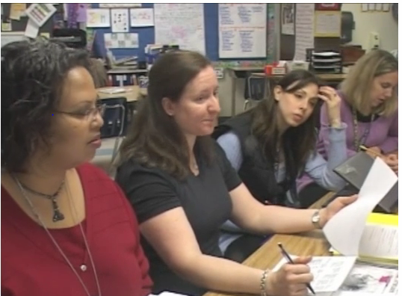
Notes:
Did you notice how these teachers were comfortable expressing where they felt they had not done a good job and how other teachers stepped in to assist them with ideas and materials? Did you notice how every teacher was given a chance to speak and all the others listened? They looked at their students as a whole: students were THEIR students and they were all invested in the improvement of their practices to better serve their students. This is what good instructional teams do.

Slide 44
Table discussion
Do you have Instructional teams in your school? Are they grade-level, grade-level clusters, or subject-area teams?
If you do not have teams, why not?
Does your Instructional teams function like the team in the video?
What is one characteristic of the video team that you saw or heard that you would like to take back to your own Instructional teams?
Click to restart after activity
Notes:
At your table or with a partner, discuss the following questions. We’ll take about 10 minutes and then we’ll share out at least one characteristic of the video team that you saw that you can take back to your own team.

Slide 45
School Community Council
Team
Members
Parent
Principal
Parent
Teachers
Parent
Notes:
A School Community Council consists of the principal, teachers, and parents. There should be a majority of parent members—and they should be parents who are not otherwise employed by the school. The School Community Council meets twice each month to connect families and communities with the school’s learning goals to provide the necessary support for all students.

Slide 46

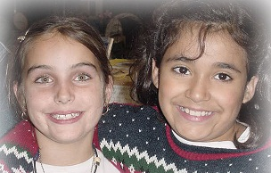
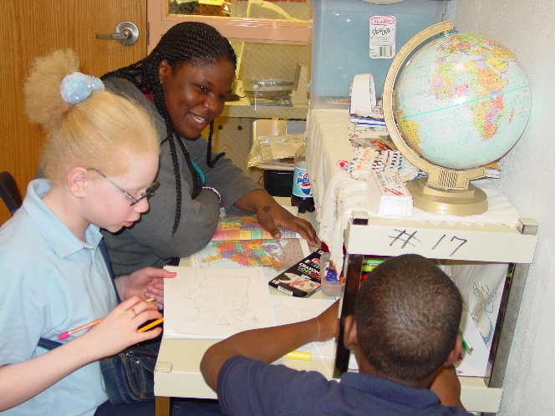
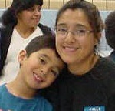

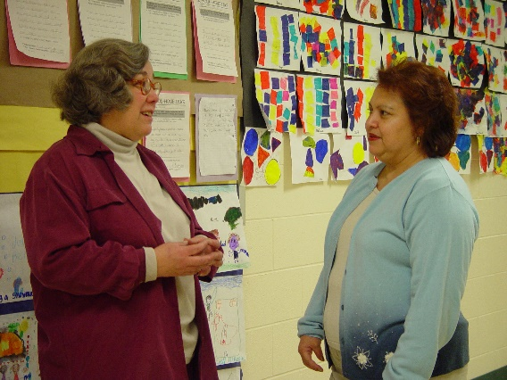
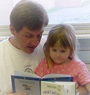
Defining the community of the school
Notes:
A connection between the school and the home is built upon purpose, communication, education, and association. A school community is not the school’s affiliation with external agencies, nor is it a place. A school community is found in the relationships among the people intimately attached to a school—the students, their teachers, the families of the students, the school’s staff, and volunteers. The people know their school community’s purpose, what they value in the education of their children, and everyone’s role in getting the job done.

Slide 47
Working with Indicators
The principal personally engages parents and the community in the improvement process.
Parent representatives advise the Leadership Team on matters related to family-school relations.
The school’s Compact outlines the responsibilities (expectations) of teachers, parents, and students.
The schools Parent Involvement Policy includes a vision statement about the importance of family-school partnership in a school community.
The “ongoing conversation” between teachers and parents is candid, supportive, and flows in both directions.
The school team annually conducts a “walk-through” the school, parking lot, and grounds to suggest ways to make the school a more welcoming place.
Notes:
The following are just a few indicators of an effective school community.

Slide 48

The Value of a School Community Council

Slide 49
Table Discussion
Does your school have an active School Community Council?
Does it have a majority of parents who feel their input is valued and acted on?
Does the team make decisions of real importance?
Are teachers comfortable including parents as full partners in the education of their children?
Click to restart after activity
Notes:
At your table or with a partner, discuss these questions. Let’s take about 10 minutes.

Slide 50

www.schoolcommunitynetwork.org
Notes:
There is a wealth of free resources for schools, teachers, and parents at www.schoolcommunitynetwork.org. I would encourage you to visit the site and see what is available to assist you in working with your parents. You can also connect to the site by putting a link on your school’s web page and let parents and teachers know the site is available with resources for them.

Slide 51
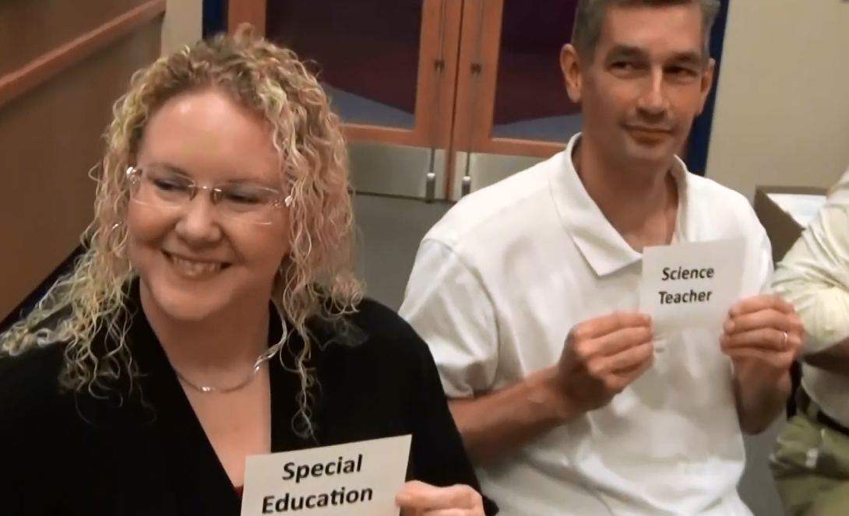
Magnifying Our Talents
“The school administrator cannot be an expert in everything. . . A group of teacher leaders can supply the variety of professional knowledge needed for sustained school improvement.”
Notes:
You can see the valuable role that teams play in the make-up and structure of the school. We’ve looked at the process of teaming: how do you form effective teams. We’ve looked at the specific role different types of teams have in a school: what teams do. But why have teams at all? They seem like a LOT of work. Because teams allow you to magnify the talents of everyone in the building.
Danielson says, “The school administrator cannot be an expert in everything. Individual teachers, of course, have their own particular areas of knowledge,
but a group of teacher leaders can supply the variety of professional knowledge needed for sustained school improvement” (Danielson, 2007).

Slide 52
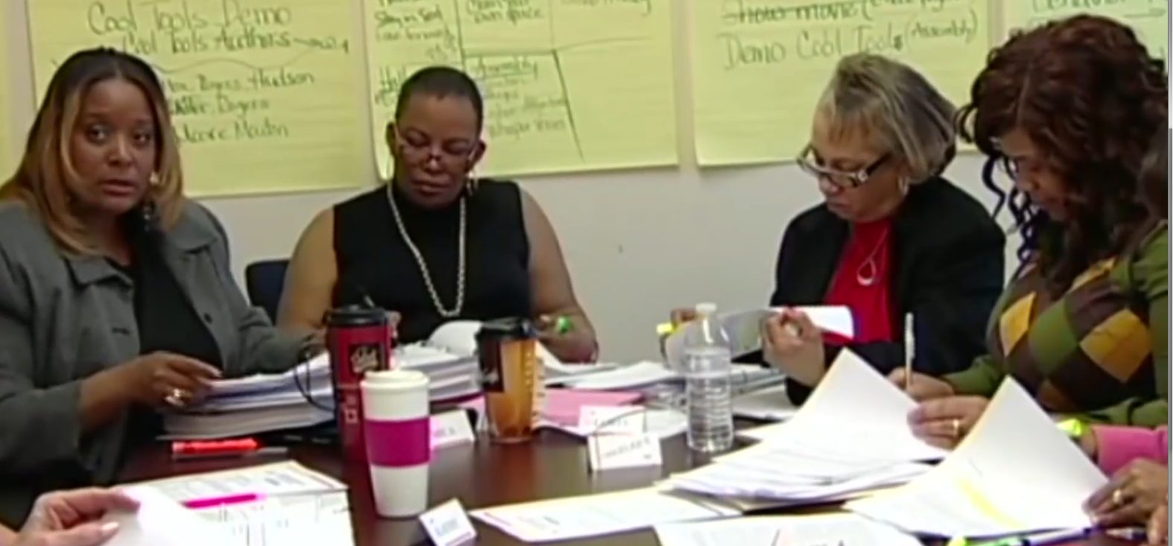
Learning from each other
By inviting expert teachers to assist in improving learning conditions throughout the school, we aren’t removing our best teachers from the classroom. We are extending their reach.”
Notes:
Promoting teacher leadership is not about involving teachers in “managerial and administrative duties” but rather “playing to the strength of their classroom expertise….By inviting expert teachers to assist in improving learning conditions throughout the school, we aren’t removing our
best teachers from the classroom. We are extending their reach” (Scherer, 2007). The benefits for cultivating teacher leaders are well worth the effort. Teacher leaders can “mentor new faculty members, contribute deep knowledge of their school and community to the decision-making
process, provide example of outstanding teaching to colleagues, and support school improvement efforts (Barth, 2001; Lieberman & Miller, 2004)” (Lattimer, 2007).

Slide 53
Indicators of effective practice
The principal develops the leadership capacity of others in the school.
Professional development for teachers includes observations by peers related to indicators of effective teaching and classroom management.
The principal plans opportunities for teachers to share their strengths with other teachers.
Notes:
The opportunities for teacher leadership or sharing do not happen of their own accord. The
principal needs to plan for this to happen or create the atmosphere in which this can take place.

Slide 54
Example from cedarville
Notes:
In Cedarville, Arkansas, the school was working on tasks related to curricular alignment, specifically the development of standards aligned units of instruction for each subject and grade level. The practice of developing essential and guiding questions came up in the Wise Ways research. Through team discussion, it was discovered that some teachers did not know what essential and guiding questions were or how they contributed to well-planned units and lessons. The team added a task: train teachers on the purpose and practice of developing essential questions and guiding questions.
The leadership team identified teacher experts within the school who were particularly skilled in understanding and developing these questions and assigned them the task of training other teachers. Now adept at posing those essential and guiding questions, the faculty relies on them as keys to focusing their instructional planning.

Slide 55
A final look at teams
Team members take a positive approach in determining the way they are going to work together and what they want to happen.
Team members have a well-defined purpose of what the team will accomplish.
Team members have a positive attitude toward change and are willing to accept change to occur as needed to accomplish desired results.
Team members understand that patience is required, and for some goals, long-term commitment to stay the course to achieve desired results.
A well-functioning team is characterized by team members who verbally and publicly support each other.
Notes:
When team resources are focused and members are all working to accomplish the same purpose, teamwork can be very rewarding and productive. To accomplish this:
Team members take a positive approach in determining the way they are going to work together and what they want to happen.
Team members have a well-defined purpose of what the team will accomplish.
Team members have a positive attitude toward change and are willing to accept change to occur as needed to accomplish desired results.
Team members understand that patience is required, and for some goals, long-term commitment to stay the course to achieve desired results.
A well-functioning team is characterized by team members who verbally and publicly support each other.

Slide 56
What We Learned Together
  We learned how teams function in schools
  We looked at how highly effective teams operate (process of teaming)
  We reviewed specifics on the responsibilities of different types of teams (indicators of effective practice or what teams do)
  We looked at how teams magnify the talents of each member
Notes:
Please take a moment to fill out the What We Learned Together sheet. I hope you’ve learned something that you can implement with your own teams. Thank you!

