Slide 1
Indistar Plan Management
®
Feature added 7-26-2016

Slide 2
Plan Management…what’s the big idea?
Plan Management is where Indistar® users can now view and administer almost every indicator function from one page.
…one page …one interactive page …one big advantage!
Assessments
Plans / Tasks
Target Dates
Next Steps
Progress
Assignments

Slide 3
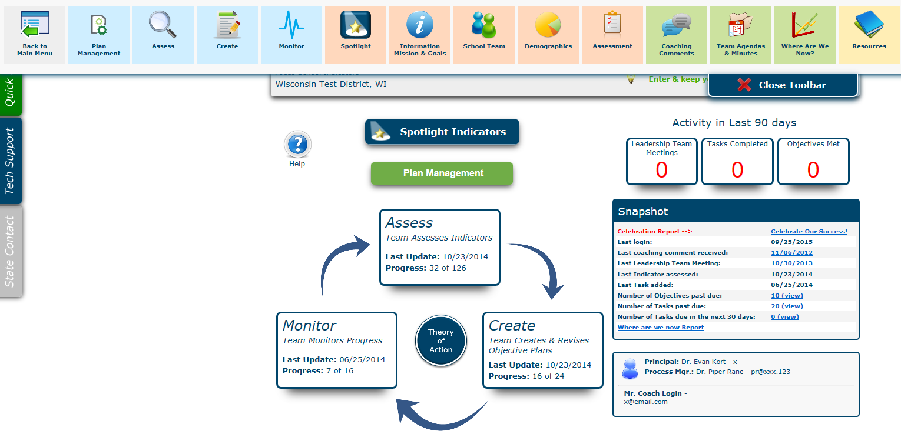
Access to the Plan Management interactive grid can be found on the Main Menu page, as well as in the Navigation Toolbar

Slide 4
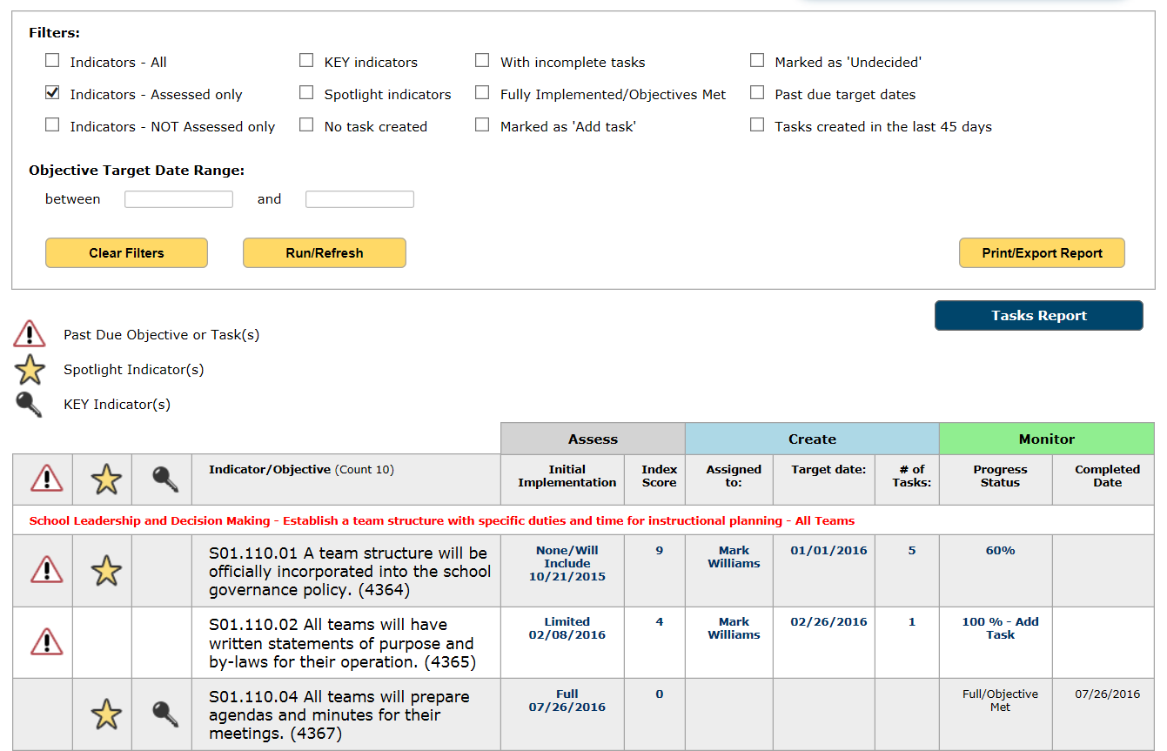
Plan Management includes filters to display :
specific sets of indicators,
newly created tasks,
and what needs updated

Slide 5
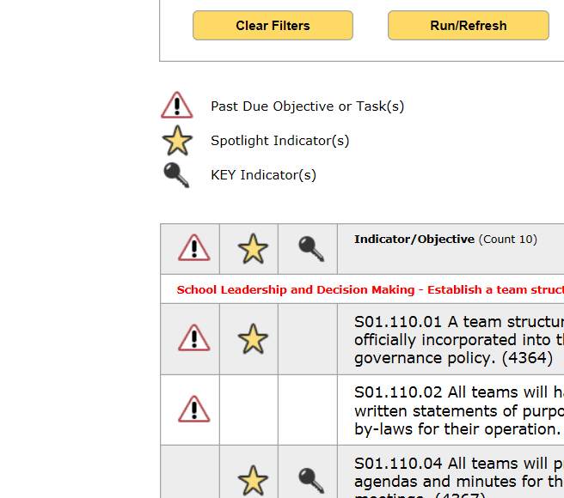
Plan Management includes filters to display:
Past Due Objectives and Tasks
Spotlight Indicators (chosen by each school or district)
KEY Indicators (chosen by SEA)

Slide 6
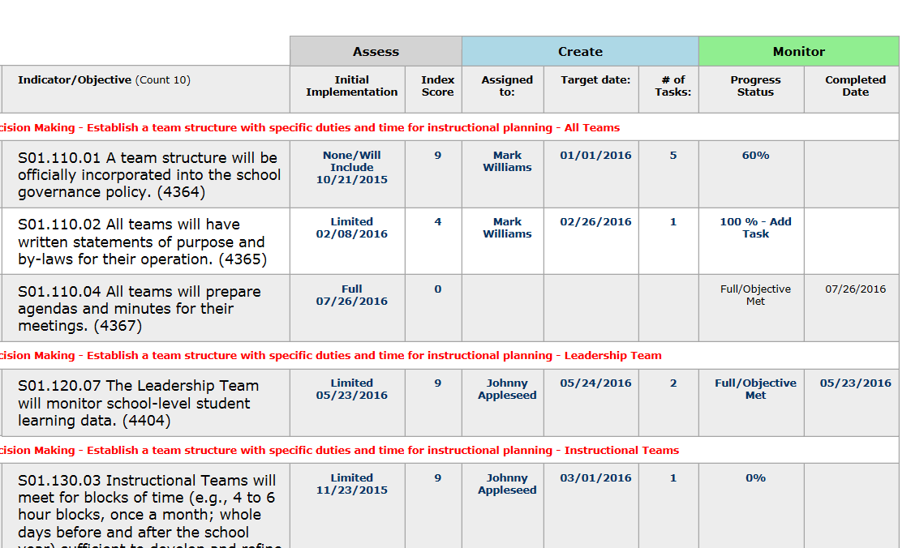
Plan Management includes interactive cells so…
users can easily move to a specific step…for a specific indicator
Under the headings:
Assess, Create, and Monitor… users can “click” any cell and be taken to that step. Here Leadership Teams can add to, edit, or update assignments, target dates, completion dates, and more!
*Some users may have view-only access

Slide 7
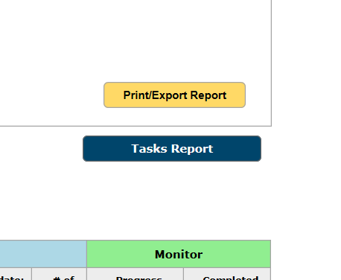
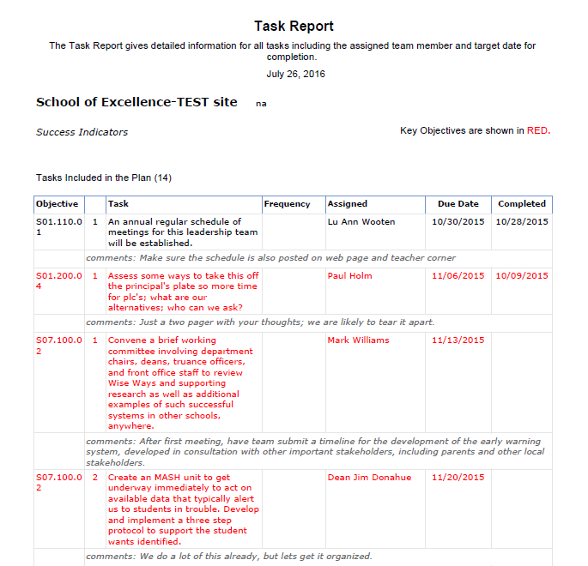
Plan Management includes links to:
Print or Export the Plan Management grid…
and the Tasks Report

